Slide 1
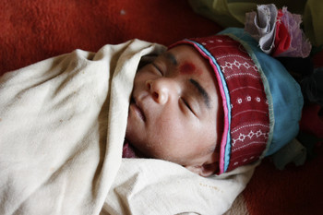
Global Newborn Health
Stephen N Wall, MD SM MSW FAAP
Saving Newborn Lives/Save the Children
DC Children’s Global Health Course
October 12, 2015

Slide 2
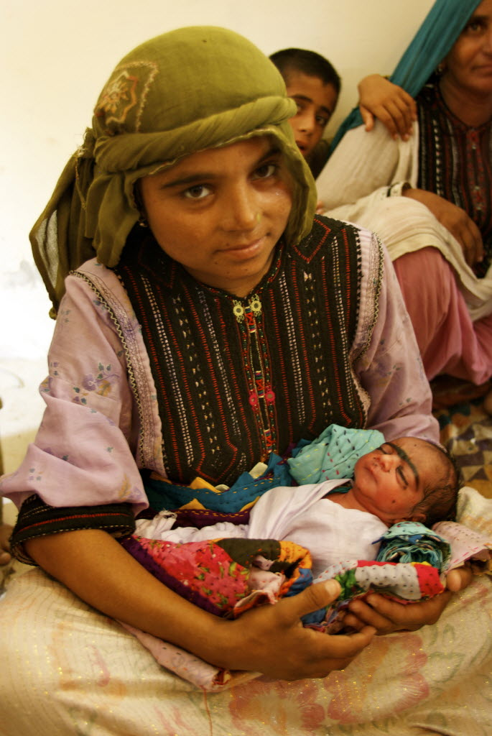
Outline
History of global newborn health movement
Global newborn epidemiology and trends
Interventions – evidence, policy, programs
Global newborn health initiatives
Photo by Ian Woolverton/ Save the Children
Notes:
2

Slide 4
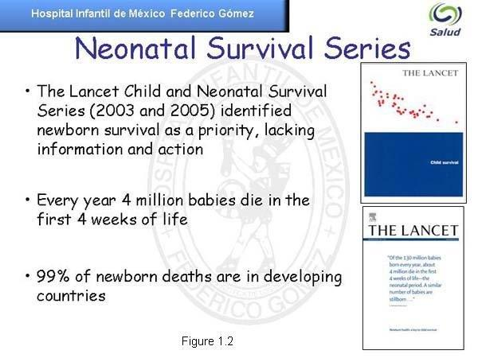

Slide 5
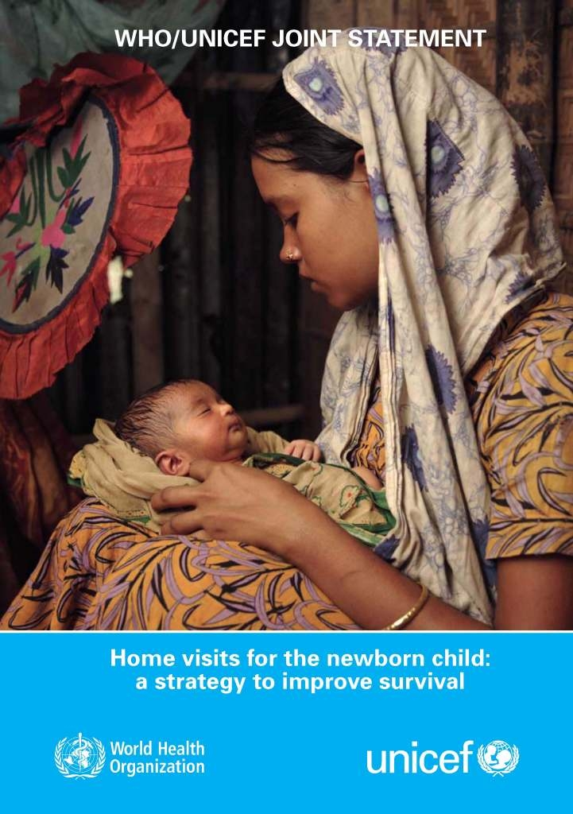
First evidence-based global policy to address newborn deaths
WHO/UNICEF Joint Statement: CHW home visits
  Antenatal counseling/birth preparedness
  Early postnatal
    ENC counseling
    Newborn assessment, referral/management
    Day 1, 3, and 7

Slide 6
Version Jan 2013

Slide 7
Global epidemiology
2.9 million newborns die during their first 4 weeks of life each year
  Over 1 million newborns die on their first day of life
2.6 million stillbirths each year
  Over 1 million intrapartum stillbirths
Over 98% of these deaths are in LIC/MIC

Slide 8
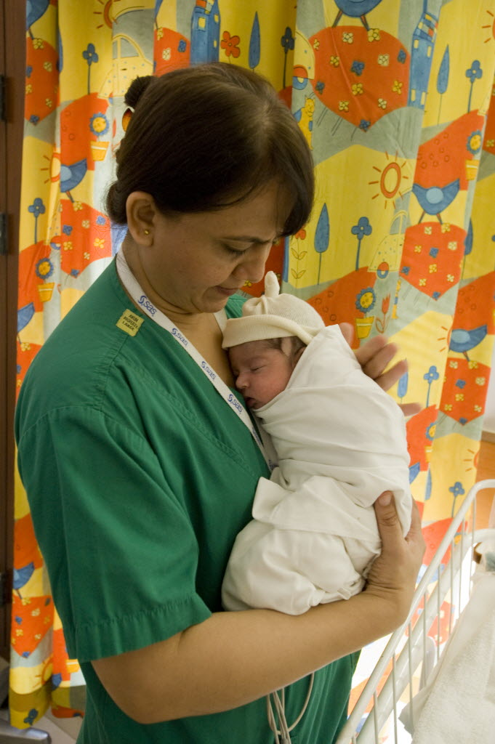

NMR is not reducing as fast as U5M
 | Average rate reduction 1990-2010
Maternal mortality ratio | 4.2%
Children aged 1- 59 months | 3.0%
Neonatal mortality (newborn, first 4 weeks after birth) | 1.8%
Stillbirths (last 3 months of pregnancy) | 1.0% (1995-2009)
Photo by Ayesha Vellani/ Save the Children
Source: Lawn J,E. et al. 2012. Newborn survival: a multi-country analysis of a decade of change. Health Policy and Planning. 27(Suppl. 3): iii6-ii28. Data sources: UNICEF 2011 www.childinfo.org , UN MMR estimates 2012

Slide 9





We have proof that change is possible
Some countries are “bending the curve” for newborns
Over the last decade
77 countries reduced NMR by >25%
including at least 13 low income countries
Bangladesh, Bolivia, Eritrea, Guatemala, Indonesia, Nepal, Madagascar, Malawi, Morocco, Senegal, Rwanda, Tanzania, Vietnam
 | MDG 4 | MDG 5 | Neonatal mortality rate Av annual change 2000-2010
Rwanda |  | Progressing | 6.2%
Bangladesh |  |  | 4.0%
Nepal |  |  | 3.6%
Malawi |  | Progressing | 3.5%
Source: Newborn survival decade of change analysis: Health Policy and Planning. 27(Suppl. 3) papers 3 to 7

Slide 10
We know the causes of newborn deaths
3 main killers to address:
Preterm birth
Birth complications
Neonatal infections
Neonatal
44%
Two-thirds of neonatal deaths
are preventable
Data source: Cause of death - WHO. Global Health Observatory http://www.who.int/gho/child_health/en/index.html); Child deaths - UN Inter-agency Group for Child Mortality Estimates. Levels and Trends in Child Mortality. Report 2013; Stillbirths - Lawn et al The Lancet stillbirth series 2011. 377 (9775) p1448 – 1463
10
Notes:
We know the causes of newborn deaths
Four out of five newborn deaths result from three preventable and treatable conditions:
Complications from preterm birth, infections, complications during childbirth
Ten years ago newborn deaths were invisible in the global estimates but included since 2005 and now visible.

Slide 11
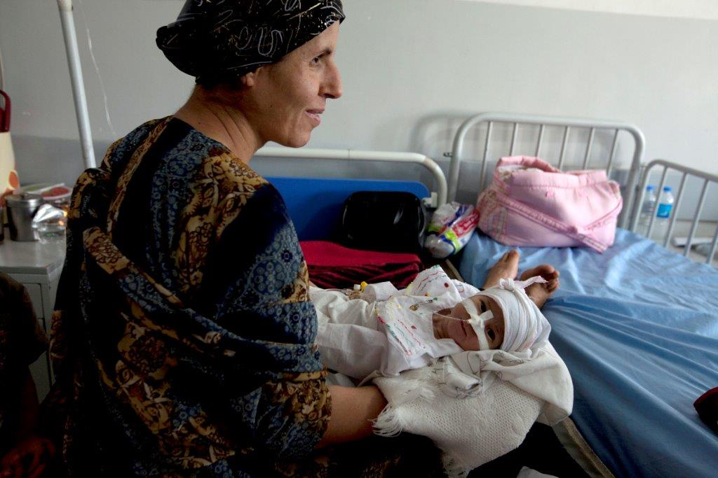
Interventions – evidence, policy, and programs

Slide 12
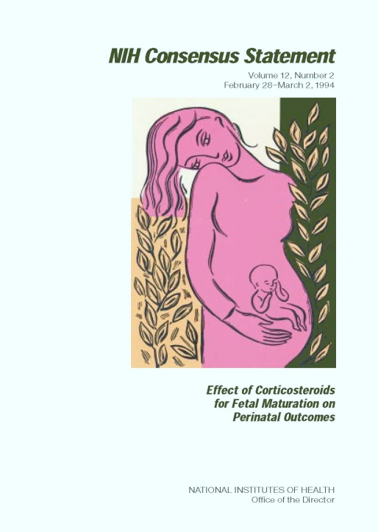
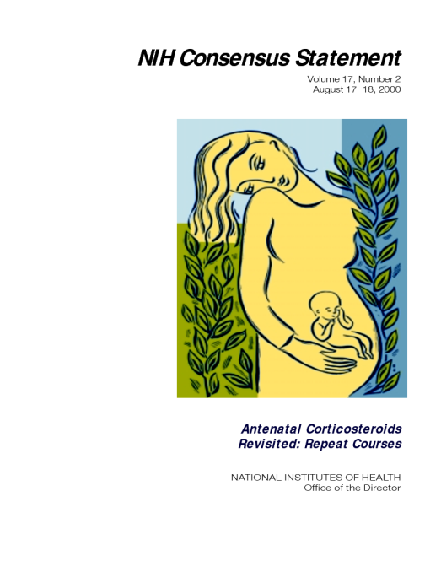


Antenatal corticosteroids
2006 Cochrane review: ACS reduced neonatal mortality by 37% in LBW
Low Use in developing countries: 10% to 50%
Lack of provider awareness, standards/guidelines
On WHO EML for preterm labor since 2013
Lack of community awareness of life-saving care for prematurity

Slide 14
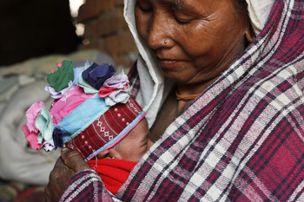
Kangaroo Mother Care
Facility-based Kangaroo Mother Care can reduce deaths by up to 40-50% among <2kg
Low “effective coverage”
Not considered evidence-based (“low tech”)
Large implementation variations - “intermittent” to “continuous” (lack of global consensus)
Poor quality of implementation
Challenges for mother and family
Photo by Sanjana Shrestha/Save the Children
Sources: Conde-Agedula et al. Cochrane Review, 2013 (in press)
Notes:
There is also now a new Cochrane Review from 2011 on facility-based KMC that suggests benefits from KMC

Slide 15
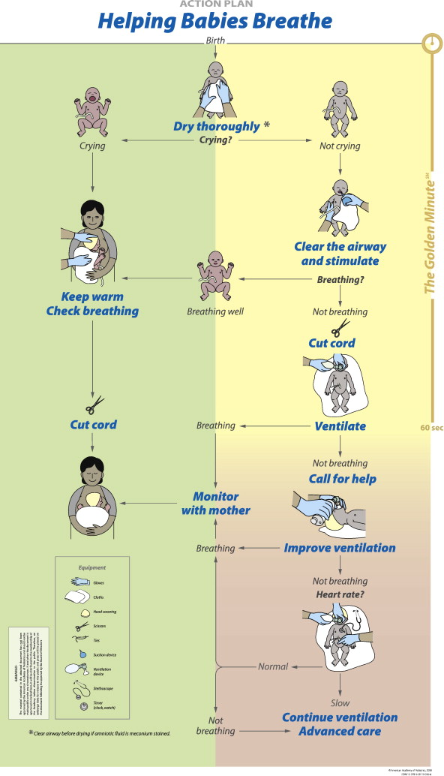

Helping Babies Breath
Recent evidence:
Tanzania – 8 hospitals
47% reduction in early neonatal mortality (<24 hours)
24% reduction in fresh stillbirths Msemo. Pediatrics (2013); 131
Tanzania – large rural hospital
HBB 1-day training, no refreshers
Increased simulation skills (18% to 74%)
No change in clinical practice after 7 months
Ersdal. Resuscitation (2013)

Slide 16
Chlorhexidine umbilical cord cleansing
Source: Imdad et al. BMC Public Health, 2013.
RR 0.77 (0.64, 0.93)
23% reduction in all-cause neonatal deaths
Higher reduction for infection deaths

Slide 17
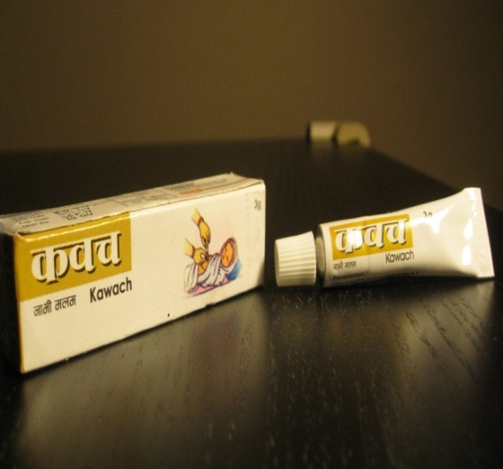
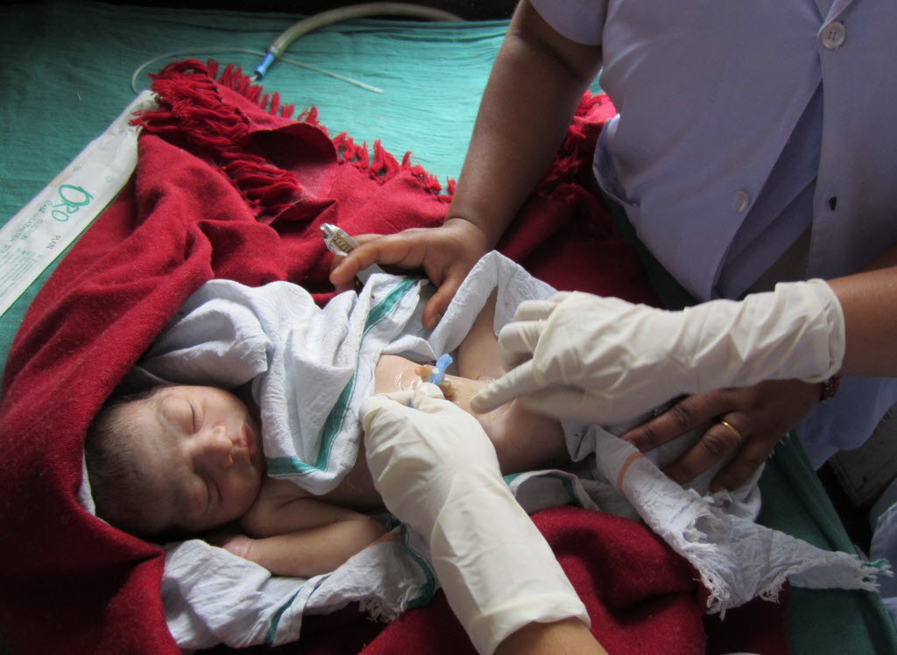
Chlorhexidine – Implementation guidelines
23% reduction in NMR
WHO guidelines
  Settings with NMR > 30
  7 day application
  Home deliveries
Additional considerations
  New evidence of impact in facility-born infants
  1-day vs 7-day use
Photo by Picasa

Slide 18
Management of PSBI
WHO recommends 7-10 days of ampicillin & gentamicin in hospital for 0-59 day old (IMNCI)
  When hospitalization is not possible, outpatient management with 5 days of gent and ampicillin (3 injections daily, 2 visits to health center each day)
    Impossible for families
    Not implemented
  But, only 10-20% of families accept hospitalization
Recent RCTs tested simplified antibiotic regimens in outpatient setting where hospitalization was not possible (Bangladesh, DRC, Kenya, Nigeria, Pakistan)
  7 days gent + amox (7 injections)
  2 days procaine pen + gent, followed by 5 days amox (4 injections)
  2 days gent + amox, followed by 5 days amox (2 injections)
  Compared to reference: 7 days procaine pen + gent (14 injections)

Slide 20
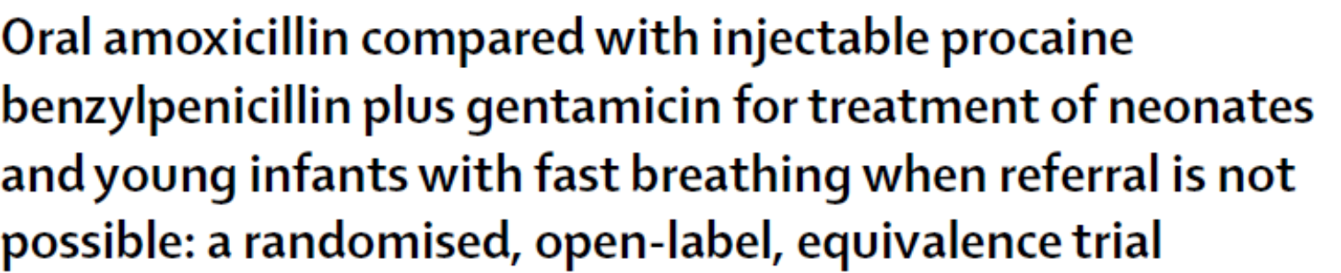
Results: simplified regimens were equivalent to reference treatment in all studies

Slide 21
Implications and Next Steps
New WHO guidelines on managing PSBI when hospitalization is not possible
http://www.who.int/maternal_child_adolescent/en/
http://www.who.int/maternal_child_adolescent/documents/bacterial-infection-infants/en/ j
‘Early adopter’ countries – policy, introduction in pilot areas, lessons learned, scale up
  Bangladesh, DRC, Ethiopia, Nigeria, Pakistan, Uganda
Implementation guidelines
    Dosing regimens for amox and gent for newborn PSBI

Slide 22
Saving Newborn Lives – new efforts
Integration of maternal and newborn health (quality of intrapartum care)
Maternal/newborn health in urban poor settings
Newborn health in humanitarian emergencies

Slide 23
Global Initiatives
UN Commission on Life Saving Commodities
  Injectable antibiotics (SNL/SC convener), antenatal corticosteroids, chlorhexidine, neonatal resuscitation equipment
  8 pathfinder countries, expansion to 20 countries?
Global KMC Acceleration Partnership
  SNL/SC secretariat
  Catalyze learning, effective implementation, scale up at country level

Slide 24
Global Initiatives (cont)
Global Development Alliances
  Helping Babies Breathe (HBB)
  Survive & Thrive:
    Helping Babies Survive
      Essential Care for Every Baby
      Small Baby Package
      HBB

Slide 25
Version Jan 2013

Slide 26
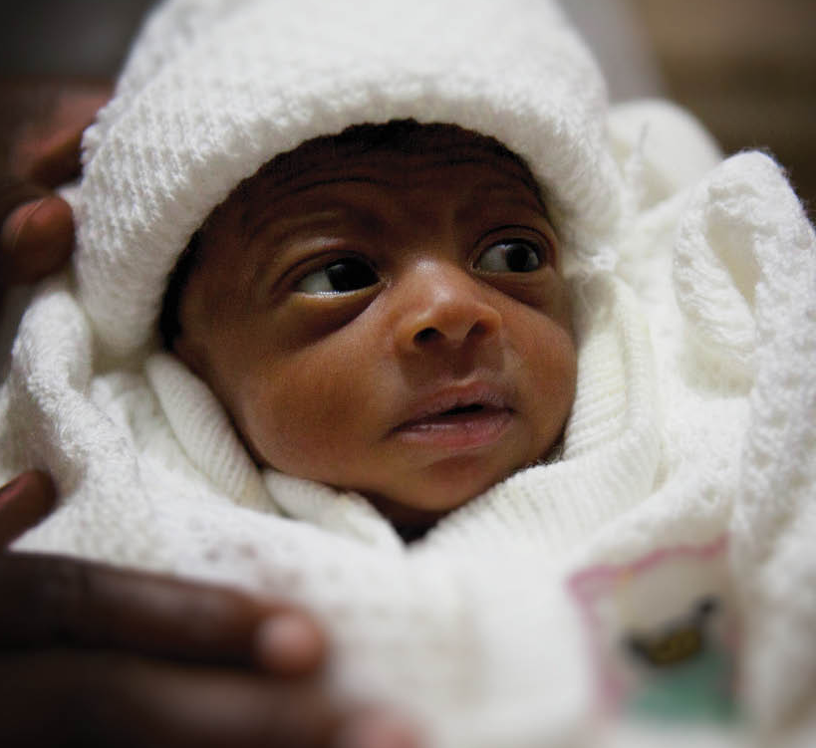
The Every Newborn Action Plan:
building a movement
A global roadmap for change…
A movement for greater action and accountability…
A platform for harmonized action by all partners…
Sets out a clear vision with mortality target, strategic directions, and innovative actions within the continuum of care
Supported by new evidence to be published in The Lancet in May 2014
Photo credit: Save the Children

Slide 27
Every Newborn’s strategic objectives
Strengthen and invest in care during labour, child birth and the first day and week of life
Improve the quality of maternal and newborn care
Reach every woman and every newborn; reduce inequities
Harness the power of parents, families and communities
Count every newborn – measurement, tracking and accountability
Notes:
The Every Newborn Action Plan proposes five strategic objectives.
Strategic objective 1: Strengthen and invest in care during labour, childbirth, and the first day and week of life. More than one-third of stillbirths (1.2 million), 75% of newborn deaths (2 million) and 72% of maternal deaths (206 250) occur within this period. Many deaths and complications can be prevented by ensuring provision of high-quality, essential care for every pregnant woman and every baby around the time of labour, childbirth and in the first 24 hours and week after birth.
Strategic objective 2: Improve the quality of maternal and newborn care. Substantial gaps in the quality of care exist across the continuum of care for women and children’s health. In many settings women and newborns do not receive the care that they need even when they have a contact with the health system whether before, during or after pregnancy. The key to success is introducing high-quality care with high-impact, cost-effective interventions for mother and baby together – in most cases, by the same health providers at the same time.
Strategic objective 3: Reach every woman and every newborn to reduce inequities. Access to high-quality health care that people need without suffering financial hardship when paying for them is a human right. There is increasingly robust evidence of approaches for ending preventable newborn deaths that effectively accelerate the coverage of essential interventions, through innovations that include task sharing, improved access to life-saving commodities, health insurance and financing mechanisms, and use of information technology and social and knowledge networks.
Strategic objective 4: Harness the power of parents, families and communities. Education and information are crucial for empowering parents, families and their communities to demand quality care. Evidence has shown the power of engaged community leaders, women’s groups, and community workers in turning the tide for better health outcomes for newborns. Participatory learning and action in poor rural communities is a core intervention that requires investment and expansion.
Strategic objective 5: Count every newborn - measurement, programme tracking and accountability. Measurement enables managers to improve performance and adapt actions as needed. Assessing outcomes and financial flows with standardized indicators improves accountability. There is an urgent need to improve the metrics globally and nationally, especially for birth outcomes and quality of care. Every newborn needs to be registered and newborn deaths need to be counted. Counting every maternal death and stillbirth is of equal importance.

Slide 28
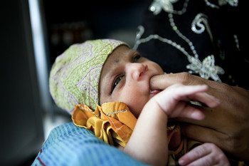
Much to do . . .
- Thanks
Photo by Jason Tanner/Save the Children

Slide 29
New WHO NBH guidelines
WHO PNC guidelines (including CHX) www.who.int/maternal_child_adolescent/documents/postnatal-care-recommendations
WHO Guideline Review Committee Recommendations on Newborn Health (2013)
www.who.int/maternal_child_adolescent/documents/mnca-recommendations
Caring for Sick Newborn & Child in Community (2012) www.who.int/maternal_child_adolescent/documents/caring_for_newborn

