Slide 1

Treatment and Prevention of HIV in Infants and Children:
A Global Approach
Lineo Thahane, MD
Children’s National Medical Center
Global Child Health Elective
October 2015

Slide 2
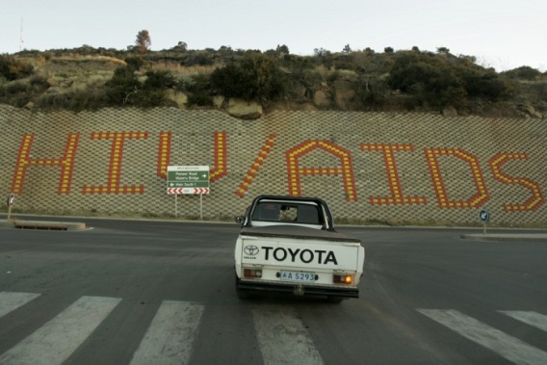
Learning Objectives
Treatment
  Summarize goals and principles of antiretroviral therapy
  Identify some of the challenges of implementing an effective treatment program
Prevention
  Articulate strategies for global elimination of pediatric HIV
  Discuss safer infant feeding in the context
  of HIV

Slide 3
HIV Treatment in Infants and Children

Slide 4
Goals of Antiretroviral Therapy
The primary goal of antiretroviral therapy is to improve the health and prolong the life of the HIV infected child or adult
ARVs reduce the ability of the virus to replicate within the body
  Maintain or reverse immune system damage
  Decrease opportunistic infections and cancers
  Promote normal growth and development
  Improve quality of life
  Prolong survival

Slide 5
Principles of Antiretroviral Rx
What is Highly Active Antiretroviral Therapy (HAART) aka Combination Antiretroviral Therapy (cART)?
  A combination of at least 3 antiretroviral medicines that attack HIV at a minimum of 2 different points in the life cycle
  More likely to achieve an undetectable viral load
  Less likely to develop resistance

Slide 6
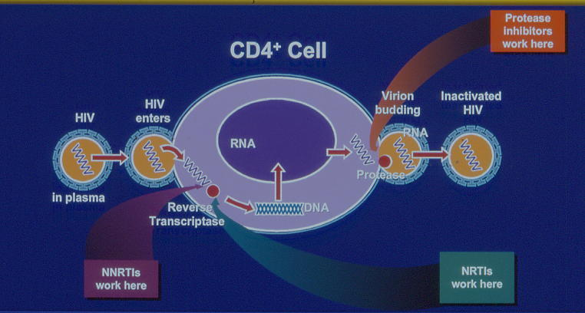
HIV Lifecycle and Antiretroviral Therapy
Entry
Inhibitors
Maraviroc
Enfuvirtide
Raltegravir
Dolutegravir
Elvitigravir
Lopinavir/R
Atazanavir
Darunavir
Ritonavir
Tipranavir
Nelfinavir
Fosamprenavir
Integrase Inhibitors
Zidovudine
Lamivudine
Abacavir
Didanosine
Stavudine
Emtricitabine
Efavirenz
Nevirapine
Etravirine
Tenofovir (NtRTI)

Slide 7
Principles of Antiretroviral Rx
Continuous therapy
  Medicines must be taken indefinitely
  Medication adherence is critical
HAART is never an emergency!
  Treat TB, acute and opportunistic infections first
  Start appropriate prophylaxis
  Adherence counseling
  Two Exceptions:
    PMTCT
    PEP

Slide 8
Criteria for ARV initiation (WHO 2013)
Infants (< 1 year): treat all
Age 1-5 years: treat all, regardless of clinical stage or immunological status
  Prioritize: Age ≤ 2 years, WHO Stage 3 or 4, CD4 count ≤ 750 or 25%
Age ≥ 5 years: treat if CD4 ≤ 500 or WHO Stage 3 or 4
  Prioritize: CD4 ≤ 350
  TREND TOWARDS EARLIER INITIATION

Slide 9
Treatment Update (WHO Sept 2015)
Infants (< 1 year): treat all
Age 1-10 years: treat all, regardless of clinical stage or immunological status
  Prioritize: Age ≤ 2 years, WHO Stage 3 or 4, CD4 count ≤ 750 or 25%, CD4 ≤ 350 if over age 5
Age 10-19 years: treat all, regardless of clinical stage or immunological status
  Prioritize: WHO Stage 3 or 4, CD4 count ≤ 350

Slide 10
Case
Katleho, a 3-year-old, has recently tested positive for HIV-1 via rapid testing. She has herpes zoster, but is otherwise healthy. Her CD4 count is 410.
  Should you start her on ARVs?
  If she is eligible to start ARVs, how should you prepare her family for initiation?
  Which ARVs should you start her on?
  How should you follow her?

Slide 11
Eligibility: Summary
 | 0-12 months | 1-10 years | 10-19 years
CD4 % | All | All (prioritize ≤ 25%) | n/a
CD4 count | All | All (prioritize ≤750 if < 5yrs, ≤ 350 if > 5yrs) | All (prioritize ≤350)
WHO Stage | All | All (prioritize Stage 3, 4) | All (prioritize Stage 3, 4)

Slide 12
Case
Katleho, a 3-year-old, has recently tested positive for HIV-1 via rapid testing. She has herpes zoster, but is otherwise healthy. Her CD4 count is 410.
  Should you start her on ARVs?
  If she is eligible to start ARVs, how should you prepare her family for initiation?
  Which ARVs should you start her on?
  How should you follow her?

Slide 13
Preparation for ARV Therapy
Confirm the diagnosis
  In infants < 18 months, may initiate based on the “Presumptive clinical diagnosis of severe HIV disease” while awaiting confirmatory test results
Identify and fully counsel the primary caregiver
  Take time, allow questions
Confirm availability of support services: family, social, laboratory, inpatient care, etc.
Discuss disclosure to the infected child and to significant others

Slide 14
Preparation for ARV Therapy
Start co-trimoxazole prophylaxis
  Exposed infants: start at 4-6 weeks, until HIV infection excluded
  Infected infants, children and adolescents: provide to all, regardless of CD4 or clinical stage
    Prioritize: children <5 years, stage 3, or 4, CD4 ≤ 350 or universal & continue until adulthood (high prevalence settings)

Slide 15
Preparation for ARV Therapy
Treat acute infections
Treat opportunistic infections
Evaluate / manage TB, malnutrition
Adherence readiness evaluation
  Starting ARVs is almost never an emergency

Slide 16
Adherence, Adherence, Adherence
The best chance of success with ARV therapy is with the first regimen, therefore: choose well, prepare well
  Consider formulations, including taste and simplicity
Adherence Plan and Contract:

Slide 17
Case
Katleho, a 3-year-old, has recently tested positive for HIV-1 via rapid testing. She has herpes zoster, but is otherwise healthy. Her CD4 count is 410.
  Should you start her on ARVs?
  If she is eligible to start ARVs, how should you prepare her family for initiation?
  Which ARVs should you start her on?
  How should you follow her?

Slide 18
First Line ARV Treatment
HIV-1 infected child < 3 years:
Abacavir (ABC) or Zidovudine (AZT) | Lamivudine (3TC) | LPV/r* (preferred) or Nevirapine (NVP) (alternative)
*Reduced risk of discontinuing treatment, virological failure or death; increasing evidence of NNRTI resistance among young children, especially in the context of PMTCT

Slide 19
First Line ARV Treatment
Child 3-10 years, or weight < 35kg:
Abacavir (ABC) | Lamivudine (3TC) | Efavirenz (EFV) (preferred)
Alternatives: Zidovudine (AZT) | Lamivudine (3TC) | EFV/NVP
Tenofovir (TDF) | Lamivudine (3TC)/ Emtricitabine (FTC) | EFV/NVP
* Use Stavudine (d4T) only if there is toxicity to AZT and limited access to ABC or TDF
* Use fixed-dose and once-daily combinations wherever possible

Slide 20
First Line ARV Treatment
Adolescent (10-19 years) ≥ 35kg:
Tenofovir (TDF) | Lamivudine (3TC) / Emtricitabine (FTC) | Efavirenz (EFV) (preferred)
Alternatives: Zidovudine (AZT) | Lamivudine (3TC) | EFV/NVP
Tenofovir (TDF) | Lamivudine (3TC / Emtricitabine (FTC) | NVP

Slide 21
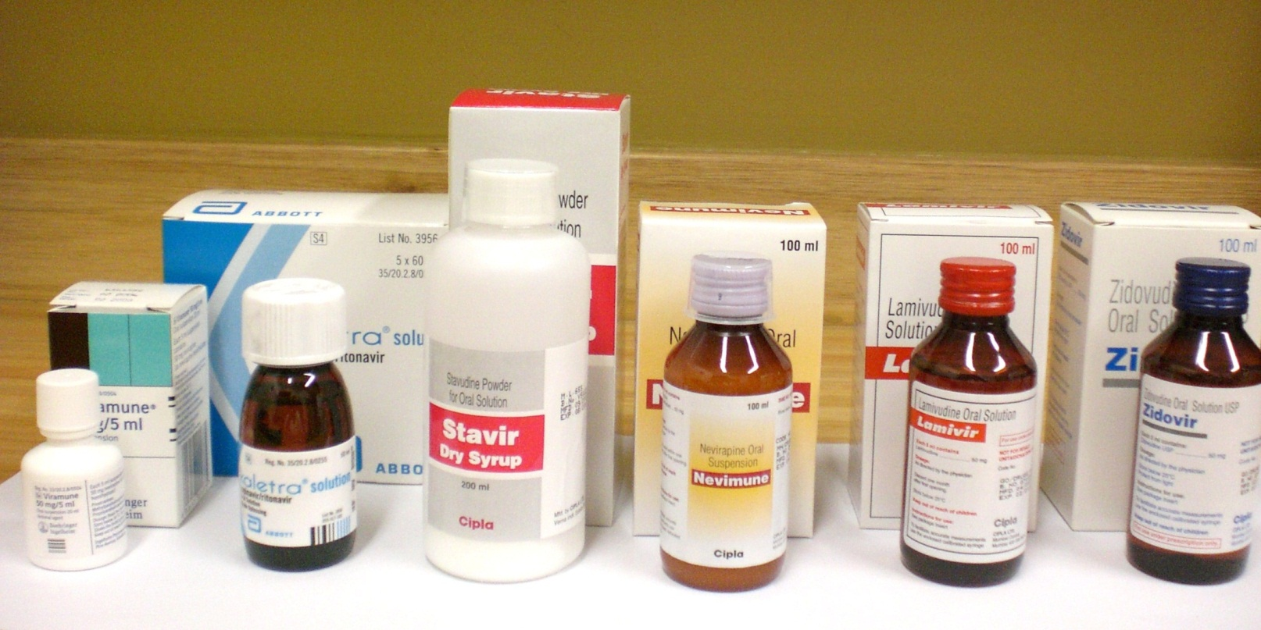
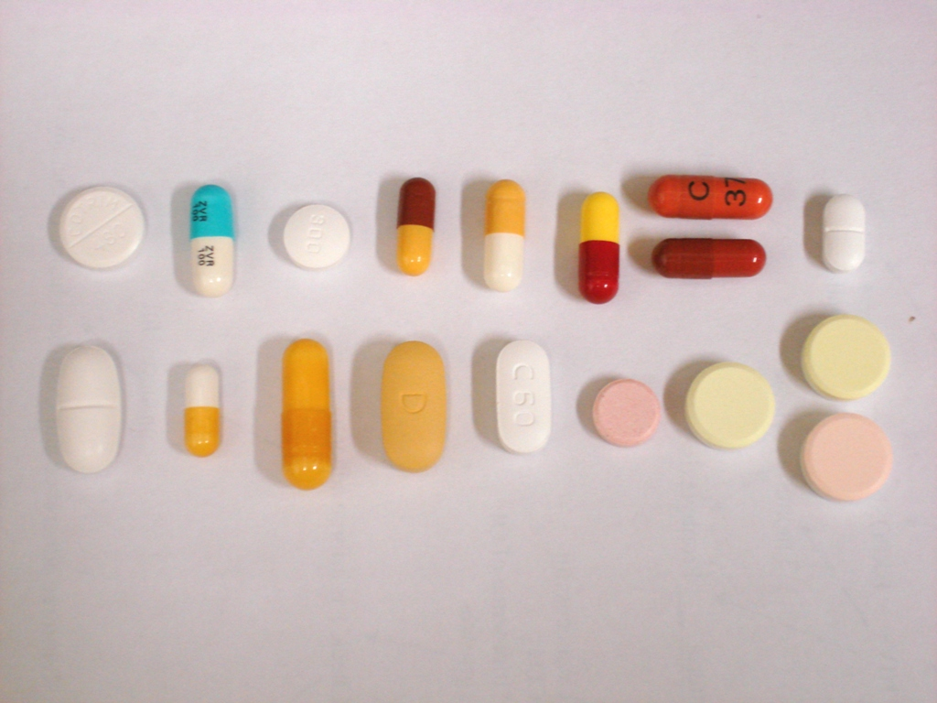
Older Formulations

Slide 22
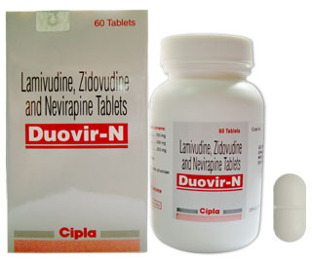
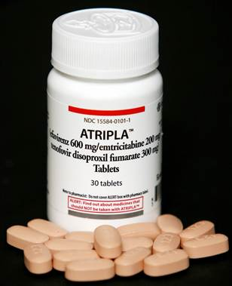
ARV Therapy
Newer formulations make ARV regimens for children and adults simpler
  Utilize fixed-dose combinations wherever possible to maximize adherence
    Simplified (weight-band) dosing available
  Simplify / harmonize regimens where there is no history of treatment failure

Slide 23
Case
Katleho, a 3-year-old, has recently tested positive for HIV-1 via rapid testing. She has herpes zoster, but is otherwise healthy. Her CD4 count is 410.
  Should you start her on ARVs?
  If she is eligible to start ARVs, how should you prepare her family for initiation?
  Which ARVs should you start her on?
  How should you follow her?

Slide 24
Monitoring Children on ART
Clinical evaluation
  Growth (height, weight, HC)
  Development
  New clinical signs & symptoms
  Side effects of medications
Lab monitoring:
  CD4 every 6 months
  Hb for AZT if high risk for adverse events (low CD4 or low BMI)
  Viral load at 6 months, then q12 months
  CD4 and viral load if suspected treatment failure

Slide 25
Monitoring Children on ART
Immune Reconstitution Inflammatory Syndrome (IRIS)
  Paradoxical clinical deterioration after starting ART resulting from an improving immune system
  Usually 1-3 months after initiation of effective ART
  Clinical presentations vary depending on the causative organism and the organ system that is colonized

Slide 26
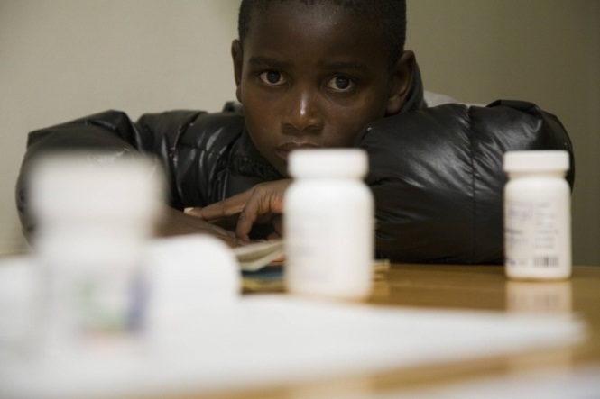
Monitoring Children on ART
Treatment adherence
  Adherence = doses actually taken
  doses to be taken
  Good adherence: more than 95%
  Measuring adherence: subjective recall, pill counts
    Multidisciplinary approach: social work involvement, adherence contract, treatment buddies, community support, stigma
  Poor adherence leads to accumulation of HIV mutations and eventual resistance to ART
    “Moderate” adherence – more likely to lead to resistance than poor adherence

Slide 27
Monitoring Children on ART
Signs of treatment efficacy:
  Clinical response (weight gain, reduction of OIs)
  Immunologic response (increase in CD4 count)
  Virologic response (decrease of VL)
Treatment Failure
  Early identification of treatment failure is critical
    Routine VL monitoring if feasible (threshold 1000 copies/ml)
  Second line treatment: depends on first line regimen
    For children: AZT/ABC, EFV/LPV/r
  More expensive, more difficult to take

Slide 28
Major Toxicities
ABC | Hypersensitivity
AZT | Marrow suppression Lactic acidosis Lipodystrophy or lipoatrophy Severe hepatomegaly
d4T | Peripheral neuropathy Lactic acidosis Lipodystrophy or lipoatrophy Severe hepatomegaly Pancreatitis
EFV | Hetatotoxicity Seizures Hypersensitivity Stevens-Johnson
LPV/r | Hepatotoxicity Pancreatitis Lipoatrophy or metabolic syndrome Dyslipidemia Diarrhea
NVP | Hepatotoxicity Stevens-Johnson
TDF | Renal tubular dysfunction Lactic acidosis Severe hepatomegaly Decreased bone mineral density

Slide 29
Key Drug-Drug Interactions
Boosted PI (LPV/r, ATV/r) | Rifampicin | Substitute with Rifabutin Adjust the PI dose Substitute with 3-NRTI regimen
 | Estrogen-based hormonal contraception | Use alternative or additional
 | Tenofovir | Monitor renal function
Nevirapine | Rifampicin | Substitute with Efavirenz
 | Itraconazole, Ketoconazole | Use an alternative agent (Fluconazole)

Slide 30
Challenges of Program Implementation

Slide 31
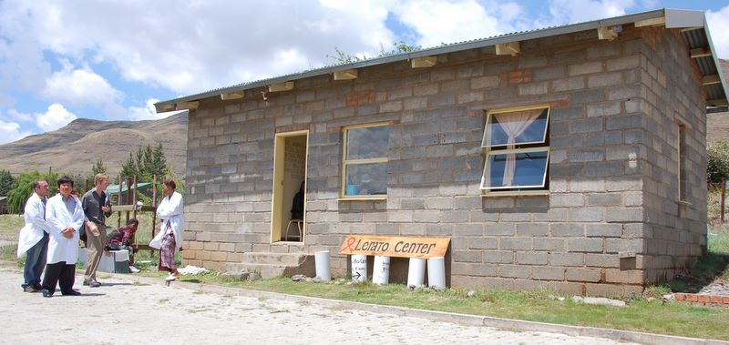
Limited Access to Services: Rural Clinic Settings

Slide 32
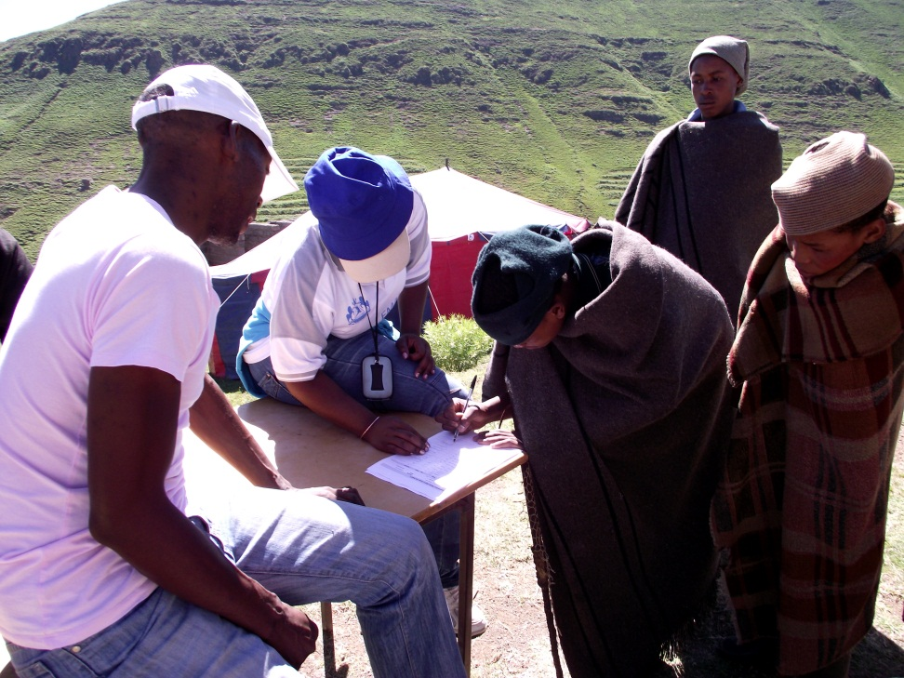
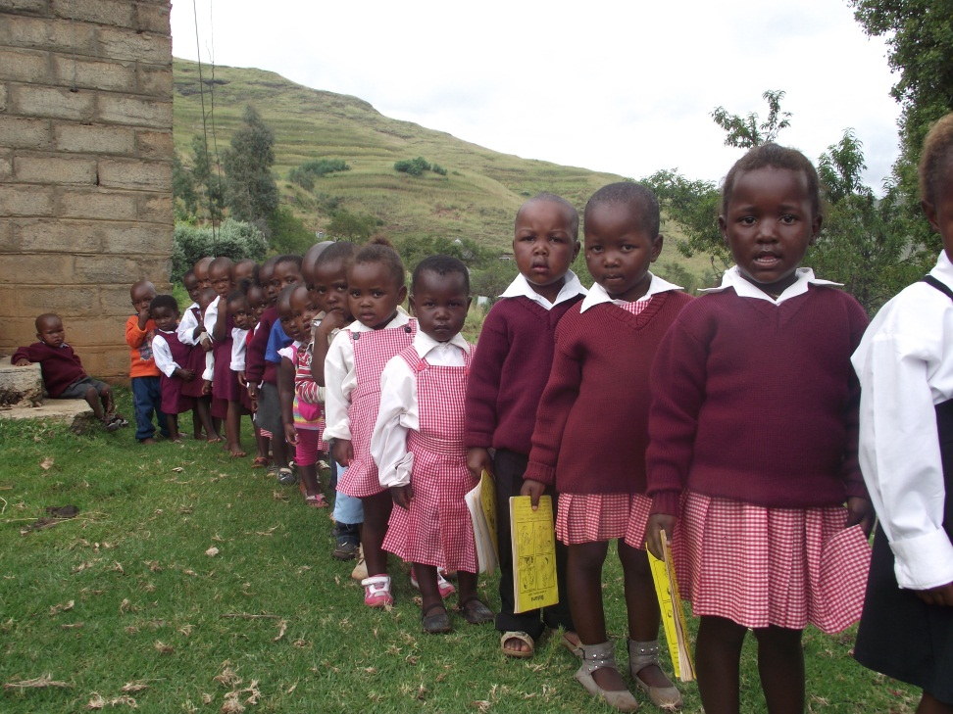
Limited Access to Services
Community HIV testing initiatives
School-based HIV testing and malnutrition screening

Slide 33

Limited Access to Services: Transportation Challenges

Slide 34

Transportation of medications and supplies may be difficult; supply chain / cold chain may be challenging to maintain
34

Slide 35


Slide 36
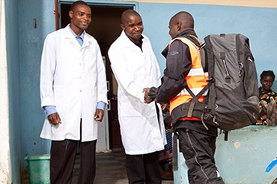

Innovative Solutions for Medication / Sample transport

Slide 37

Other Transportation Options

Slide 38


Slide 39
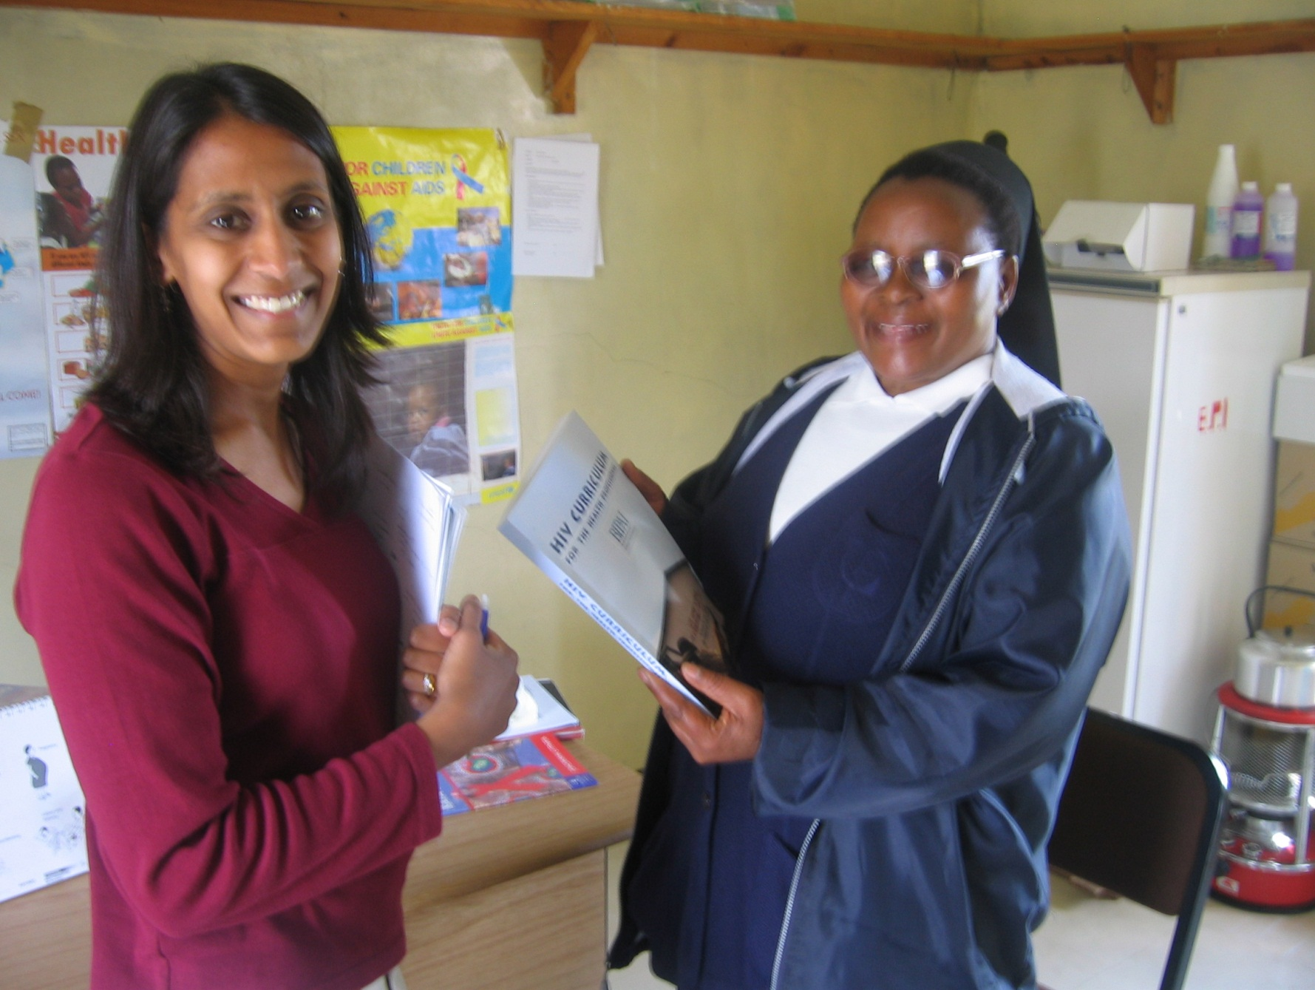
Task-shifting: nurse-managed ART programs; need government support

Slide 40
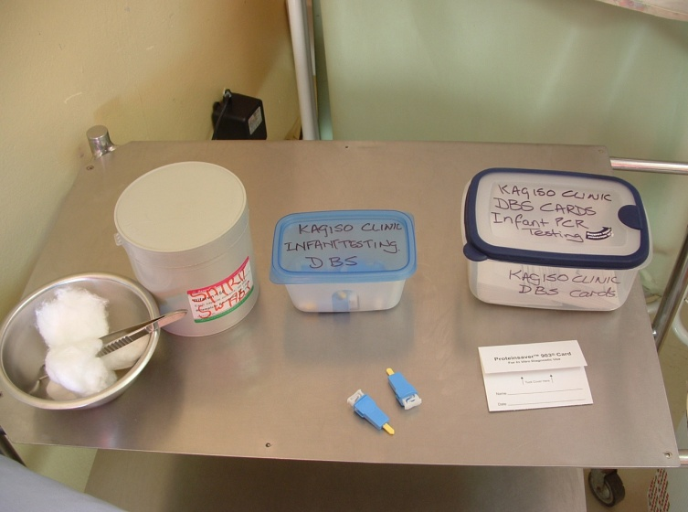

Task-shifting: training of health providers in local language
Liatlana
Pene
Foromo e tlatsoang
Karete ea mali
Nale e hlabang serethe
Sepiriti
Boea /gauze e hloekisang
Terei e omisang mali
Moo o tlang ho tsela linale

Slide 41

Laboratory Testing Not Always Accessible

Slide 42
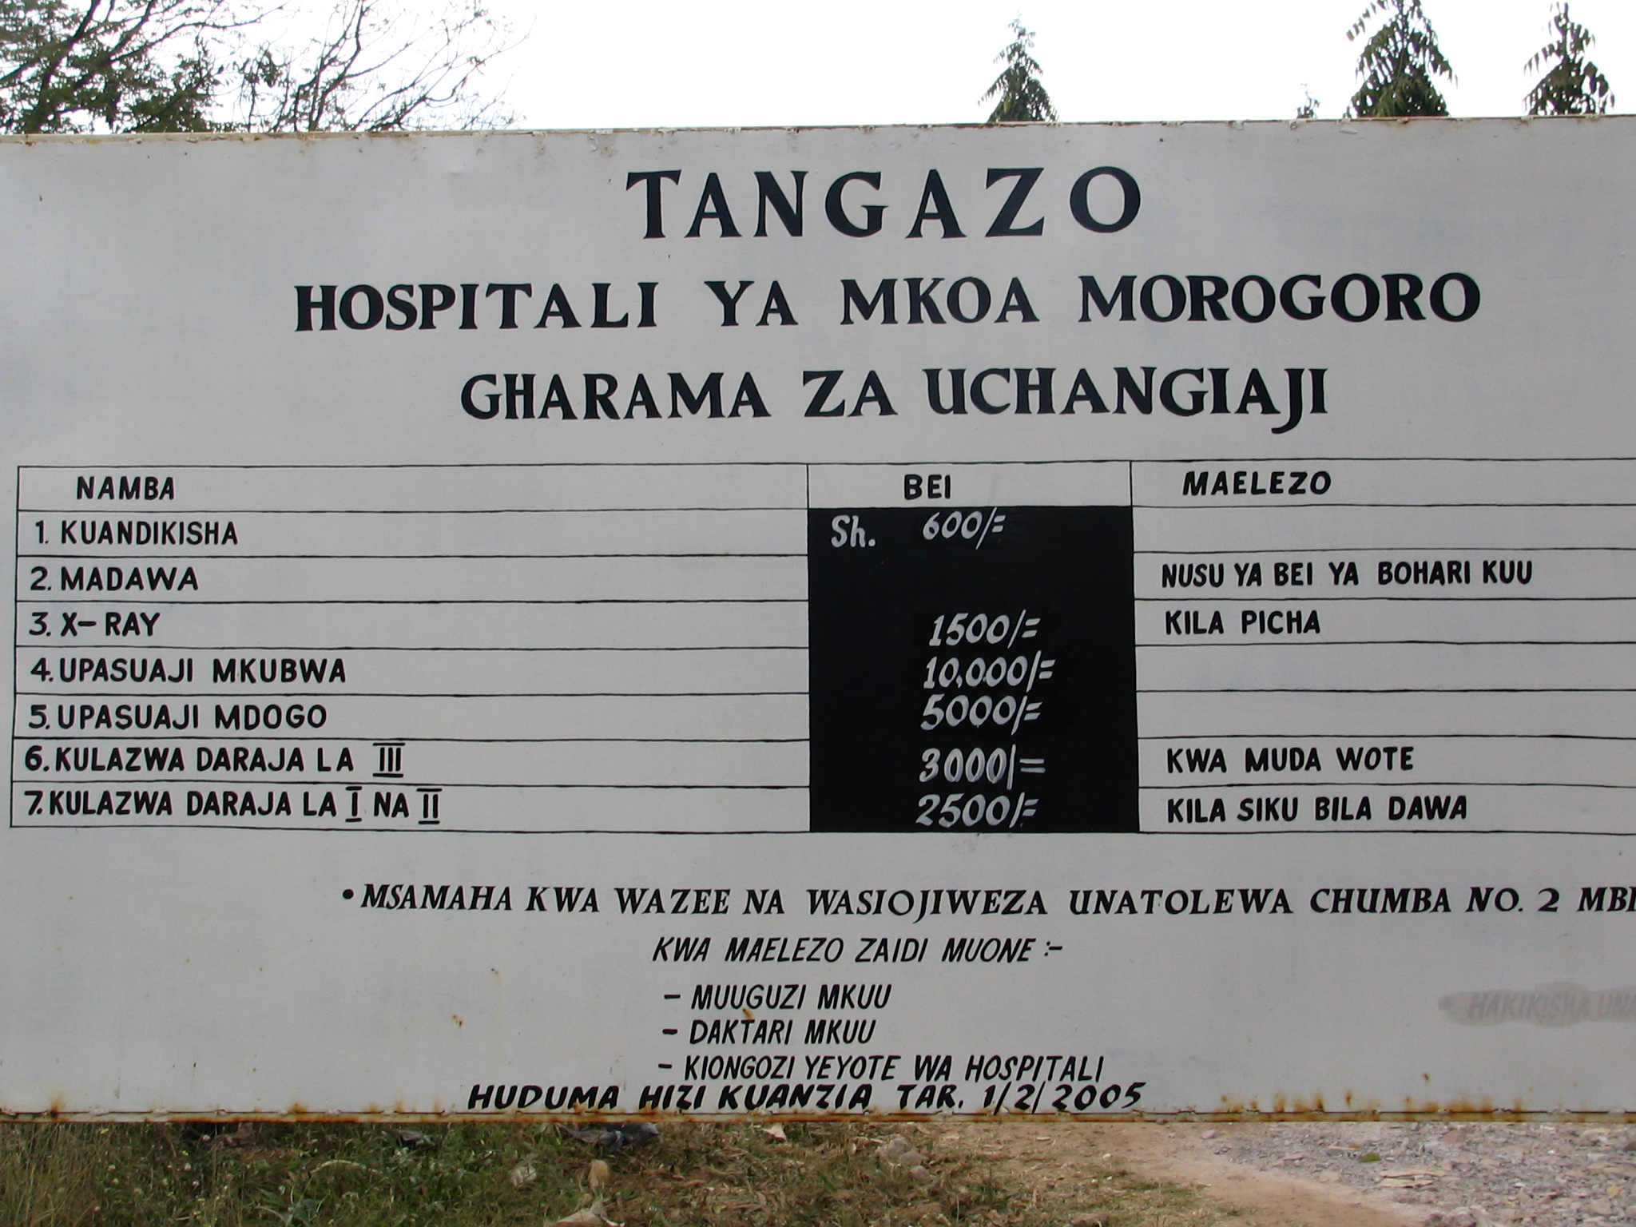
Fees for Services: Limits Access for Patients

Slide 43
Programmatic Challenges
Health systems:
  Patient access
    Geography / terrain
    ART availability at hospitals vs. health centers
    Cost for services
  Drug shortages / stock-outs
    Due to funding, forecasting, distribution to sites
  Shortage of trained medical personnel
    Nurse-driven ARV treatment systems
    Task shifting
  Availability of clinical support services – laboratory (CD4 testing, DNA/RNA PCR, Hb monitoring, etc.), radiology

Slide 44
Programmatic Challenges
Other Issues
  Management of co-morbidities (e.g. TB, malnutrition)
  Government commitment (especially with competing child health priorities)
  Community education and support
  High numbers of orphans
  Challenging workplace policies
  Stigma

Slide 45
ARV Therapy: Before and After

Slide 46
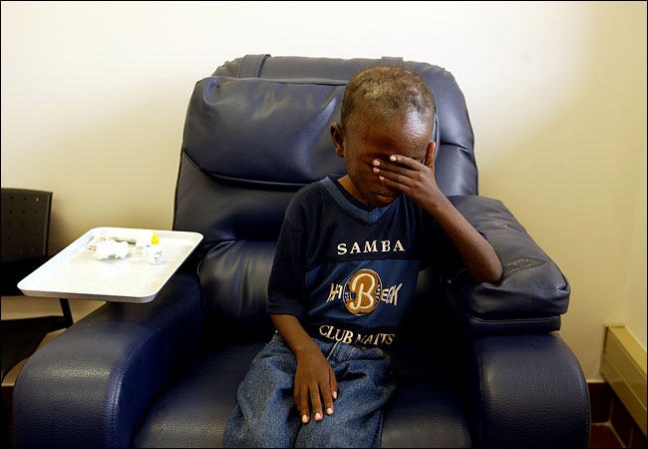
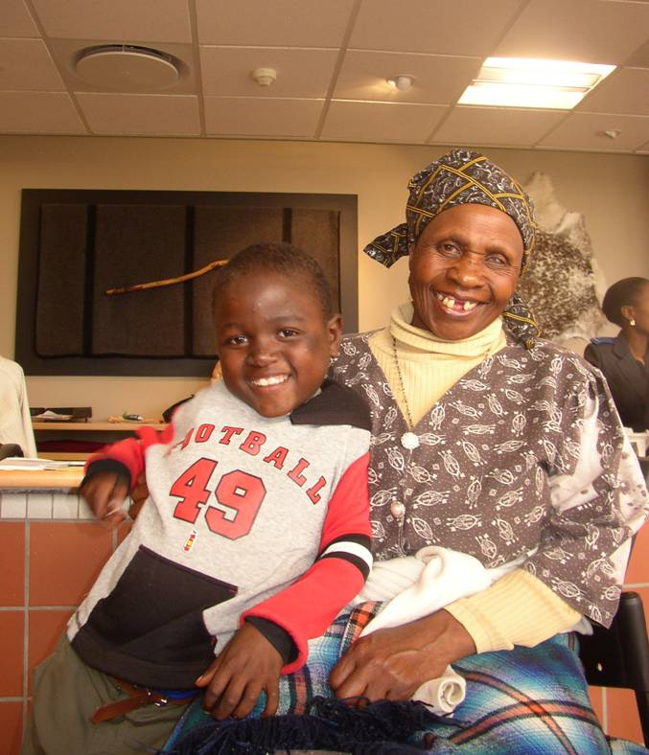
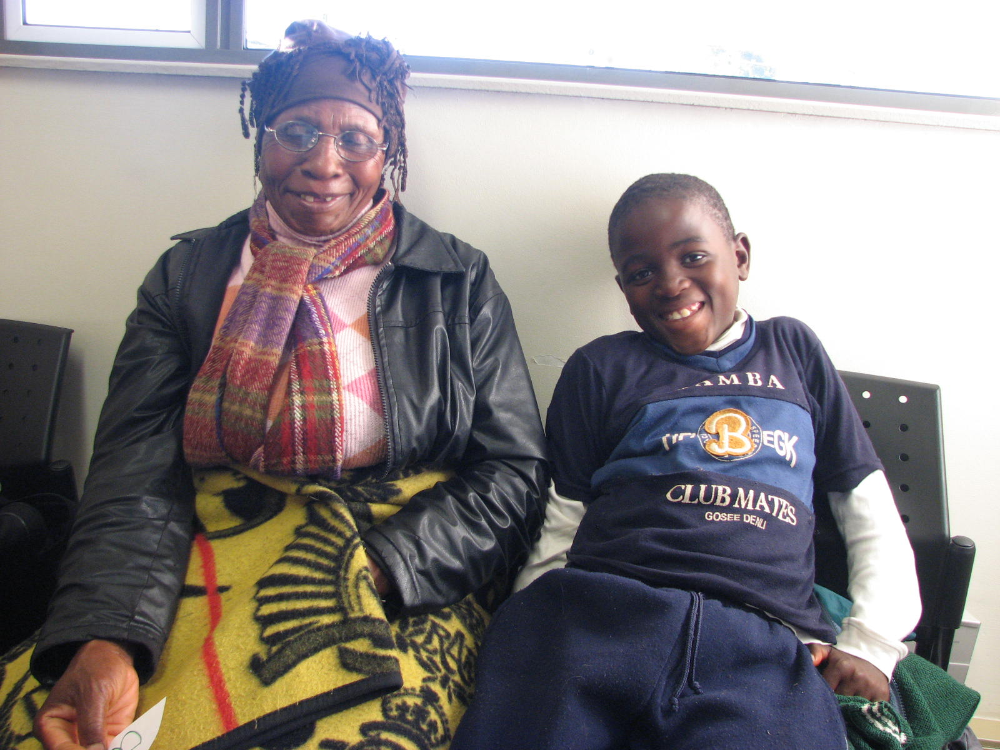

Slide 47
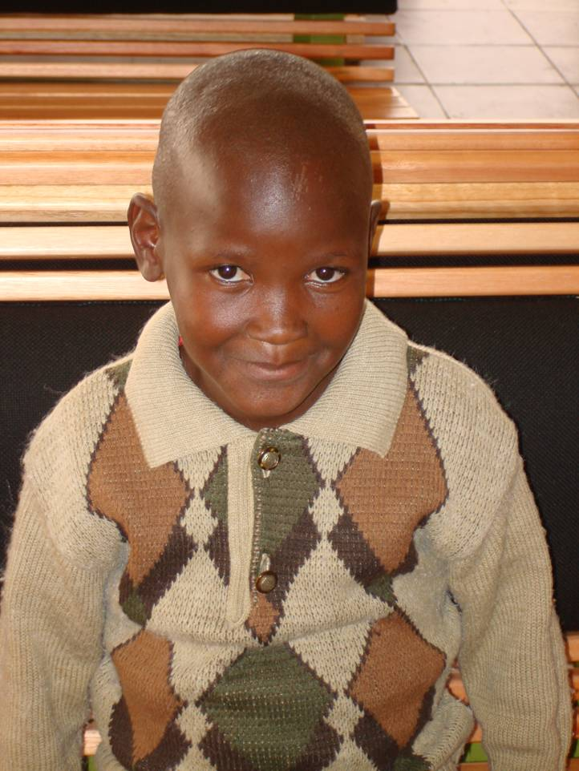
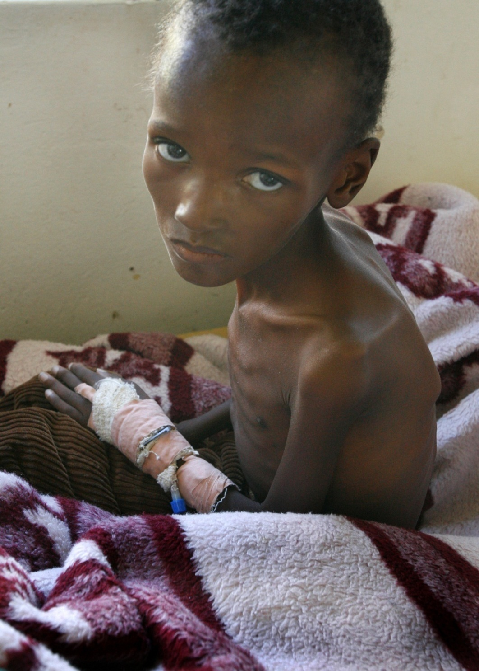

Slide 48
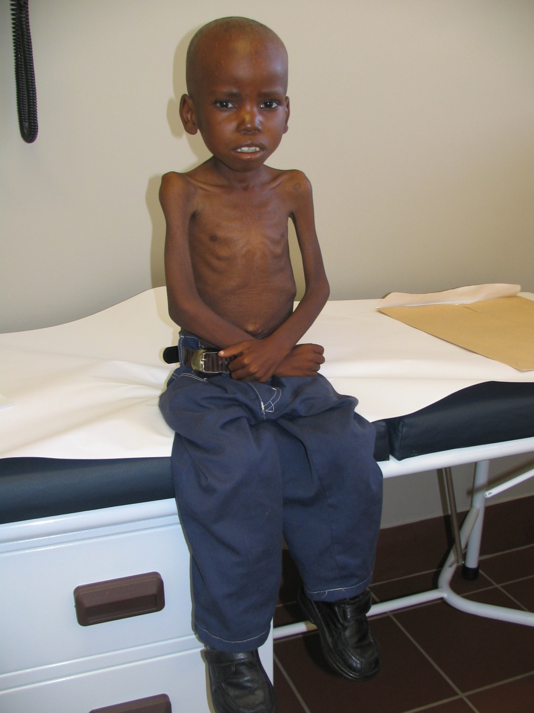
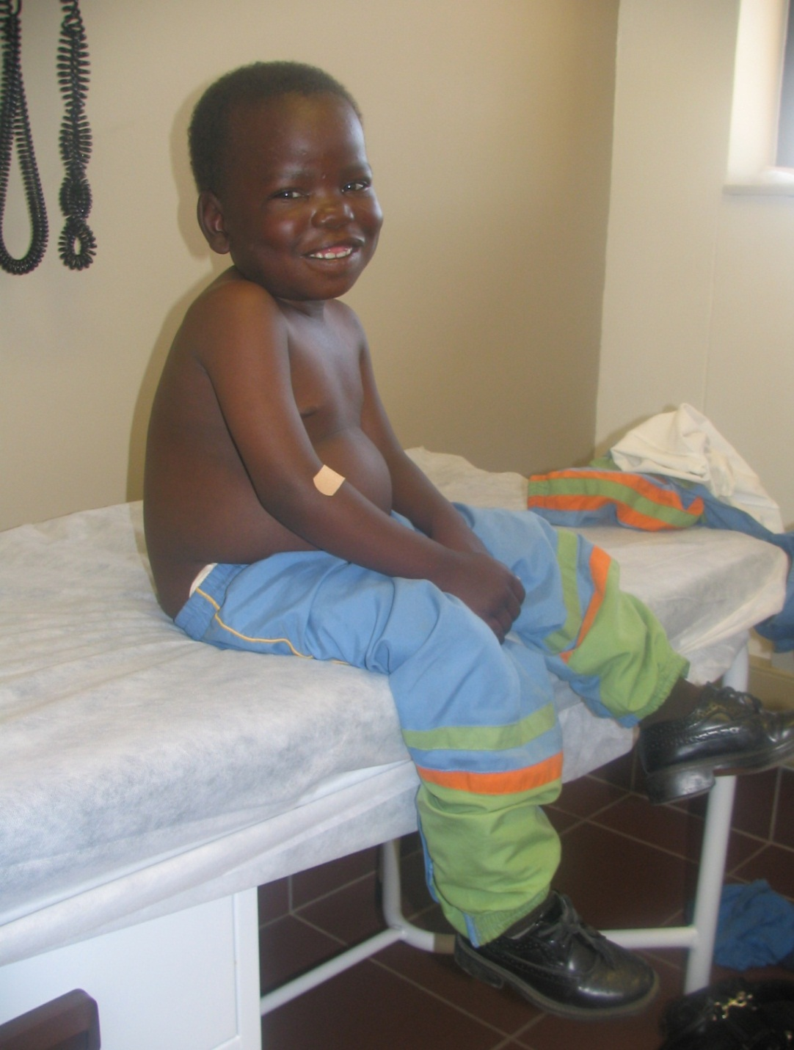

Slide 49
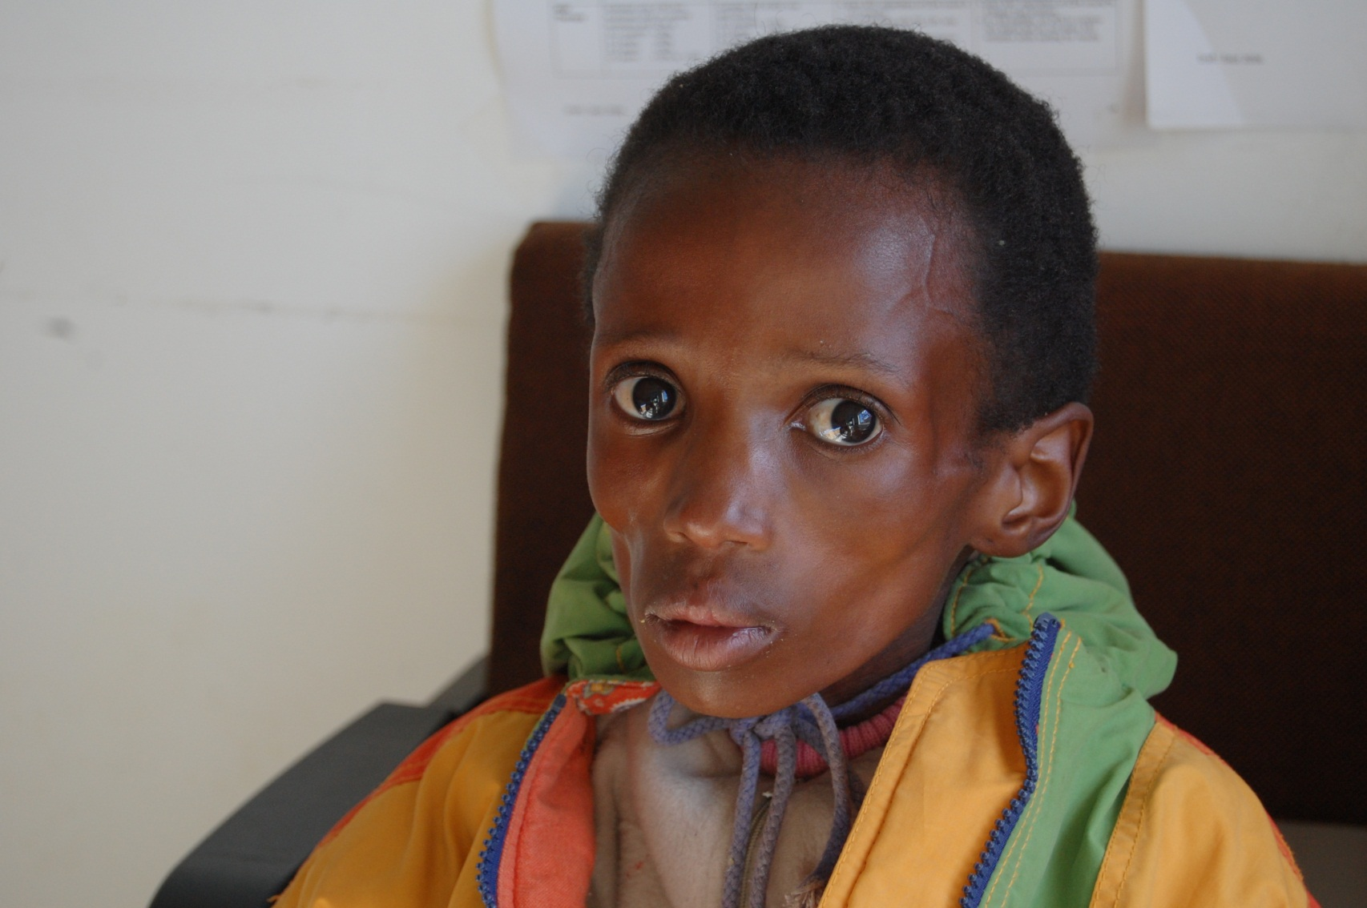
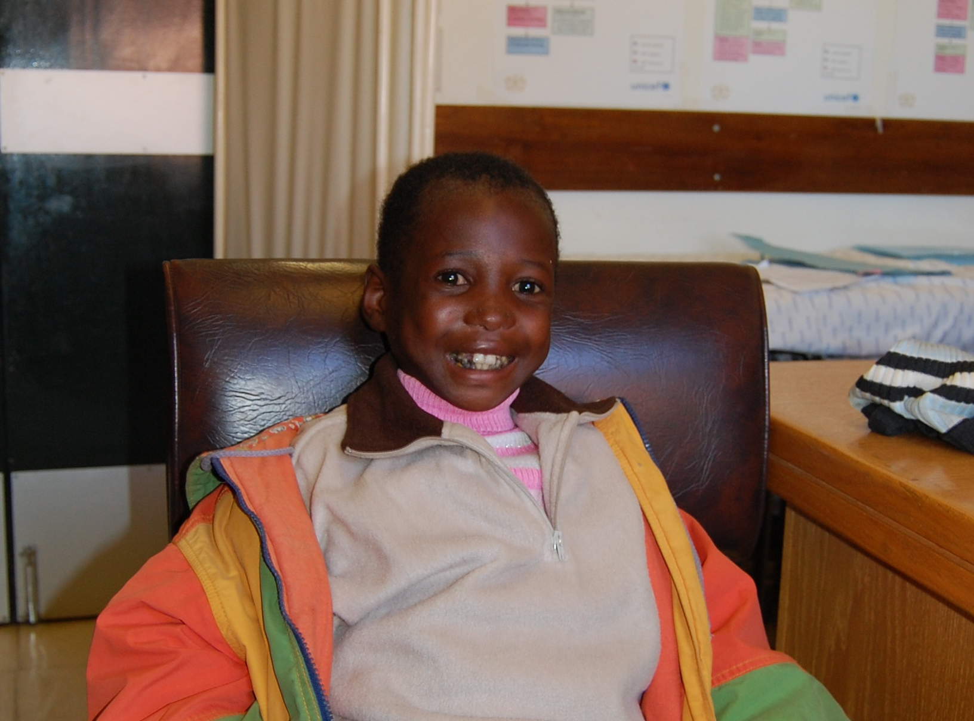

Slide 50
Prevention Of
HIV Transmission in
Infants and Children

Slide 51
Exposure Risks (average, per episode, involving HIV-infected source patient)
Percutaneous (blood) | 0.3%
Mucocutaneous (blood) | 0.09%
Receptive anal intercourse | 1 - 2%
Insertive anal intercourse | 0.06%
Receptive vaginal intercourse | 0.1 – 0.2%
Insertive vaginal intercourse | 0.03 – 0.14%
Receptive oral (male) | 0.06%
Female-female orogenital | 4 case reports
IDU needle sharing | 0.67%
Vertical (no prophylaxis) | 24%
Notes:
51

Slide 52
HIV Transmission in Infants & Children
Mother-to-Child Transmission: >95%
Contaminated blood supply
Re-use of needles in health care
Sharing sharps (knives, razors, scarification, tatooing, etc.)
Sexual abuse
Unprotected sex

Slide 53
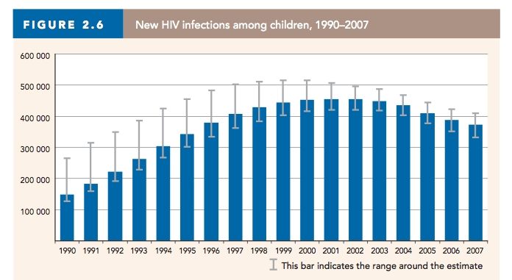
New HIV infections in children, 1990-2007
Global trend
Notes:
So you can appreciate the regional versus the global context of these numbers, I’m going to use my experience in Lesotho as a comparison for our experience here in DC.

Slide 54

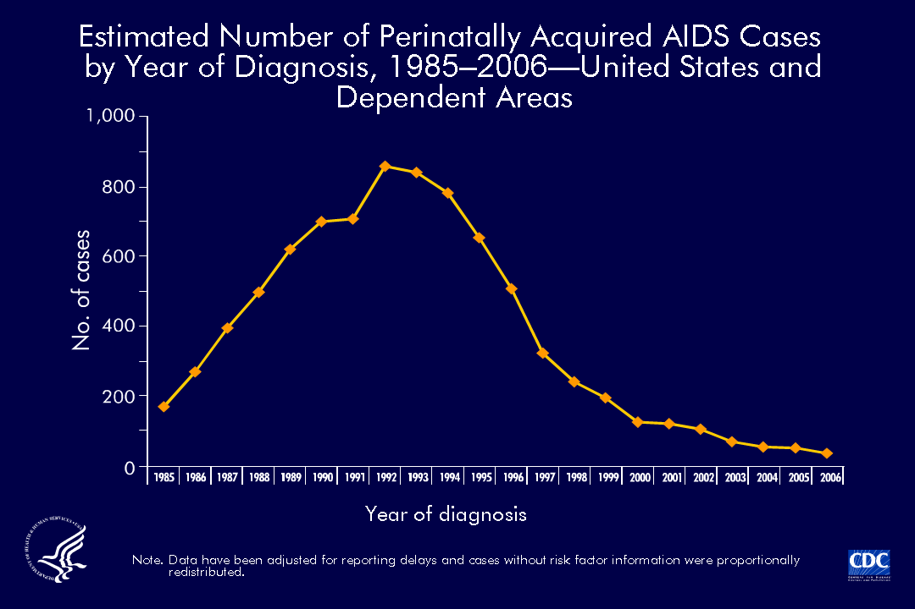
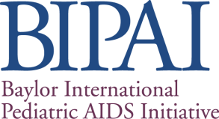

Notes:
The estimated number of AIDS cases diagnosed among persons perinatally exposed to HIV peaked in 1992 and has decreased in recent years.
The decline in these cases is likely associated with the implementation of Public Health Service guidelines for the universal counseling and voluntary HIV testing of pregnant women and the use of antiretroviral therapy for pregnant women and newborn infants (MMWR 2002;51(No. RR-18)). Other contributing factors are the effective treatment of HIV infections that slow progression to AIDS and the use of prophylaxis to prevent AIDS opportunistic infections among children. NO NEW GRAPHS FOR 2007; latest data as of 4/09 is 2007:Reported cases of HIV/AIDS in infants born to HIV-infected mother (for the 25 states that require name-based reporting) was 79 (HIV/AIDS Surveillance Report. Cases of of HIV Infection & AIDS in the US and Dependent Areas, 2007.) Dependent Areas: American Samoa, Guam, the Northern Mariana Islands, Puerto Rico, and the U.S. Virgin Islands.

Slide 55




 | World | US | DC | Lesotho
Population | 6,500,000,000 | 300,000,000 | 600,000 | 1,880,000
Adult Prevalence | 0.8% | <1% | 3% | 23%
2005 estimate # children newly infected | 410,000 | 110 | 7 | 6,000
2012 estimate # children newly infected | 290,000 | 131 | 0 | 3,600
Notes:
In, 2005, I arrived in Lesotho and as you can see the HIV epidemic for kids was in full swing. There were no antiretrovirals available for kids. Literally, physician were breaking up adult medications to give to kids; there were no liquid formulations of HIV medications in the entire country. Not only that, when I arrived in Lesotho, I was the second pediatrician for the country. There were less than 20 children on ARV therapy at the time. And, prevention of mother to child transmission or PMTCT was essentially nonexistent. Pregnant women were not being tested for HIV and certainly they were not receiving medications. One of the barriers at the time was cost: how much do you think a year’s worth of ARVs cost in 2005--$200 per year—and that was just for the medications, did not include cost of labs/doc visits. at the time the government was spending about $26 per person per year. So, ARVs was cost prohibitive. Clinton foundation helped with this.
Technical expertise and infrastructure was a huge problem. And, that was one of my tasks when I was there—to teach health professionals—docs, nurses, pharmacists, community representatives how to prescribe and manage children exposed to HIV and infected with hiv. A very tall order.
So, in 2005 the HIV prevalence in lesotho was 25%. This translated to about 6000 kids being born with hiv every year. Now

Slide 56
Timing of HIV Transmission in Infants
Intrauterine
Intrapartum
Postpartum via breastmilk

Slide 57
Absolute Risk of Mother-to-Child Transmission without prophylaxis
Early Postpartum
(0-6 months)
Late Postpartum
(6-24 months)
Pregnancy
Labor and Delivery
Breastfeeding
5-10%
10-20%
5-20%
Overall without breastfeeding 15-30%
Overall with breastfeeding thru 6mos 25-35%
Overall with breastfeeding 18-24mos 30-45%
JAMA 2000;283:1175-1182

Slide 58
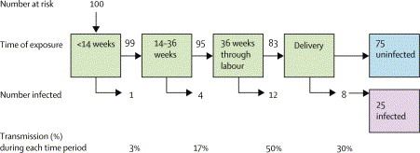
Timing of Vertical HIV Transmission: non-BF population
Source: Kourtis AP, Lee FK, Abrams EJ, Jamieson DJ, Bulterys M. Mother-to-child transmission of HIV-1: timing and implications for prevention. Lancet Infect Dis 2006; 6: 726-732.
Notes:
So, 6000 pregnant women infected with HIV-1 q yr in US would predict ~1500 babies infected in US q yr. MOST MTC TRANSMISSION OF HIV OCCURS BEFORE OR DURING LABOUR, when the placenta separates from the uterine wall, PROBABLY THROUGH MOM TO INFANT MICROTRANSFUSIONS (50% of infected) and 30% from birth canal. Estimates by Kourtis et al. came from a summary of 15 separate clinical trials then based on a hypothetical cohort of 100 women:
Landmark study that paved way for MTCT was PACTG 076 Study in nonBF pop, 409 women, started on AZT from 14-34 wks through delivery, + baby 6 wks AZT; decresed trans 67%. Conner et al NEJM 1994 study Reduction of MIT of HIV 1 with AZT. Then found Mandelbrot et al JAMA 280.55-60.1998 and by Intl Perinatal HIV Group: N Engl J Med 350. 977-987.1999 that the AZT 076 regimen + elective C/S before onset of labor TRANSMISSION RATE CAN BE REDUCED TO 1-2%. So Kourtis made this model in 2001, and adapted it to above by applying that and other info . HAART not even considered in this. For women on HAART during pregnancy transmission rate to <2%.

Slide 59
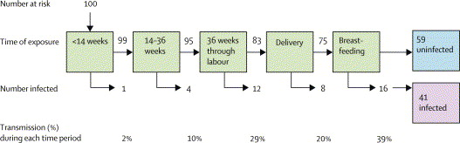
Timing of Vertical Transmission – Breastfeeding population
Source: Kourtis AP, Lee FK, Abrams EJ, Jamieson DJ, Bulterys M. Mother-to-child transmission of HIV-1: timing and implications for prevention. Lancet Infect Dis 2006; 6: 726-732.
Notes:
Postnatal transmission rate as high as ~15% for the women that engaged in prolonged BF of ~2 yrs. Believe BF transmission risk is higher in early lactation bc of increased breastmilk viral load in colostrum.

Slide 60
Risk Factors for HIV Perinatal Transmission—maternal
Social / behavioral factors
High maternal viral load
Advanced maternal disease
Newly acquired HIV infection
Prolonged rupture of membranes
Presence of STIs, chorioamnionitis
Vaginal delivery
Breastfeeding
Notes:
Advanced maternal disease: In the analysis of 1,800 mother-infant pairs from the European Collaborative study, an inverse linear relationship between maternal CD4 count and HIV transmission was found. In other words, lower CD4 counts are associated with a higher risk of perinatal transmission. However, there is still a 11-15% risk of transmission even in infected women with a normal CD4 count. Hence, therapeutic regimens which increase CD4 count for prolonged periods are indicated.
All else will be discussed in turn.

Slide 61
Breastfeeding Women With Low CD4 Are at Highest Risk of Infecting Their Infants:
Zimbabwe Iliff PJ et al. AIDS 2005;19:699-708
Women Who Would be
Eligible for HAART

Slide 62
HIV Transmission Risk by Maternal HIV RNA
Notes:
This is Viral Load (usually RNA is quantitative, whereas DNA is qualitative):
RNA PCR for plasma viral load works in the 30 cycle range to maximize quantitation ability. DNA PCR works in the 35-40 cycle range to maximize saturated detection so that everything above say 5 input copies will be detected, but not quantitated. Above 30 cycles, PCR loses it's ability to be quantitative because there is just too much product from all the cycles of amplification, so the detection systems become saturated (unable to detect differences in input copy number). So 10 copies looks the same as 10,000 copies. (http://www.thebody.com/Forums/AIDS/Labs/Archive/TestingHIV/Q6083.html)
, ACOG (the American College of Obstetricians and Gynecologists) has published recommendations: These state that if a woman’s viral load is >1,000 copies/microliter, the mother should be given the option of undergoing scheduled c-section in the 38th week of pregnancy (one week earlier than usual). This, of course would be in conjunction with the ACTG 076 regimen

Slide 63
Risk of HIV Transmission by Duration of Membrane Rupture
Notes:
These data come from mother-infant pairs enrolled in Wits (Wits HIV/AIDS Research Institute, University of Witwatersrand, Johannesburg, SA). Rupture of membranes for longer than 4 hours is thought to be associated with an increased risk of MCT. Hence, membranes should not be ruptured prematurely if avoidable.
Based on these studies, ACOG (the American College of Obstetricians and Gynecologists) has published recommendations: These state that if a woman’s viral load is >1,000 copies/microliter, the mother should be given the option of undergoing scheduled c-section in the 38th week of pregnancy (one week earlier than usual). This, of course would be in conjunction with the ACTG 076 regimen

Slide 64
Social/Behavioral Factors
Injection drug users or partners of IVDU
Exchange sex for money or drugs
Share sex partners of HIV-infected persons
Have had a new or more than one sex partner or diagnosis of sexually transmitted infection during pregnancy
Maternal smoking
Notes:
Opt-out testing = bulldozer consent! (new recs with MMWR: September 22, 2006 / 55(RR14);1-17 Revised Recommendations for HIV Testing of Adults, Adolescents, and Pregnant Women in Health-Care Settings)
Cigarette smoking during pregnancy: In a study in NY, women with low CD4 counts who smoked during their pregnancy had more than a 3-fold increased risk of transmission; the relative risk was proportional to the average number of cigarettes smoked daily, and independent of other factors. This may be because cigarette smoking has been associated with immune system alterations, placental morphologic changes, and obstetric complications such as premature rupture of membranes
Frequent unprotected sex with multiple partners: Mechanisms for enhanced transmission under these circumstances include physical trauma or inflammation, and exposure to multiple HIV-1 strains from different partners. Also, frequent, unprotected sex with multiple partners may be a surrogate for other risk factors.

Slide 65
Risk Factors for Perinatal HIV Transmission - Infant
Breastfeeding Duration
Non-exclusive breast-feeding
Lesions in mouth or intestine
Low birthweight
Prematurity

Slide 66
Most breastfeeding transmission occurs early
highest
Early BF Transmission
Late BF Transmission

Slide 67
Mixed Feeding vs. Exclusive Breastfeeding
Notes:
~Reason hypothesized: formula is FB, causing inflammation, microabrasions, then when add BF, milk with HIV virus can pass more easily through those mucosal sites.

Slide 68
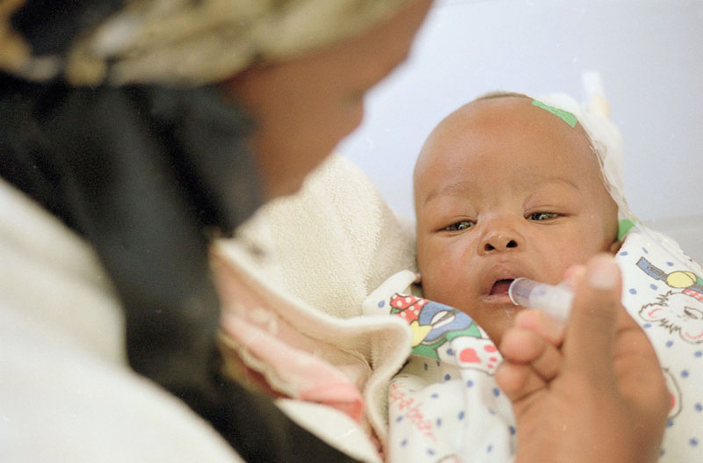
PMTCT Strategies

Slide 69
Comprehensive Approach to PMTCT
Prevention of unintended pregnancies among women infected with HIV
Prevention of HIV transmission from women infected with HIV to their infants
Prevention of primary HIV infection
Provision of Treatment, Care, and Support to
Women Infected with HIV and their Families

Slide 70
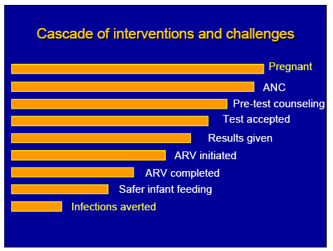
Interventions to decrease risk of HIV transmission —global perspective

Slide 71
PMTCT: pregnancy, labor & delivery
Prevent new HIV infections during pregnancy
  Test all women at first ANC visit AND 3rd trimester or during L&D
    “Opt-out” testing approach: significantly improves HIV testing uptake
Prevention of unintended pregnancies among HIV infected women
  Access to comprehensive reproductive health services for HIV infected women (including family planning options)

Slide 72
PMTCT: pregnancy, labor & delivery
Improve the health of HIV+ pregnant women
  Make sure all eligible pregnant women are on ARVs
Avoid unnecessary procedures during delivery
Elective cesarean section when feasible & safe
ARV treatment and/or prophylaxis

Slide 73
Anti-Retrovirals and PMTCT
ARVs reduce HIV transmission by lowering viral load
  AZT is most studied
  AZT, NVP, & 3TC are considered safest
ARVs for PMTCT can be administered as part of:
  Maternal treatment programs (HAART)
  Maternal / infant prophylaxis programs
  Emphasis on integration of treatment and PMTCT programs
Notes:
Landmark study that paved way for MTCT was PACTG 076 Study in nonBF pop, 409 women, started on AZT from 14-34 wks through delivery, + baby 6 wks AZT; decresed trans 67%. Conner et al NEJM 1994 study Reduction of MIT of HIV 1 with AZT. Then found Mandelbrot et al JAMA 280.55-60.1998 and by Intl Perinatal HIV Group: N Engl J Med 350. 977-987.1999 that the AZT 076 regimen + elective C/S before onset of labor TRANSMISSION RATE CAN BE REDUCED TO 1-2%. So Kourtis made this model in 2001, and adapted it to above by applying that and other info . HAART not even considered in this. For women on HAART during pregnancy transmission rate to <2%.

Slide 74
Anti-Retrovirals and PMTCT
Two other important mechanisms through which ARVs reduce transmission:
  Pre-exposure prophylaxis of infant (through transplacental drug passage) – produces adequate systemic drug levels in infants
  Post-exposure prophylaxis of infant (by administering to the infant after birth) – protection from cell-free or cell-associated virus that may have entered the circulation during delivery

Slide 75
Results of PACTG 076: Landmark Study
30
67% reduction in risk for transmission (P = <0.001)
20
22.6%
Transmission Rate (%)
10
7.6%
Placebo
ZDV Group
Connor EM et al. N Eng J Med 1994, 331(18):1173-80.
Notes:
75
75
Landmark study that paved way for MTCT was PACTG 076 Study in nonBF pop, 409 women, started on AZT from 14-34 wks through delivery, + baby 6 wks AZT; decresed trans 67%. Conner et al NEJM 1994 study Reduction of MIT of HIV 1 with AZT. Then found Mandelbrot et al JAMA 280.55-60.1998 and by Intl Perinatal HIV Group: N Engl J Med 350. 977-987.1999 that the AZT 076 regimen + elective C/S before onset of labor TRANSMISSION RATE CAN BE REDUCED TO 1-2%. So Kourtis made this model in 2001, and adapted it to above by applying that and other info . HAART not even considered in this. For women on HAART during pregnancy transmission rate to <2%.

Slide 76
Antiretroviral Regimens and
Perinatal HIV Transmission
Women & Infants Transmission Study, 1990-1999
Cooper E et al. JAIDS 2002;29:484-94

Slide 77
For Maximal Efficacy, Early ARV Initiation Needed
ARV Duration in Pregnancy and MTCT: - Johannesburg, S. Africa
Hoffman R et al. JAIDS 2010;54:35-41
Group | % MTCT
Overall group women all on HAART (N=873) (no sig. difference NVP vs LPV/r vs EFV regimen) | 4.9%
On HAART when became pregnant (N=143, median duration 93.4 weeks by delivery) | 0.7%
Started HAART during pregnancy (N=730, median duration 10.7 weeks by delivery) | 5.7%
Duration of HAART during pregnancy:
<4 weeks (N=151) | 9.3%
4-16 weeks (N=422) | 5.5%
16-32 weeks (N=157) | 3.5%
(873 pregnant women with advanced HIV infection)
p= 0.01
In women starting HAART during pregnancy, each additional week of HAART reduced odds of transmission
by 8% (adjusted OR 0.92, 95% CI 0.87-0.99)
Slide courtesy of Dr. Lynn Mofenson, NIH

Slide 78
WHO 2013 Recommendations:
Option B: Maternal Triple ART | Option B+ | 2015 Update
Mother | Mother | Mother
Triple ART: TDF + 3TC/FTC + EFV If eligible for treatment for her own health, continue with lifelong Rx If not, stop ART 1 week after cessation of BF | Triple ART: TDF + 3TC/FTC + EFV as soon as diagnosed (regardless of CD4) – continue for life | Triple ART as soon as diagnosed (regardless of CD4) – continue for life
Infant | Infant
BF infant: NVP x 6 weeks Non-BF infant: AZT or NVP for 4-6 weeks THEN: Early Infant Diagnosis | BF infant: NVP x 6 weeks Non-BF infant: AZT or NVP for 4-6 weeks THEN: Early Infant Diagnosis
37

Slide 79
WHO 2013 and 2015 Guidelines
Advantages of Option B+ & Universal approach
  Simplification of PMTCT programs
    No need to determine CD4 for eligibility
    Simplification of regimens to match with recommended first-line ART (e.g. TDF-3TC-EFV)
  Extended protection for mothers with multiple pregnancies (no need to start/stop ART)
  Treatment as Prevention: prevention of sexual transmission in serodiscordant couples
  Long-term benefit to the woman’s health
Need to evaluate programmatic challenges and cost implications

Slide 80
Male circumcision
Biologic plausability
Meta – analysis
  Relative risk for HIV infection was 44% lower in circumcised men
  Consistent substantial protective efffect
RCT
  Circ group lower incidence of HIV infection
    South Africa – 60%
    Kenya – 53%
    Uganda – 51%
Effect of male circumcision on male-to-female transmission
  If VL < 50,000 copies/mL, no HIV transmission if circumcised, compared to transmission rate of 9.6 per 100 person-years in uncircumcised man

Slide 81
Early Infant Diagnosis
Viral diagnostic test recommended at 4-6 weeks
  Start ART immediately if positive
If negative and BF, continue daily NVP prophylaxis
  Antibody test at 9 months: viral test for confirmation if positive; otherwise repeat antibody testing at 18 months (and/or 6 weeks after cessation of BF)

Slide 82
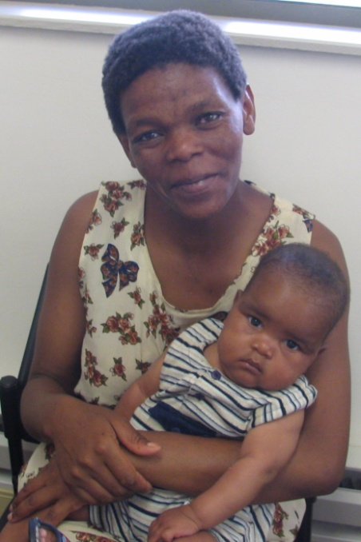
HIV and Infant Feeding

Slide 83
40-50% of all MTCT of HIV can be attributed to breastfeeding; 10% of all infants who are breastfeeding will become infected
Early Antenatal
(<36 wks)
Early Postpartum
Late Postpartum
Pregnancy
Labour &
Delivery
Breastfeeding 35-40%
0-1
1-6 mos
6-24 mos
Late Antenatal
(36 wks to labour)
Substantial Proportion of infections occur during BF
Notes:
This slide presents the risks of MTCT following the degree of color. Infants acquire HIV in utero, intrapartum and post partum.
Substantial proportion of transmissions occur near and during labor & delivery
Intervention can be effective in settings where women access antenatal care late in pregnancy
Substantial proportion of transmissions occur during breast feeding. Breast Feeding can account for about 35-40% of all MTCT
Data from the BHITS study estimates this risk is ~ 0.8% per month.

Slide 84
Several factors increase the risk of MTCT during breastfeeding
Longer duration of feeding
Mixed Feeding (especially in the early postpartum period)
Advanced maternal disease
Breast problems (mastitis, cracked nipples, etc.)
Acute maternal HIV infection
So why breastfeed?
Notes:
Postnatal transmission occurs during breastfeeding. Infants are at risk for acquiring HIV for as long as they continue to breastfeed. Mothers with advanced disease who breastfeed are more likely to transmit HIV to their infants during breastfeeding.
Mixed feeding has been associated with increased risk of postnatal transmission. This is because the GIT tract is exposed to complex proteins which result in inflammation, which decreases the effectiveness of the gut lumen in preventing entry of HIV. Mixed feeding is also associated with increased breast problems such as cracked nipples and mastitis which are also associated with increased breast milk Viral load.

Slide 85
PMTCT during breastfeeding
Appropriate infant feeding is crucial to child well-being and survival
Need to balance:
Risk of HIV transmission during breastfeeding
Risk of mortality / morbidity due to not breastfeeding (replacement feeding)
vs
Ultimate goal: optimal HIV-free survival

Slide 86
Breastfeeding protection
Breastfeeding is known to provide protection against diarrhea and respiratory tract infections
A pooled analysis in The Lancet showed that:
  Non-breastfed infants were significantly more likely to die of infectious diseases than breastfed infants
  The protection provided by breast milk decreases steadily with age
  Protection against diarrhea was substantially greater than protection against respiratory tract infections in the first six months of life
  Effect of breastfeeding on infant and child mortality due to infectious diseases in less developed countries: a pooled analysis. Lancet 2000;355:451-455

Slide 87
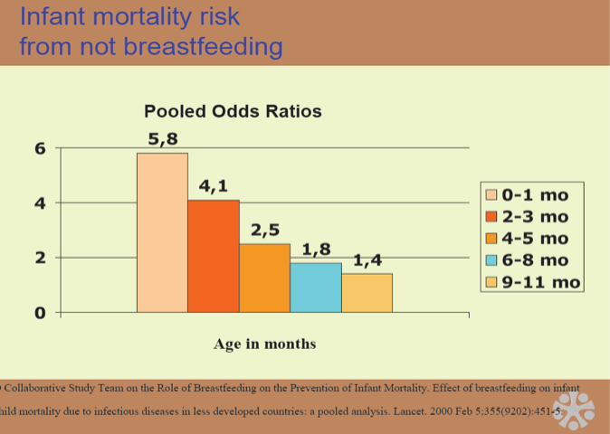
Risk of not breastfeeding

Slide 88
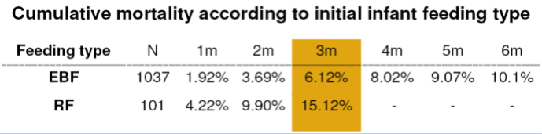
Risk of not breastfeeding
In HIV-exposed infants in developing countries, replacement feeding is associated with higher mortality (15% at 3mos) vs. exclusive breastfeeding (6% at 3 mos)
~ 2.5-fold increased risk of death associated with RF in this predominantly rural & peri-urban environment
(Coovadia, et al, IAS, 2006)

Slide 89
Breastfeeding protection
Mashi study in Botswana
  HIV transmission was naturally higher in the breastfeeding arm
  Early infant mortality was much higher in the formula fed arm
    9.3% vs. 4.9% (cumulative infant mortality at 7 months, p=0.003)
  Thior I., et al. Breastfeeding plus infant zidovidine prophylaxis for 6 months vs. formula feeding plus infant zidovidine for 1 month to reduce mother-to-child transmission in Botswana. JAMA 2006; 296:794-805

Slide 90
Does early weaning help?
When considering the overall benefit of early weaning in terms of HIV-free survival, there is NO difference in outcome
  Whatever benefit comes from decreasing HIV infection by weaning after 4 months of age, is replaced by the mortality associated with early weaning

Slide 91
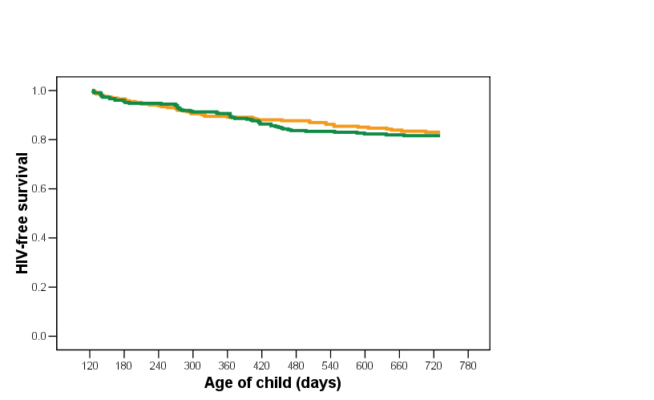
No Overall Benefit in HIV-Free Survival
to Early Cessation vs. Continued Breastfeeding
Kuhn L et al. N Engl J Med 2008;359:130
Stopped breastfeeding
Continued breastfeeding
Overall HIV-free Survival among
Children without HIV & Still Breastfeeding at Age 4 Months of Age
(Abrupt vs Standard Weaning)
p = 0.21
Notes:
91
91
When considering the overall benefit of early weaning in terms of HIV-free survival, there is NO difference in outcome.
What ever benefit in decreasing HIV infection through weaning after 4 months of age, is replaced by the mortality associated with early weaning. The HIV-free survival in Group A was 17% and in Group B 19% - statistically insignificant.
The “As Practiced” analysis where these curves were drawn based on whether the mother actually weaned their child or not (versus which group they were assigned to) was no different.
So, analyzed either way, there seemed to be NO benefit to early weaning.

Slide 92
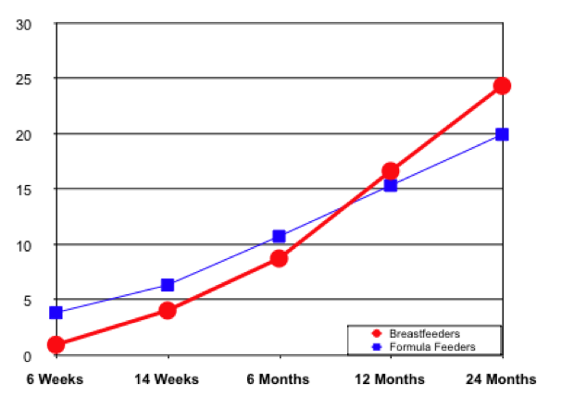
HIV Free Survival: Similar Cumulative Mortality Rates in
BF and FF Arms
Nduati et al. JAMA, 2000
Similar 2-year mortality rates in both arms; breastfeeding arm, 24.4% [95% CI, 18.2%-30.7%]; formula feeding arm, 20.0% [95% CI, 14.4%-25.6%]; (P = .30)

Slide 93
Approaches to decrease the risk of MTCT associated with BF
Complete avoidance of breastfeeding; use of replacement feeds
  Increased risk of morbidity / mortality, particularly amongst younger infants
Shorten duration of BF
  Decreases the proven benefits of breast feeding
Exclusive BF – 1st six months
ARVs for mother and/or child
  Currently recommended approach for prolonged BF
Improve BF practices
Prevent acquisition of maternal (parental) HIV infection

Slide 94
WHO Recommendations (2013)
Governments should decide whether to counsel mothers to either BF and receive ARVs or avoid all BF (given their particular context)
Mothers should exclusively BF for the first 6 months and introduce appropriate complementary foods thereafter
  Continue breastfeeding for the first 12 months of life
Breastfeeding should only stop once a nutritionally adequate and safe diet without breast milk can be provided

Slide 95
Conclusions
Treatment
  Antiretroviral therapy is effective for children in developing countries
  WHO provides recommendations for ARV initiation criteria, regimens and monitoring
  Don’t forget co-trimoxazole prophylaxis, preparation for ARV initiation
Prevention
  Delivering appropriate PMTCT regimens is essential to reducing HIV transmission to infants
  HIV+ mothers should receive counseling on safer infant feeding

Slide 96
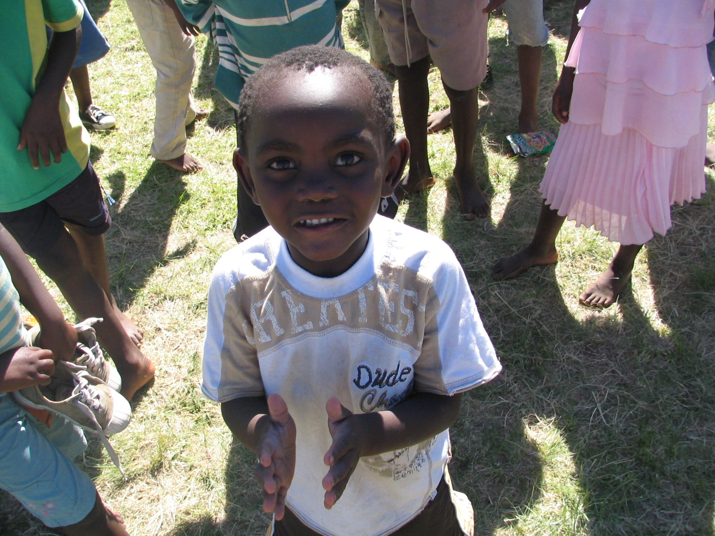
Thank you!

