Slide 1



Pediatric HIV:
Epidemiology, Diagnosis & Clinical Manifestations
October 13, 2015
Kathy Ferrer, MD AAHIVS
Notes:
90-90-90: 90% of people living with HIV knowing their HIV status; 90% of people who know their HIV-positive status on treatment; and 90% of people on treatment with suppressed viral loads.
June 2014: 13.6 million with access to ARVs,
Treatment gap for children

Slide 2
Objectives
Understand the epidemiology of HIV
Know how to diagnosis HIV in infants and children
Perform WHO clinical staging for HIV-infected children

Slide 3
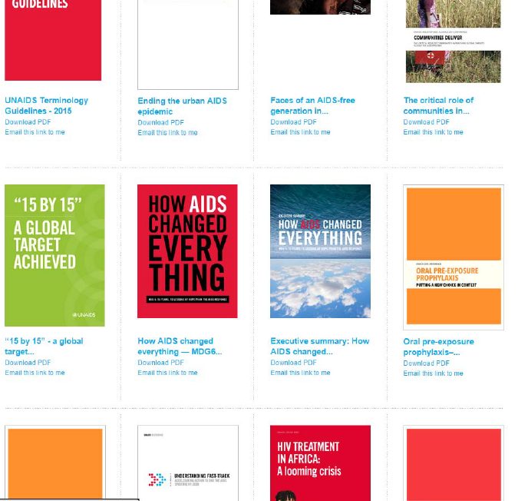
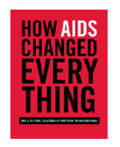
UNAIDS

Slide 4
Adults and children estimated to be living with HIV  2014
Eastern Europe
& Central Asia
1.5 million
[1.3 million – 1.8 million]
North America and Western and Central Europe
2.4 million
[1.5 million – 3.5 million]
Middle East & North Africa
240 000
[150 000 – 320 000]
Caribbean
280 000
[210 000 – 340 000]
Asia and the Pacific
5.0 million
[4.5 million – 5.6 million]
Latin America
1.7 million
[1.4 million – 2.0 million]
Sub-Saharan Africa
25.8 million
[24.0 million – 28.7 million]
Total: 36.9 million [34.3 million – 41.4 million]

Slide 5
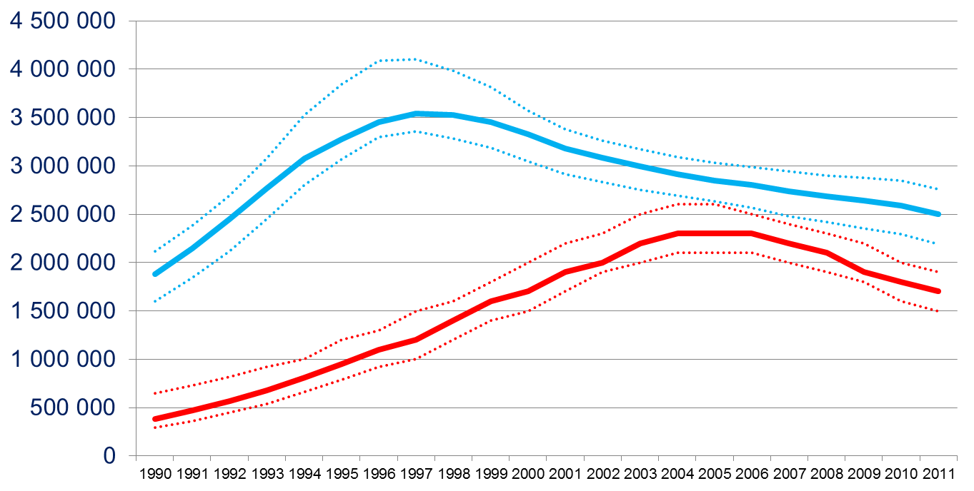
New HIV infections and AIDS-related deaths
Globally, new HIV infections peaked in 1997
New HIV infections
AIDS-related deaths
Notes:
AIDS-related deaths
HIV: 2.5 million infections/year → 7000/day; 1.7 million deaths per year
TB
2010: 8.8 million new TB cases, 1.4 million deaths
Malaria:
2010: 216 million cases; 655,000 deaths
ths peaked later: 2004-2005
2014: 2 million cases
1.2 million deaths

Slide 6
Global estimates for adults and children  2014
People living with HIV 36.9 million [34.3 million – 41.4 million]
New HIV infections in 2014 2.0 million [1.9 million – 2.2 million]
Deaths due to AIDS in 2014 1.2 million [980 000 – 1.6 million]

Slide 7
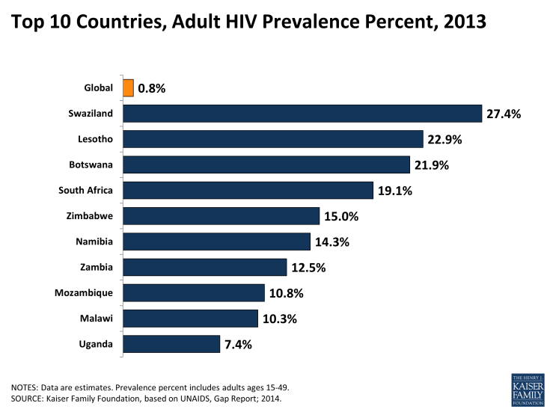

Slide 8
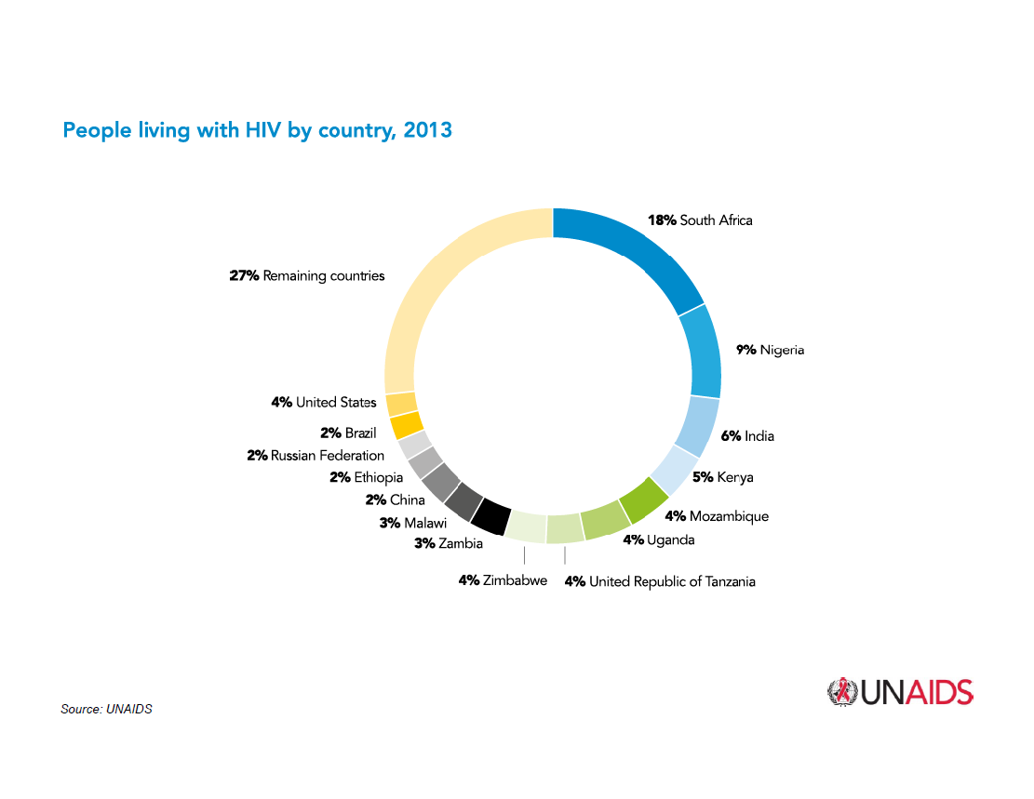

Slide 9
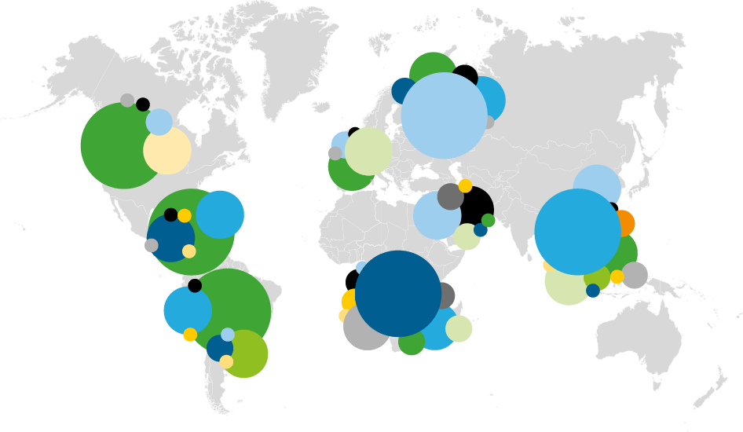


Slide 10
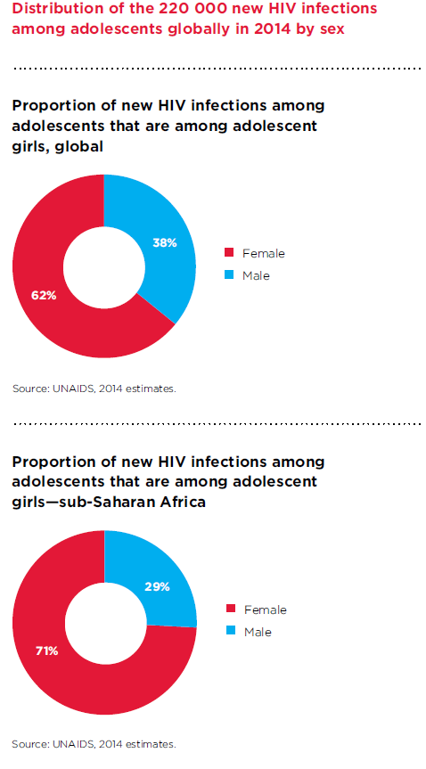
Women represent 60% of all people living with HIV in sub-Saharan Africa
Young people, ages 15-24, account for 30% of new HIV infections
Young women have a much higher risk of acquiring HIV than young men
Notes:
Girls at increased risk due to early sexual debut, early marriage and sexual violence, immature cervix

Slide 11
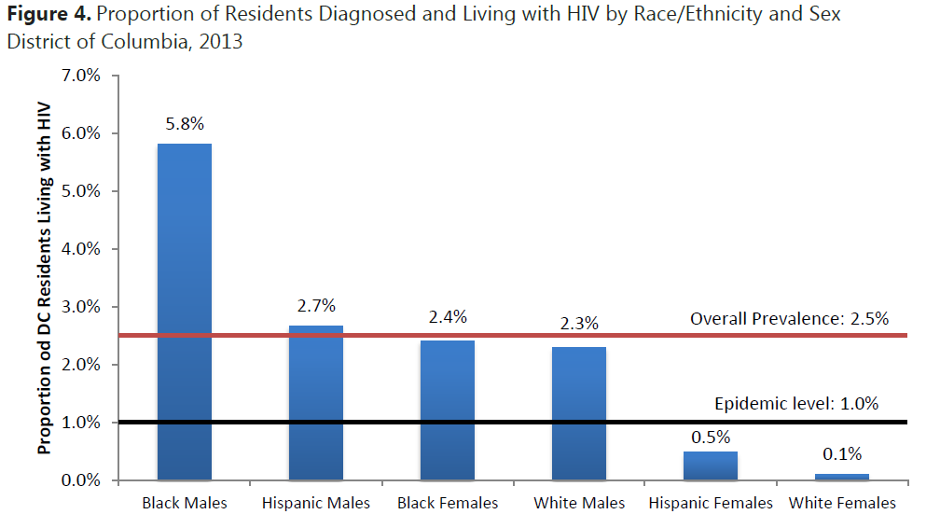

Slide 12
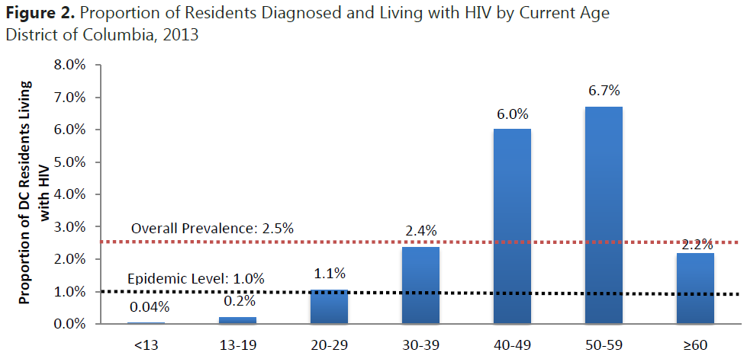

Slide 13
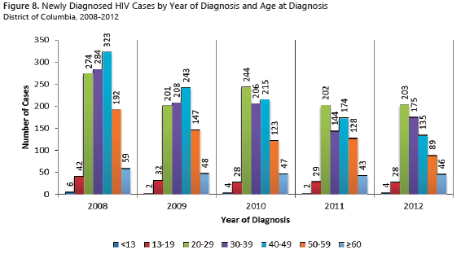

Slide 14
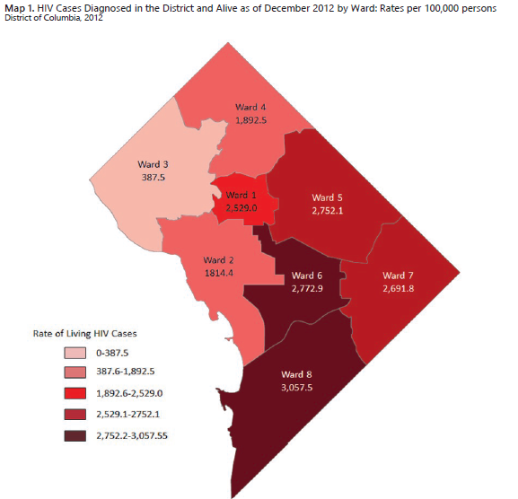

Slide 15
Children (<15 years) estimated to be living with HIV2013
Eastern Europe & Central Asia
14 000
[13 000 – 14 000]
North America and Western and Central Europe
2800
[2300 – 3600]
Middle East & North Africa
16 000
[11 000 – 22 000]
Caribbean
17 000
[14 000 – 20 000]
Asia and the Pacific
210 000
[190 000– 270 000]
Latin America
35 000
[27 000 – 54 000]
Sub-Saharan Africa
2.9 million
[2.6 million – 3.2 million]
Total: 3.2 million [2.9 million – 3.5 million]

Slide 16
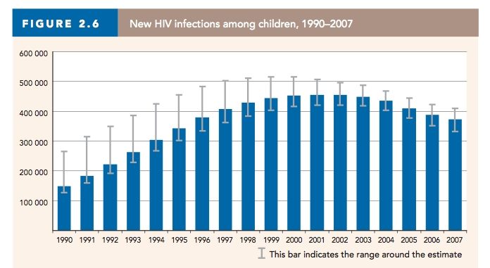
New HIV infections in children, 1990-2007
Global trend
Notes:
So you can appreciate the regional versus the global context of these numbers, I’m going to use my experience in Lesotho as a comparison for our experience here in DC.
Population of united states – 330 million
Population of dc – 600,000
Population of lesotho – 2 million

Slide 17
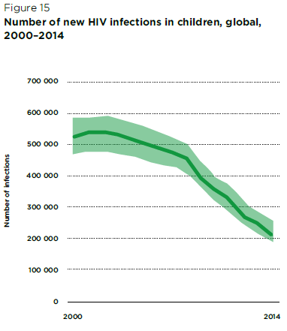

Slide 18
2013 global HIV and AIDS estimates
Children (<15 years)
Children living with HIV 3.2 million [2.9 million – 3.5 million]
New HIV infections in 2013 240 000 [210 000 – 280 000]
Deaths due to AIDS in 2013 190 000 [170 000 – 220 000]

Slide 19
About 5,600 new HIV infections a day in 2014
About 66% are in Sub Saharan Africa
About 600 are in children under 15 years of age
About 5,000 are in adults aged 15 years and older, of whom:
  ─ almost 48% are among women
  ─ about 30% are among young people (15-24)

Slide 20
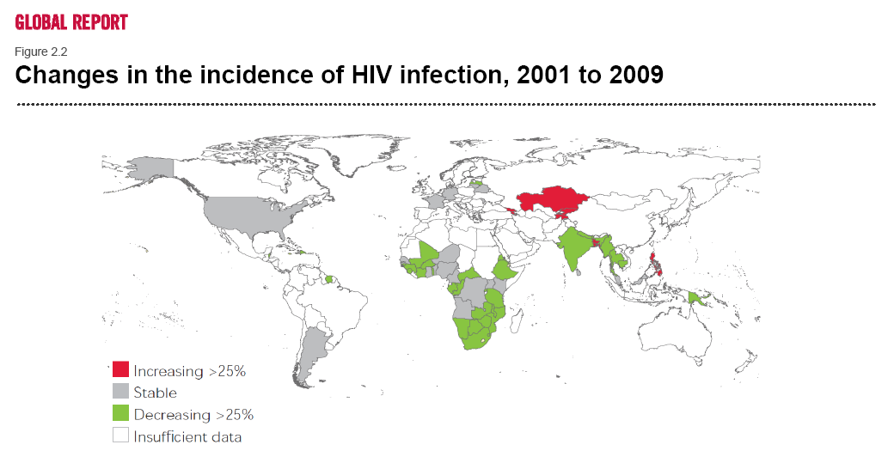
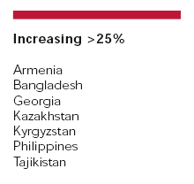

Notes:
With increase access to treatment, testing, prevention efforts, availability of antiretroviral treatment
United States – stabilized – 50,000 new infections/year

Slide 21
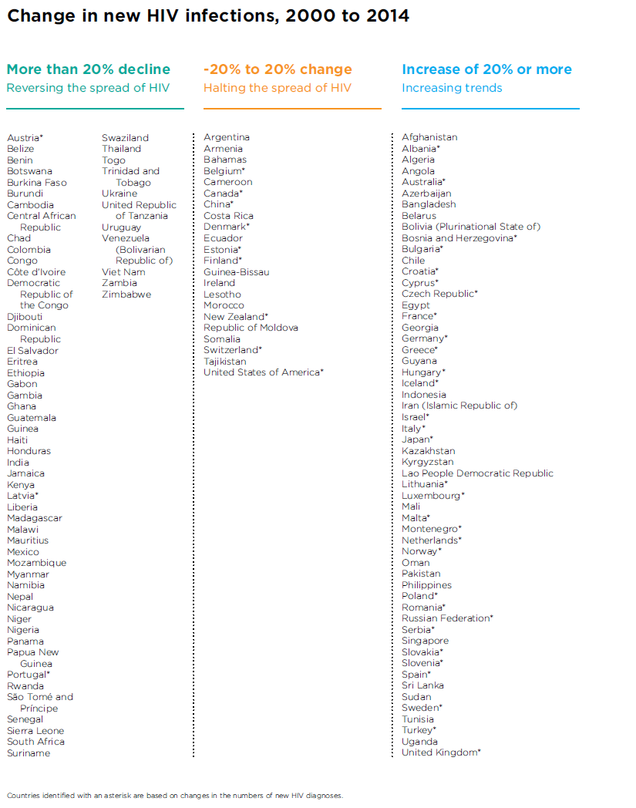

Slide 22
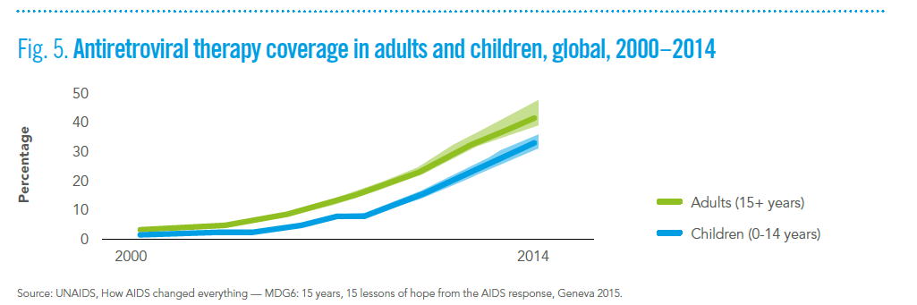

Slide 23
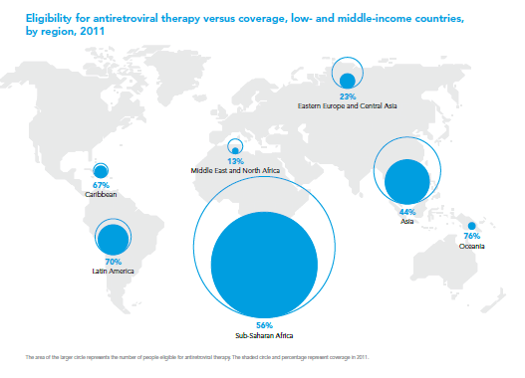
Notes:
Treatment as prevention!
Why do you think those who are eligible for ARV treatment are not accessing / getting it?
Testing, linkage to care, retention in care
Study in South Africa – people who received their CD4 result at the same time as they were diagnosed with HIV infection were twice as likely to start treatment within 3 months than those who had to wait an extra week to get the same results (10).
Faal M, etal. Providing immediate CD4 count results at HIV testing improves ART initiation. Journal of Acquired Immune Deficiency Syndromes, 2011, 58;e54-e59
Estimated need: 14.6 million
90-90-90: 90% of people living with HIV knowing their HIV status; 90% of people who know their HIV-positive status on treatment; and 90% of people on treatment with suppressed viral loads.
June 2014: 13.6 million with access to ARVs,
Treatment gap for children

Slide 24
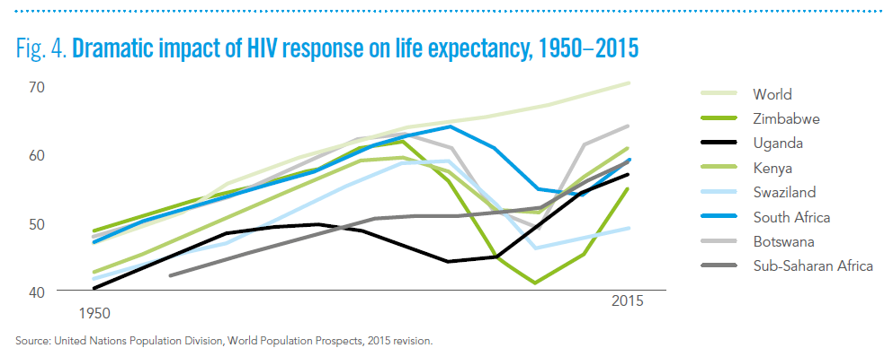

Slide 25
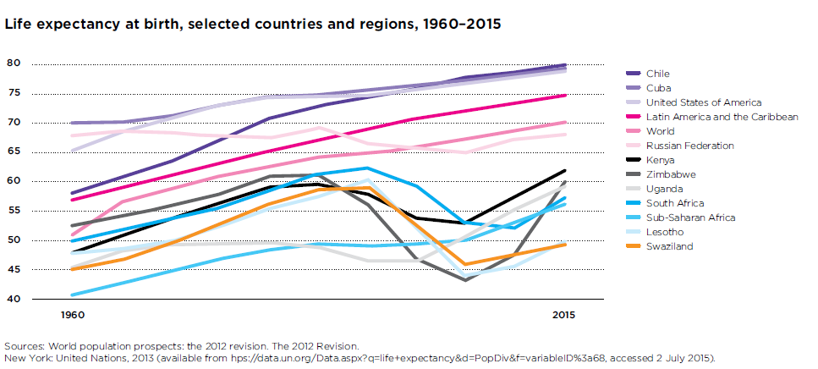

Slide 26
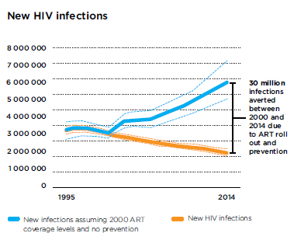
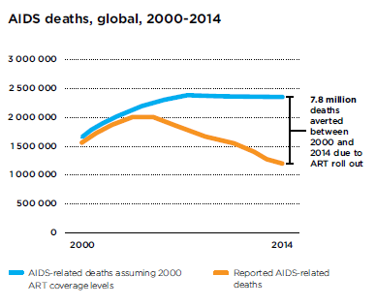

Slide 27
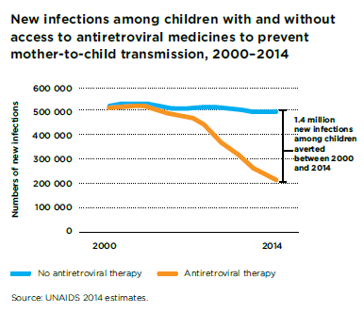

Slide 28
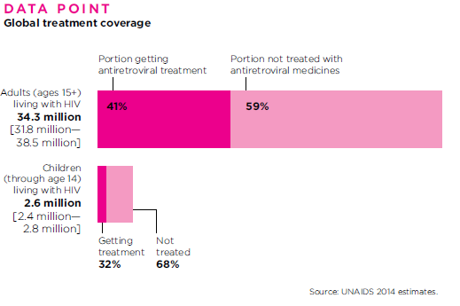

Slide 29
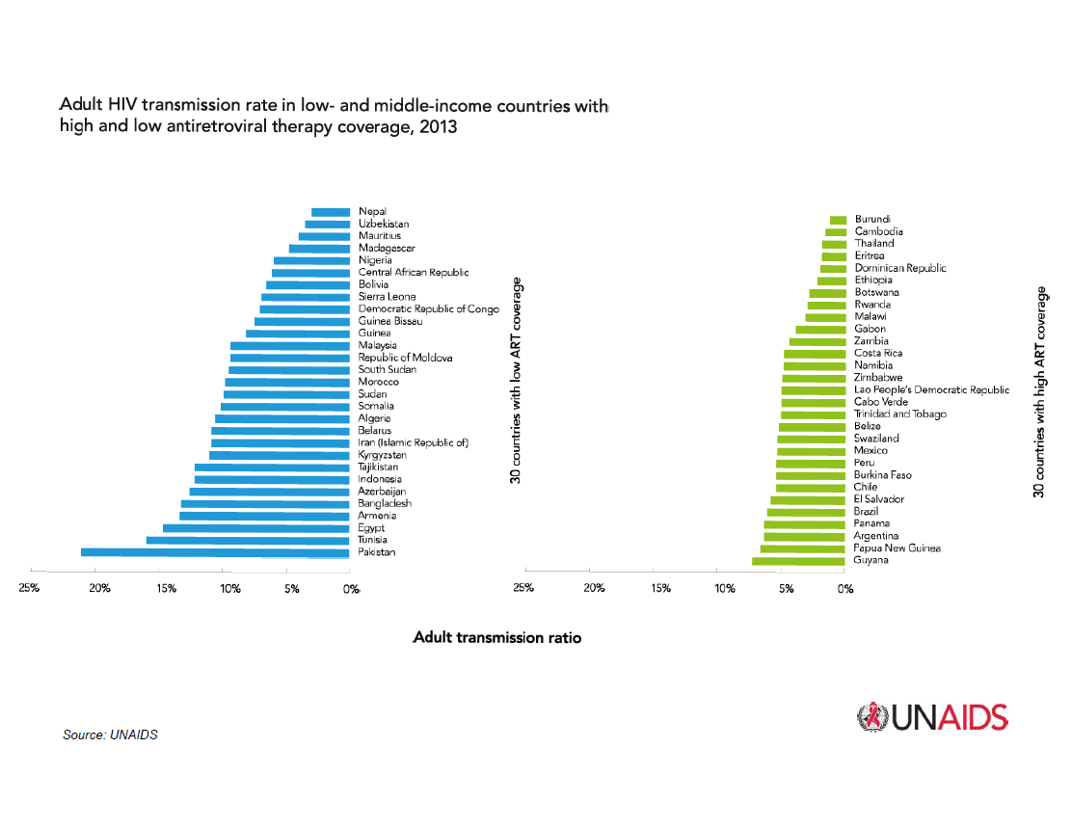
Notes:
Ultimately perinatal transmission is a function of adult transmission
Public health perspective – ARVs will decrease overall transmission – from adult to adult, eventually mother to child

Slide 30
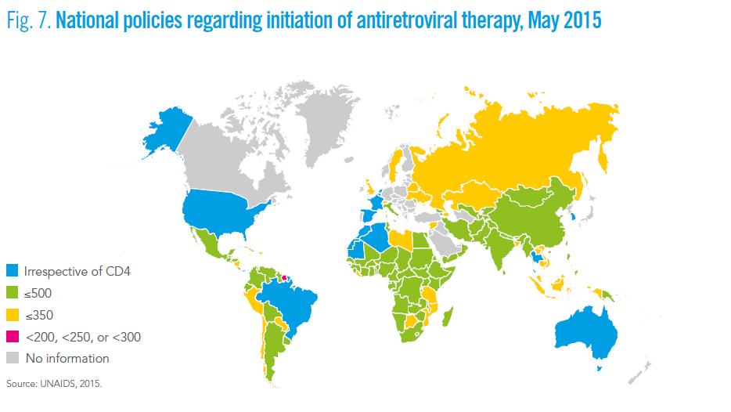

Slide 31
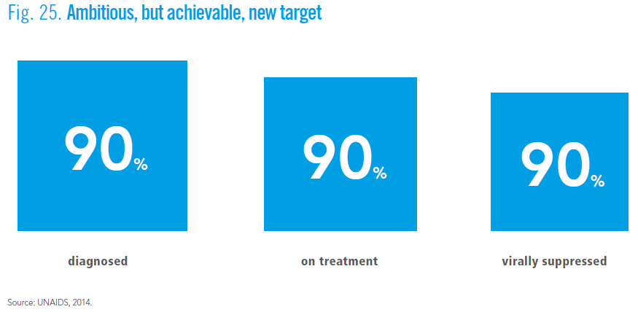

Slide 32
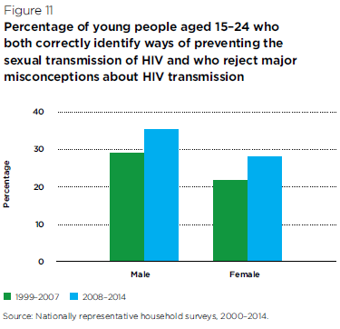

Slide 33
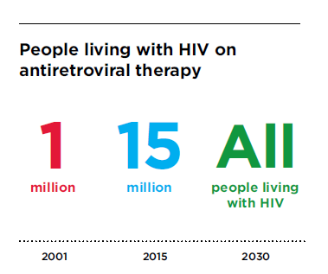
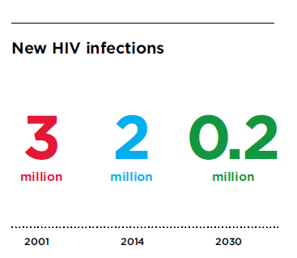
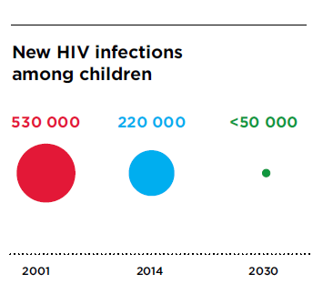
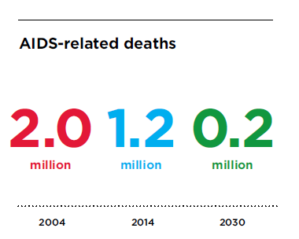

Slide 34
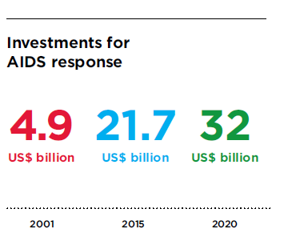

Slide 35
Graphics recap
36 million + globally
2.5 million + children
Epidemic differs in different regions
Some prevalence rates as high as 25%
Females predominate in the highest burden settings
Children and youth bear a significant burden (30% of new)
15 million receiving ART
Treatment gap btw adult ART (41%) and children (32%)
90 diagnosed – 90 treated – 90 suppressed

Slide 36
HIV -2 Infection
Clinical features
    spectrum of illnesses similar to HIV-1
    slower rate of progression (time to AIDS 20-30 years)
    lower viral loads
    lower rate of diversity
    slower CD4 decline
    lower level of immune activation
Diagnostics
    commercial assays combine HIV-1 and HIV-2 antigens
    Specific assays exist for HIV-2 Western Blot and viral load
Location
    Western Africa: Guineau bissau, Liberia, Sierra Leone, Angola, Mozambique, Brazil, India

Slide 37
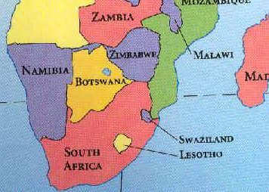
Lesotho
Size: 12,000 sq miles (Maryland + Delaware)
Population: 1.8 million
Infant mortality: 53.4 / 1000 live births (2012 est.)
GNI per capita: 1,340 USD / year
Health expenditure per person: 184 USD / year
Adult HIV Prevalence: 23%
Prevalence in pregnant women: 27.7%
TB/HIV co-infection rate: ~80% TB patients are HIV infected
# HIV infected children: 37,000 (est.)
Notes:
GNI
Lesotho 2000
US 50000
Malawi 700
Mexico 9600
Honduras 2100
Thailand 5200
Philippines 2500
health expenditure per person
world 1000
lesotho 184
mexico 800
us 8000
Thailand 330
pakistan 30
Size of Maryland – 12,000 sq miles

Slide 38
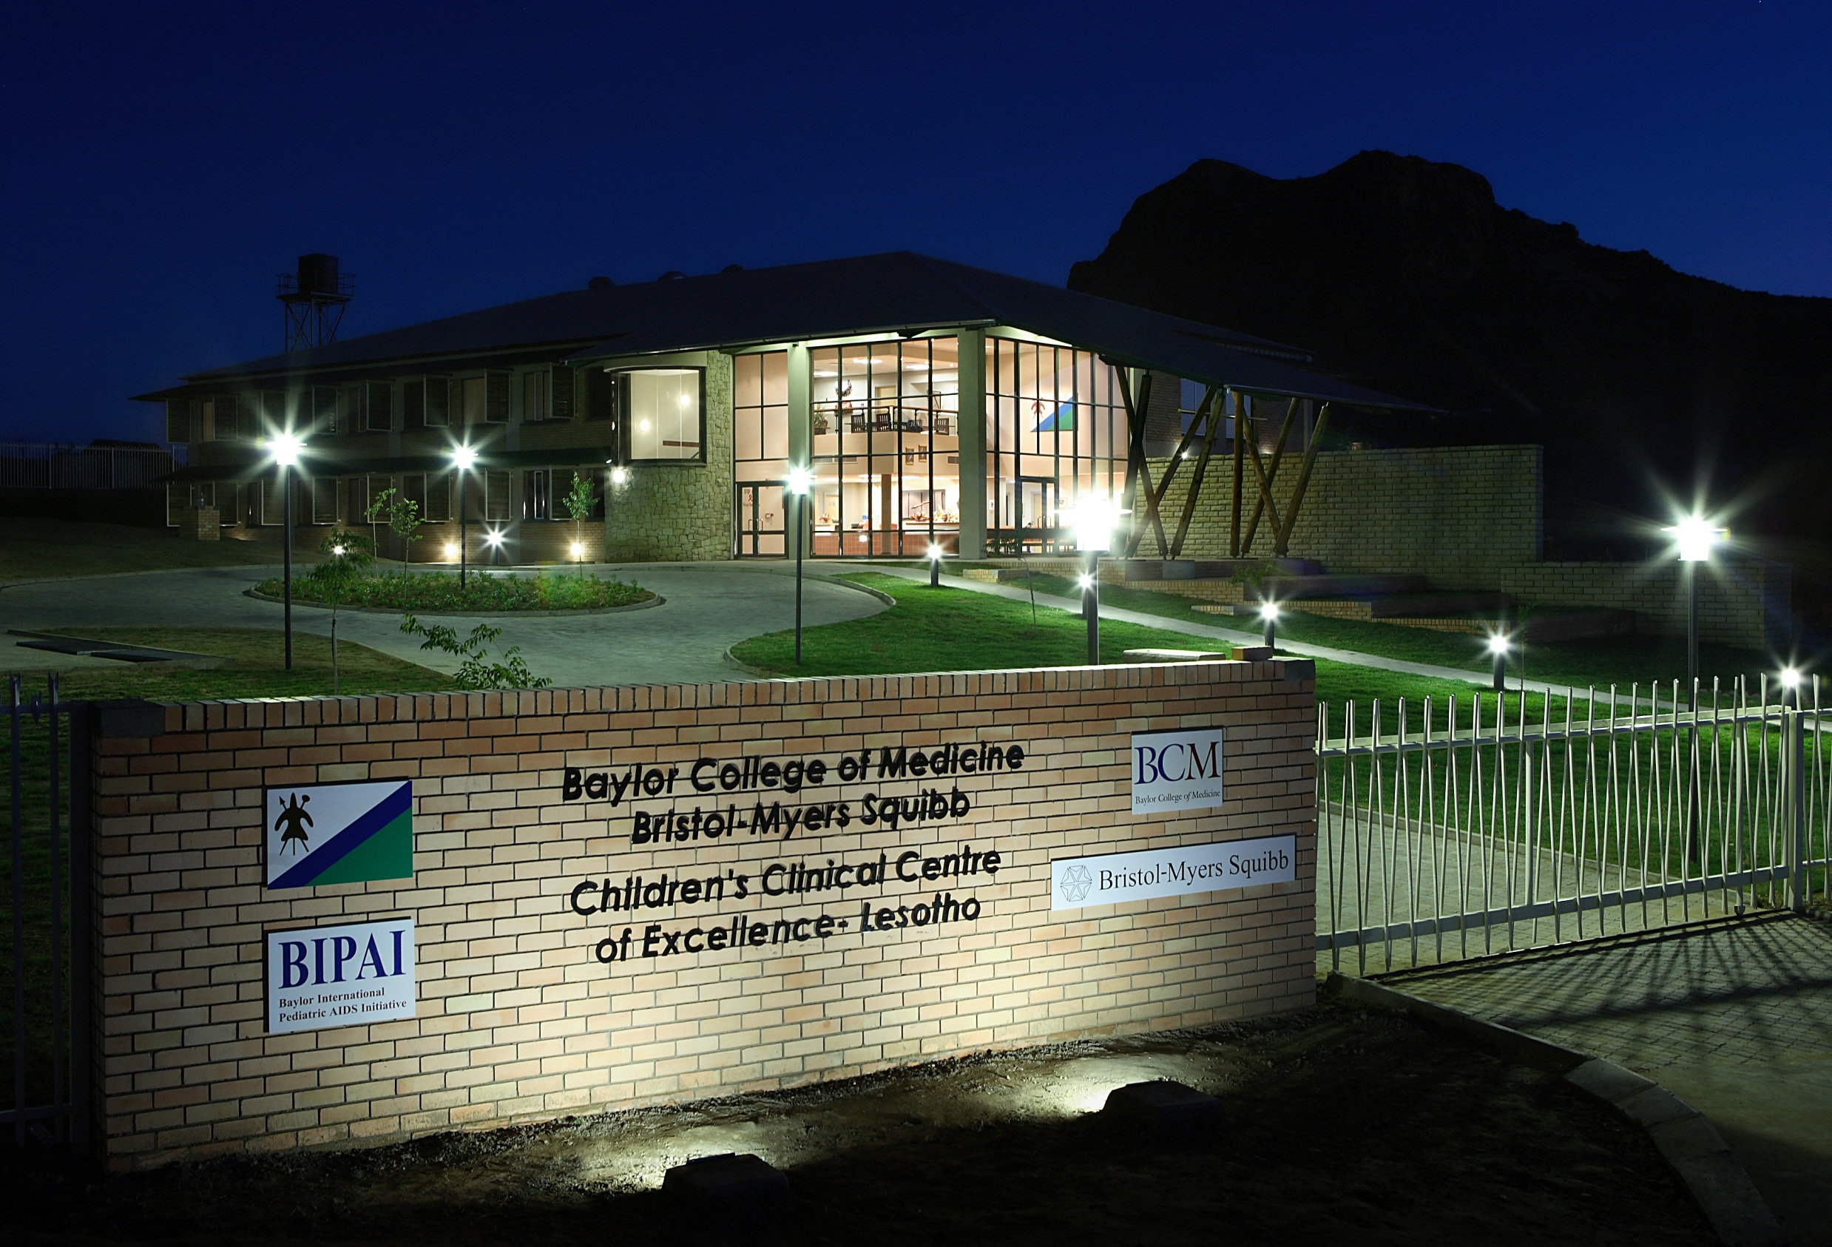

Slide 39
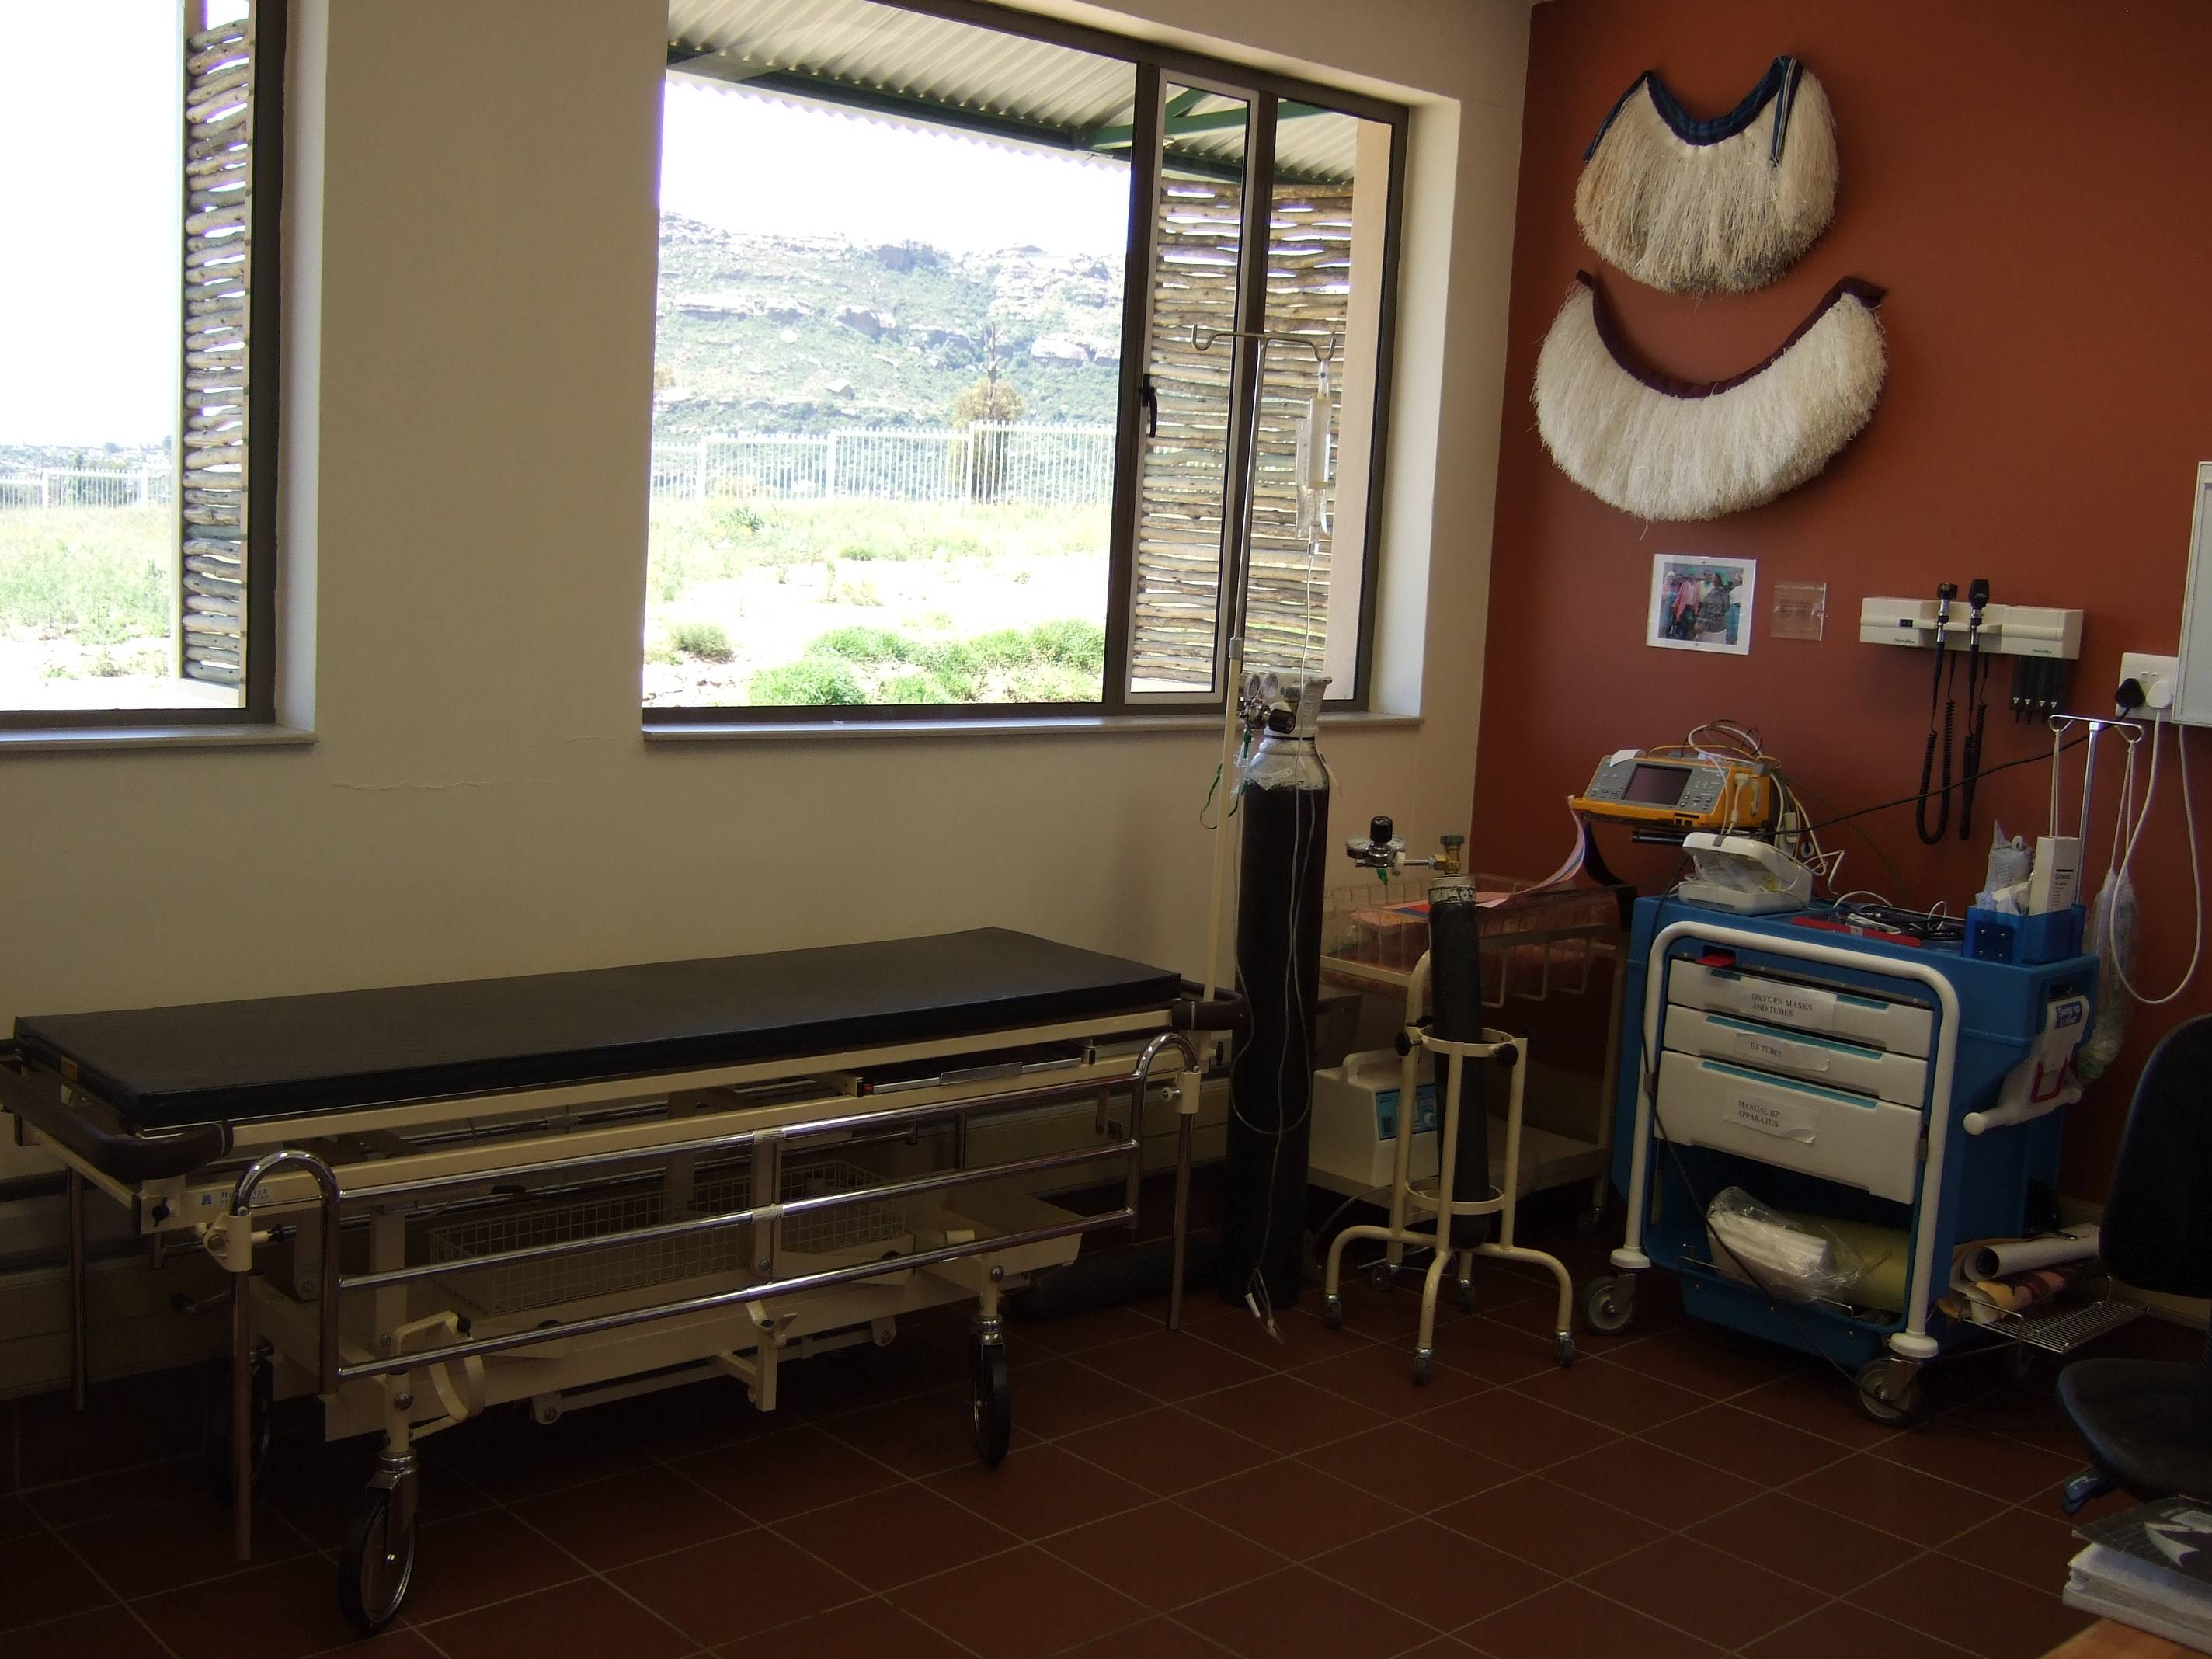

Slide 40
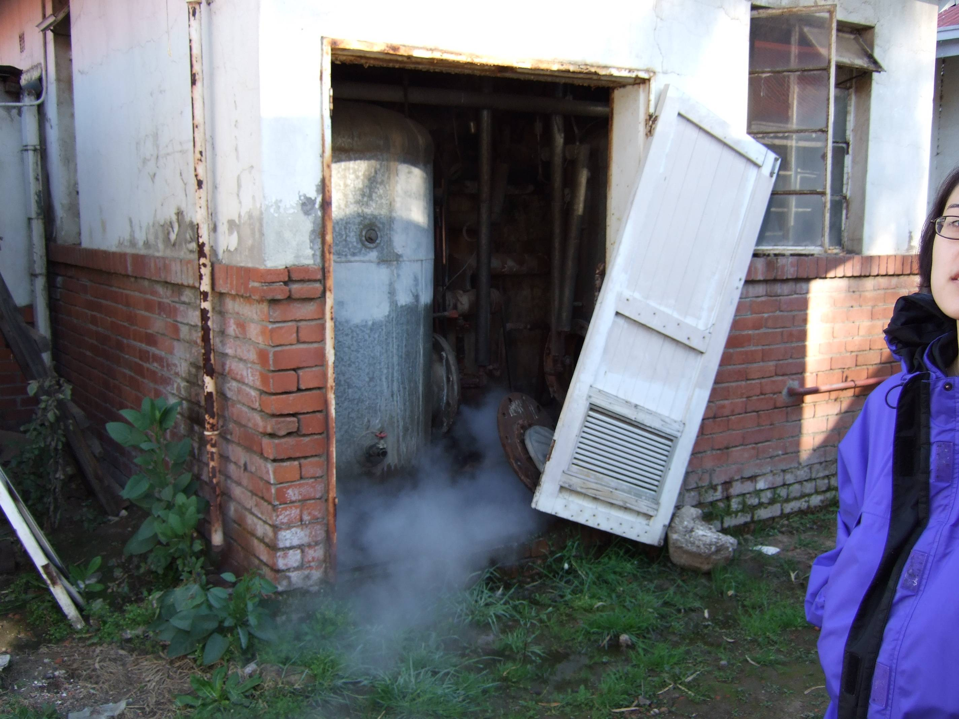

Slide 41
Why is it important to diagnose infants early?
Mortality Rates for Untreated
HIV Infected Children
Faster progression in infants vs. adults
At 1 year | 35.2%
At 2 year | 52.5%
At 5 year | 66 – 75%
At 10 years | 85%
Notes:
41
Progression of disease differs in Children and 3 distinct groups have been identified.

Slide 42
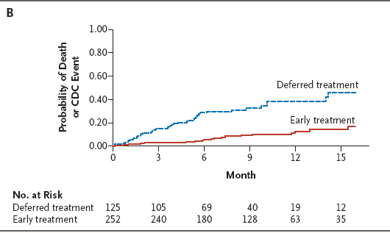
How do infected children do if we do nothing?
Children with HIV Early Antiretroviral Therapy (CHER) study; Violari et al, NEJM 2008
Notes:
Antiretroviral therapy initiated during the first 7 weeks of life reduced early mortality from 16% to 4% as compared to initiating treatment according to a threshold CD4 percentage or clinical progression of HIV disease. This is a relative reduction of 76%

Slide 43
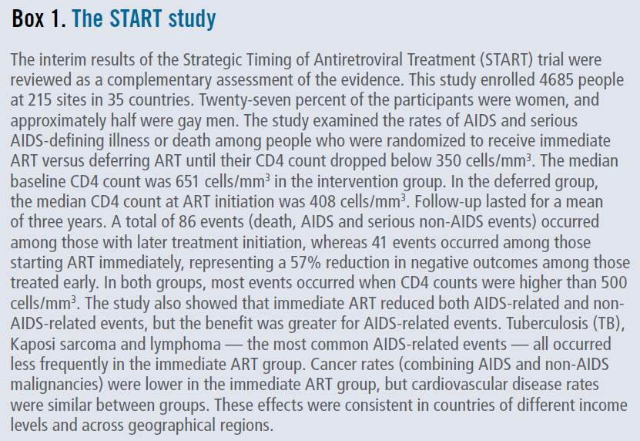
57% reduction in negative outcomes among those treated early

Slide 44
Natural Progression of HIV in Adults
Acute Clinical Syndrome
Clinical latency
Overt AIDS
Viral Load CD4 cell
level
1-12 weeks
6-10 years
1-2 years

Slide 45
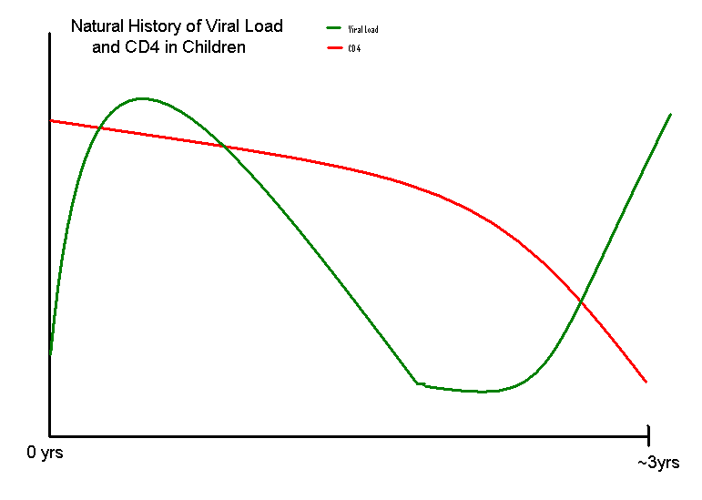
Notes:
Infant’s viral load at time of birth tends to be much higher than adults at time of infection. Infants usually peak at 2-3months at levels >100,000 and will slowly trend down to a set point at about 2-3yrs of age (for those who are going to be slow progressors). If a child is a rapid progressor then the viral set point will not be achieved and the curve will just continue to increase rapidly.
CD4 absolute levels in children are much higher than adults at time of birth and will slowly normalize to adult levels by 6yrs of age if patient is not infected. With concomitant infection, the rate of fall will be much faster and will also depend if child is rapid/slow progressor.

Slide 46
AFTER HIV enters the body...

Slide 47
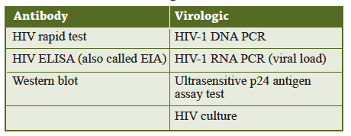

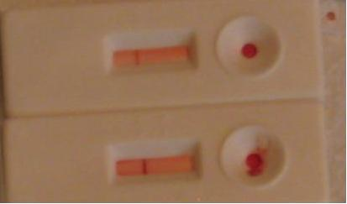
Common HIV Diagnostic Tests
Notes:
Samples of rapid tests

Slide 48
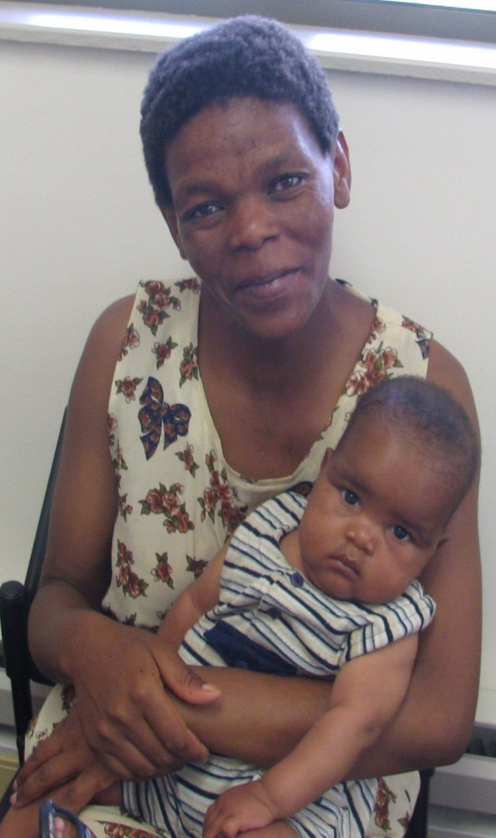

Diagnosis of HIV in Children
Tools to diagnose HIV
  HIV-1 Rapid test (antibody test)
    1st, 2nd, 3rd, 4th generation
    Oral test vs. serum
    Window period ~ 6 weeks
  HIV-1 DNA or RNA PCR (virologic test)
    Window period ~ 6 weeks
  clinical exam
Notes:
48
Window Period: inability to detect HIV during early infection
1st generation ELISA assays: 2.1 months
2nd generation : 6 weeks
3rd generation: 22 days
4th generation (+ antigen detection): 16 days
Nucleic acid testing (NAAT): 12 days
Can take up to 6 months to develop HIV antibody; most develop Ab by 6 weeks, almost all by 3 months
Antibody test
ELISA – 6 months
rapid test – 3 months (6 weeks)
Virological test (NAT): 1 month (4-6 weeks)

Slide 49
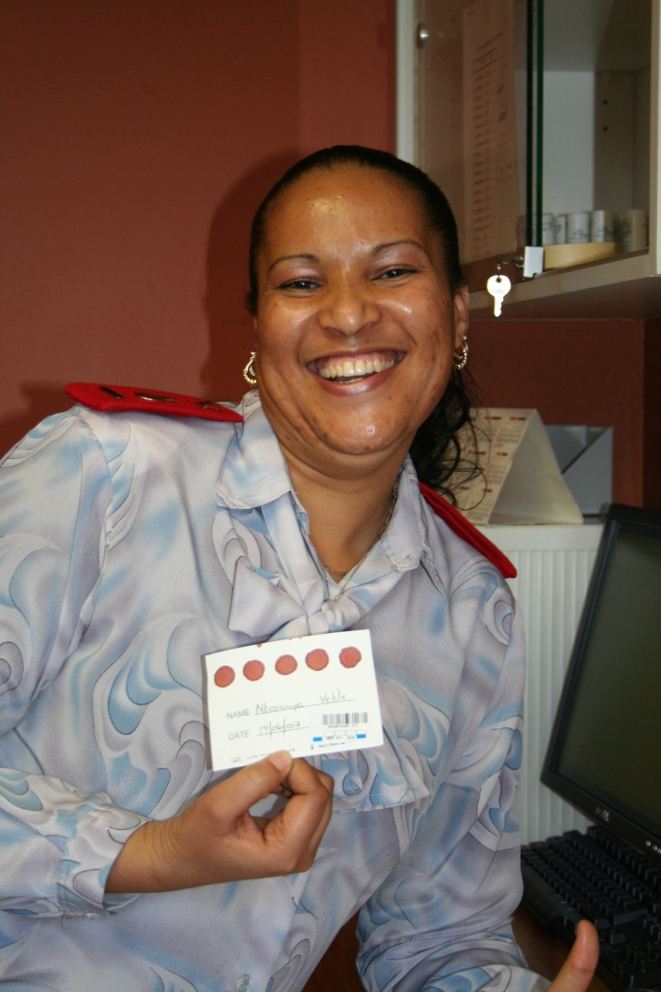
DNA PCR: Infant Diagnosis
Dried Blood Spot (DBS) DNA PCR – gold standard
Excellent sensitivity after 1 month of age
Testing is performed
  At 4- 6 weeks of age
  First visit in children <18 months
  To confirm a positive rapid test at 9 months of age

Slide 50
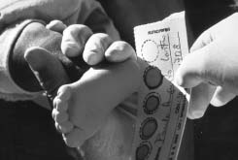
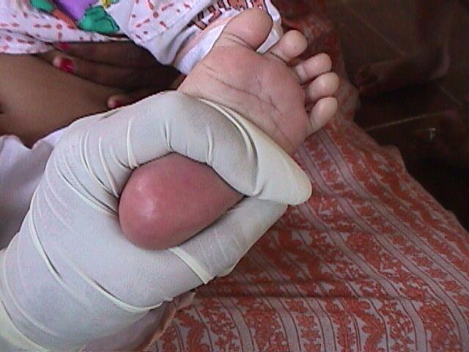
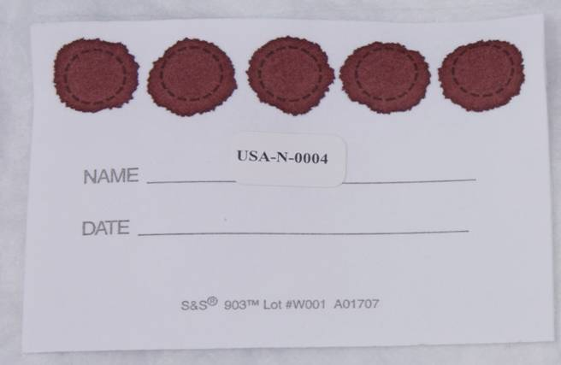

Slide 51
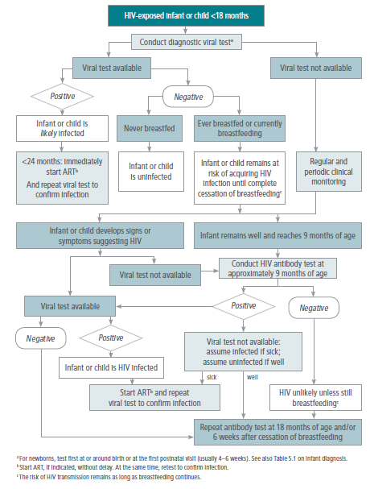

Slide 52
Pediatric HIV – Diagnosis Cases
4 month old female, well appearing, brought to clinic by sister
  HIV rapid test – positive
  HIV DNA PCR – positive
7 month old male, well appearing, brought to clinic by HIV-positive mother, not breastfed
  HIV DNA PCR - negative
5 month old female, well appearing, brought to clinic by HIV-positive mother, HIV DNA PCR negative at 1 month, still being breastfed
  HIV rapid test at 9 months of age – positive
  HIV DNA PCR – negative
  What if PCR not available?
    If sick – start ART and repeat viral test
    If well – repeat antibody test @ 18 mo or 6 weeks after cessation of breastfeeding

Slide 53
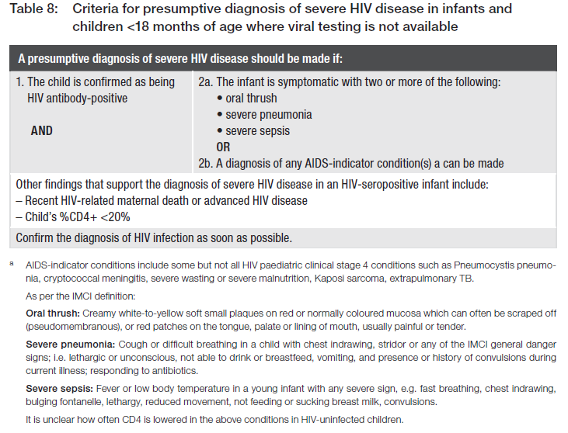
Notes:
53
AIDS indicator: stage 4, PCP, cryptococcal meningitis, HIV wasting, KS, extrapulmonary TB.

Slide 54
If HIV positive,
  Assess age
  Clinically evaluate and stage
  Immunologically evaluate (check CD4)
  Give co-trimoxazole prophylaxis
  Treat acute and opportunistic infections
  After adherence counseling, initiate ART if indicated

Slide 55
HIV Infection in Children
CD4 counts vary with age in children
CDC/WHO have developed classifications based on Clinical and Immunological Staging

Slide 56
WHO Immunologic Staging for Paediatric HIV Infection
Classification of HIV-Associated Immunodeficiency | < 11 Months (%) | 12-35 Months (%) | 36-59 Months (%) | ≥ 5 Years (cells/mm³)
Not significant | > 35 | > 30 | > 25 | > 500
Mild | 30-35 | 25-30 | 20-25 | 350-499
Advanced | 25-30 | 20-25 | 15-20 | 200-349
Severe | <25 | <20 | <15 | <200 or <15%
Notes:
Eligible to start arvs
All < 1 year of age
Age 2-5: < 25% or 750

Slide 57
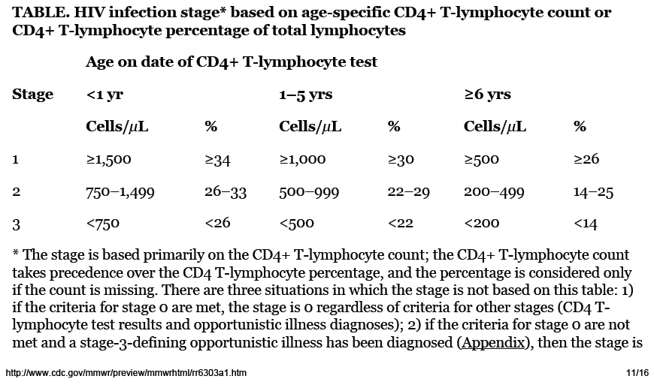

Slide 58


Slide 59



Slide 60
Common Presenting Features of HIV in the First Year of Life
Oral candidiasis (may also be a normal finding in young infants)
Lymphadenopathy
Hepatosplenomegaly
Growth failure or failure to thrive
Developmental delay
Notes:
80% of infants who looked well at 6 weeks needed arvs by 5-6 months.
No clinical algorithm that is highly sens/specific for infants
60

Slide 61


Slide 62
WHO Clinical Stage 1
Persistent Generalized Lymphadenopathy (PGL)
  >1cm lymph nodes, inguinal, axillary, submandibular
Notes:
Persistent swollen or enlarge lymph nodes >1 cm at 2+ non-contiguous sites, excluding inguinal, without known cause
62

Slide 63

Unexplained persistent hepatomegaly
3 yo M, not taking any medications, with a protuberant abdomen on exam, and liver palpated 7 cm below right costal margin.
Dx: Enlarged liver and spleen without obvious cause.
Photo by Dr. Julia Kim

Slide 64

What is your diagnosis?
Clinical Stage?
Treatment?

Slide 65

Extensive molluscum contagiosum infection
  Severely immuno-compromised are prone to numerous and giant lesions > 1 cm
  Characterized as flesh colored, dome shaped papules 3-5 mm with a central core
  WHO Clinical stage 2
Diagnosis
  Clinical, KOH slide (large clear cells in clusters)
Treatment
  Antiretroviral therapy, Gentle curettage
  Less extensive lesions may resolve on their own
Photo by Dr. Julia Kim

Slide 66


Slide 67


Photo by Dr. Julia Kim
Photo by Dr. Julia Kim

Slide 68

Herpes Zoster
Dx by clinical, Tzank smear
TX: Acyclovir
Photo by Dr. Helga Loeffler

Slide 69


Superinfected Herpes Zoster

Slide 70

Papular Pruritic Eruption

Slide 71


Slide 72

Parotid enlargement

Slide 73

Oral Candidiasis
6 month old infant with decreased feeding and recurrent white coating of the mouth.
Photo by Dr. Julia Kim

Slide 74

Case
9 yo girl presented with a painless, enlarged, left femoral lymph node for 1 year.
What is the diagnosis?
What is the clinical stage?
What is the treatment?
Photo by Dr. Julia Kim

Slide 75
Lymph node tuberculosis
Diagnosis:
  Aspirate pus from lymph node
  Send for AFB stain and culture
  Stain revealed acid fast bacilli
Clinical Stage 3
Treatment: Anti-TB treatment for at least 6 months.

Slide 76


Photo by Dr. Julia Kim
Photo by Dr. Julia Kim
Right Supraclavicular Lymph node
Acid Fast Bacilli from LN aspirate

Slide 77


Slide 78


Slide 80


11 yo M, presents with these clinical findings of his hands and feet. He complains of coughing, difficulty breathing, shortness of breath with walking to school. Oxygen saturations are 88%.
What is this clinical finding?
Dx? Stage? Tx?
Photos by Dr. Helga Loeffler

Slide 81
Symptomatic Lymphocytic Interstitial Pneumonitis (LIP)
Usually in children >2 yo. (vs PCP usually <1 yo)
Associated with clubbing and parotid enlargement
O2 saturations: <90%, persistently.
CXR: bilateral reticulonodular interstitial pulmonary infiltrates present for more than 2 months with no response to antibiotic treatment and no other pathogen found. (R/O PNA, TB)
Treatment
  Antibiotics
  Beta-agonist (salbutamol)
  Steroids

Slide 82

Finger Clubbing in
Lymphocytic Interstitial Pneumonitis (LIP)

Slide 83

Severe Recurrent Bacterial Pneumonia

Slide 84

Case Scenario
9 yo F, recently diagnosed with HIV, returns for a follow-up visit to review her labs. She complains of bruising on her legs and gum bleeding. Her FBC shows platelets of 6.
What is her diagnosis? Clinical stage? Treatment?
Photo by Dr. Julia Kim

Slide 85
HIV-associated thrombocytopenia
WHO Clinical Stage 3
Unexplained anemia (<8 g/dl), neutropenia (<0.5 x 10^9/L) and/or chronic thrombocytopenia (<50 x 10^9/L)
Repeat FBC (but likely true value, since she is symptomatic with bruising/bleeding)
  Rule out other causes (medications, other infections, etc)
Start ARVS

Slide 86

Acute necrotizing ulcerative gingivitis or periodontitis
Noma, cancrum oris

Slide 87


Slide 88
Pneumocystis jiroveci pneumonia (PCP)
Fungus based on DNA analysis
By age 2-4 years, > 80% of children have acquired antibodies to PCP
Is often the first AIDS-defining illness in children
Is most commonly seen in infants < 1 yr old
  Peaks at age 3 – 6 months of age
  Decline in infection rate in HAART era
    25 cases per 1000 HIV infected children 1994 → 6 in 2001
    95% decline in PCP
Most common cause of death in HIV-infected babies
Notes:
Name changed in 1999
Mortality 60% if resp failure is present
Immunocompetent infants – asymptomatic or mild respiratory symptoms
Median age for PCP between 6 to 9 months of age

Slide 89

Severe Acute Malnutrition
Notes:
89

Slide 90


Slide 91


Oedematous malnutrition (Kwashiorkor)
Notes:
91

Slide 92

16 month old with these lesions noted on exam. Lesions appeared 2 months ago. After 1 month, she developed swelling of the left leg.
Dx? Stage? Tx?
Notes:
92
16 month old female, presumed HIV positive by 2 rapid tests.
First visit 27/9 with thrush, gastro, pneumo.
Mild malnutrition, 85% wt for ht, wt 8.4 kg
Labs: CD4 388 (12.4%)
24/10:1 month later, start ARVS: d4T, 3TC, NVP. D4T started due to anemia.
Rash, followed LFTS, stabilized.
Complex social situation: mother and child positive, father is negative, when in past father was being blamed for being promiscuous. Now PGM does not know that father is negative. PGM is not on good terms with mother, and if she finds out that father is negative and mother and baby are positive, then she will likely not take care of child.
20/11 right buttock, arms, leg, scalp, purplish 0.5-1cm, nodular, firm lesions
5/12 – referred to MGH, who then referred to private hospital in joberg, Safrica
Called Nomvoyo on Saturday evening due to concern for running out of meds.
11/1- father came in to refill ARVs, pending biopsy, pt started on systemic chemotherapy, inpatient for 6 months (per father). How will we provide ARVs and follow up?
d/w doctors. She will instead receive systemic chemo every 4 weeks, to allow her to come to clinic for f/u and receive ARVs. Pending full report. Pt started to have swelling and lymphedema over right leg, indicating rapid progression and obstruction of the lymphatic system. Thus used combo treatment.
Combo CTX: adriamycin (heart), bleomycin (lungs), and vincristine (brain) – received 1 course of chemo.
Literature:
Maternal fetal transmission of HHV8
Can spread to lungs
Mucous membrane, skin, lung, viscera, GI tract
Evaluation
Biopsy, scope (bronch/endo), ultrasound/CT
Case reports: 6 month old, 6 week old
Lesions started at 6 months up to 30 month in Tanzania – used CT to follow lung lesions
TX:
HAART – decrease in KS by 50 % alone
Kaletra protease inhibitors with anti-neoplastic qualities
CHEMO - If no decrease in number of lesions, progresses quickly, use chemo
Local (radiation, intralesional, cryotherapy- especially for cosmetic, on face, topical retinoids)
Systemic – single, combination (combo ABV in literature reported q2wks)
Liposomal – new targeted meds to the tumor sites.
At MGH –
Tuesday at MGH is KS clinic, run by the Italian doctors.

Slide 93




Photos by Dr. Julia Kim

Slide 94

Kovarik, Carrie
Mar 2007, “The Challenges of
Diagnosis and Treatment of Dermatologic Disease in the Pediatric HIV Population within Resource Limited Settings”

Slide 95


Kaposi’s sarcoma
ANECCA Photo graphic Album
Contributed by Dr. Robert Lee

Slide 96



Slide 97
Kaposi Sarcoma
Vascular tumor. HHV-8 associated.
Case reports of starting as early as 6 weeks.
Mostly on skin, mucosa (mouth), respiratory tract, lymph nodes. Can involve any organ.
Starts as macules or indurated papules/plaques, can become more nodular
Lower leg lesions can be associated with lymphedema.
Diagnosis: Clinically, Biopsy
Treatment: HAART (with protease inhibitor)
  Chemotherapy (vincristine, doxorubicin), cryotherapy, radiotherapy.

Slide 98

Diagnosis? Treatment?
13 month old is no longer able to sit up on his own, is not able to walk. Arms remain flexed. HC has not changed over the past several months.
Photo by Dr. Helga Loeffler

Slide 99
HIV Encephalopathy
At least 1 of the following progressing over at least 2 months in the absence of another illness:
  1. Failure to attain, or loss of dev milestones or loss of intellectual ability, OR
  2. Progressive impaired brain growth demonstrated by stagnation of head circumference, OR
  3. Acquired symmetrical motor deficit accompanied by 2 or more of the following: paresis, pathological reflexes, ataxia, and gait disturbances
Start ARVS

Slide 100


Diagnosis and Treatment?
Photo by Dr. Helga Loeffler
Photo by Dr. Carrie Kovarik

Slide 101


Infant presents with pruritic rash for 2 weeks.
Mother has same rash.
Photos by Dr. Julia Kim

Slide 102

Pentalogy of Cantrell
LINK
Omphalocele
Anterior diaphragmatic hernia
Sternal cleft
Ectopia cordis
Intracardiac defect (VSD or diverticulum of the left ventricle)
Notes:
Pentalogy of Cantrell
Omphalocele, Anterior diaphragmatic hernia , Sternal cleft ,Ectopia cordis ,Intracardiac defect: either a ventricular septal defect or a diverticulum of the left ventricle

Slide 103




Slide 104







Slide 105

Thank you!!!

Slide 106


Slide 107


