Slide 1
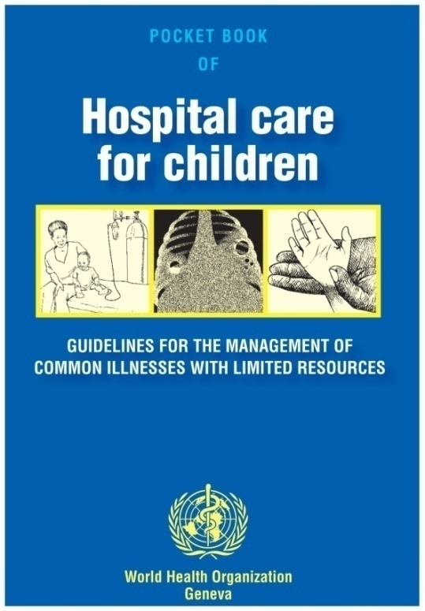
Diarrhea and Dehydration
Jennifer I Chapman, MD
Global Child Health Elective
October 12, 2015

Slide 2
Learning Objectives
Discuss comparative contribution of diarrheal illnesses to global childhood mortality
Formulate a treatment plan for acute dehydration resulting from diarrhea
Identify benefits and disadvantages of various oral rehydration fluids in the treatment of acute dehydration

Slide 3
Reflection exercise
  Think of a time you had an acute diarrheal illness
  Jot down the important transmission points related to this infection
  What factors and interventions led to your recovery

Slide 4
Fecal-oral transmission: ‘F diagram’
Fluids
Fields
Food
New
Host
Feces
Food
Flies
Fingers
“Feet”
Wagner and Lanois, 1958

Slide 5
Fecal-oral transmission: ‘F diagram’
WATER QUALITY
Fluids
SANITATION
Fields
Food
New
Host
Feces
Food
Flies
Fingers
HANDWASHING
Wagner and Lanois, 1958

Slide 6
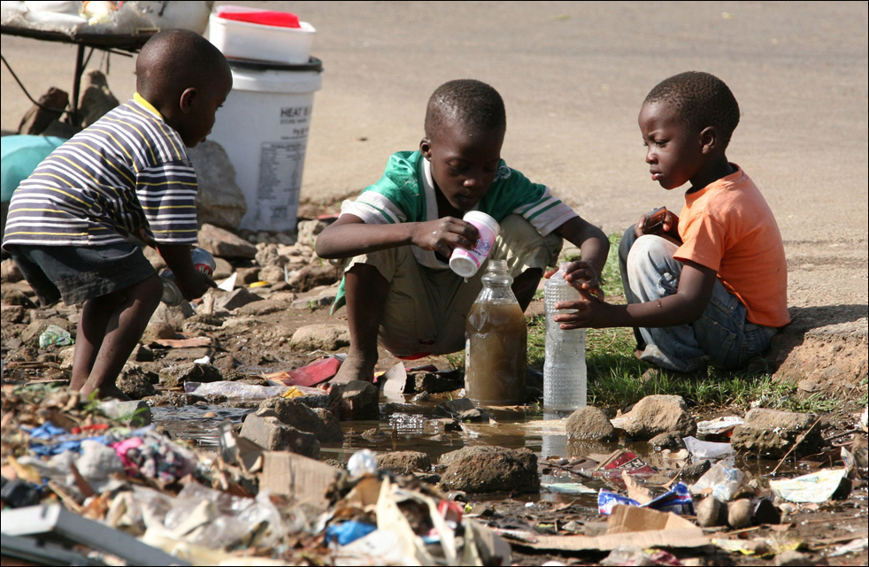
Dec 7, 2008 in Harare

Slide 7
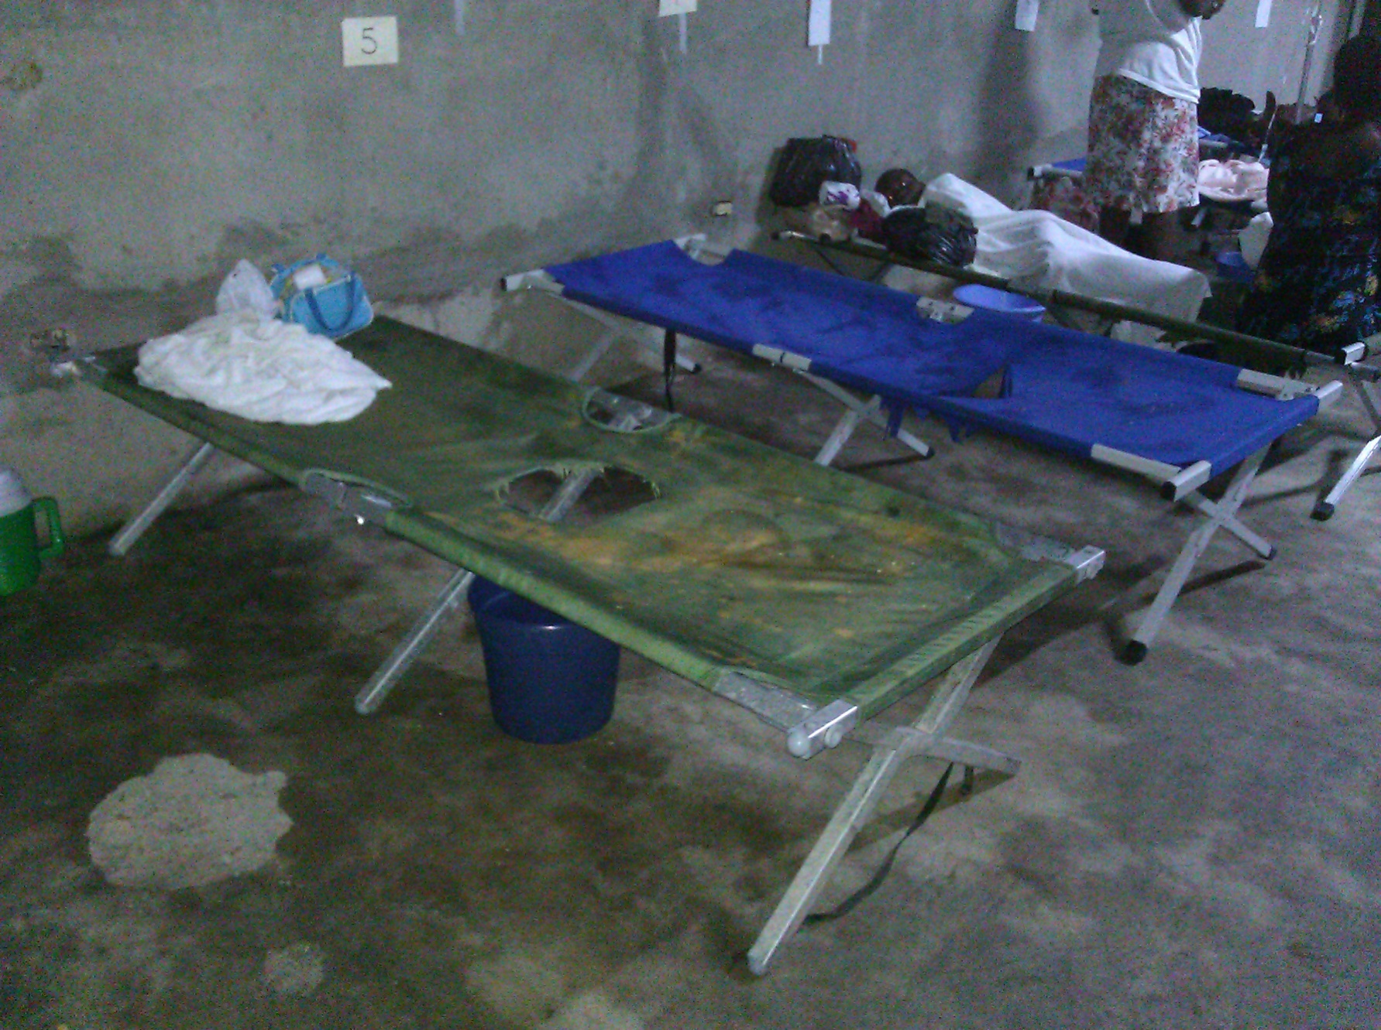
Milot, Haiti: cholera treatment unit

Slide 8
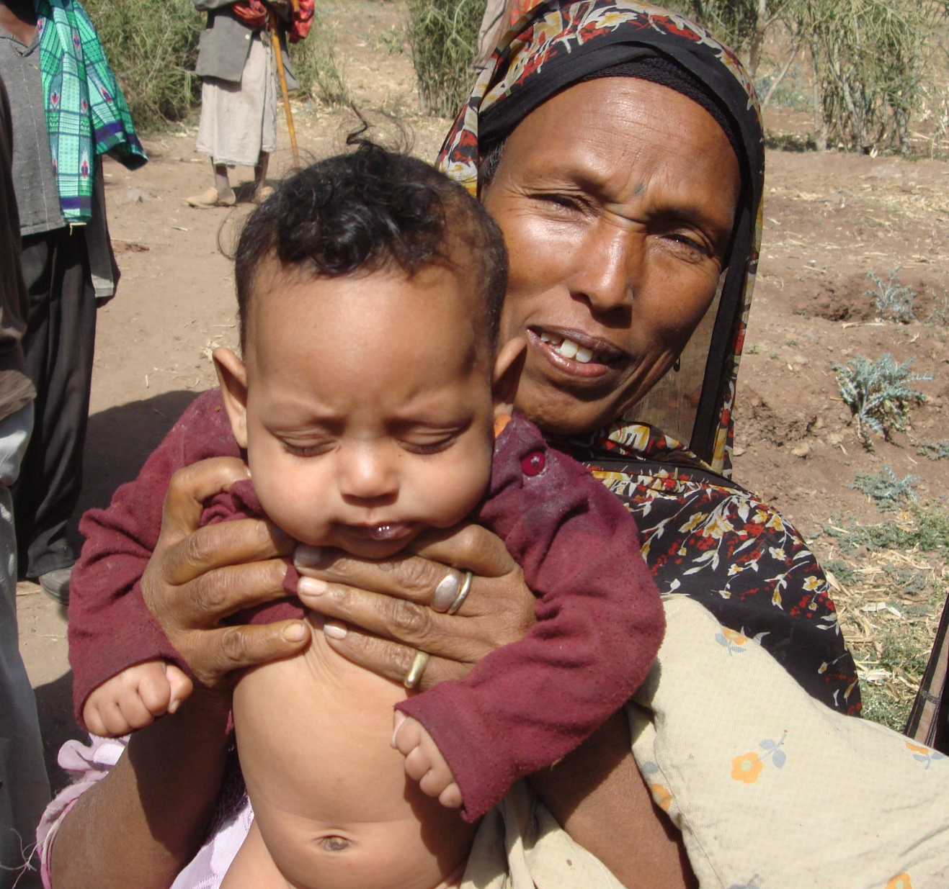
What Kills More Children Each Year?
Pneumonia
Malaria
Undernutrition
Diarrhea
HIV/AIDS

Slide 9
What Kills More Children Each Year?
Pneumonia
Malaria
Undernutrition
Diarrhea
HIV/AIDS

Slide 10
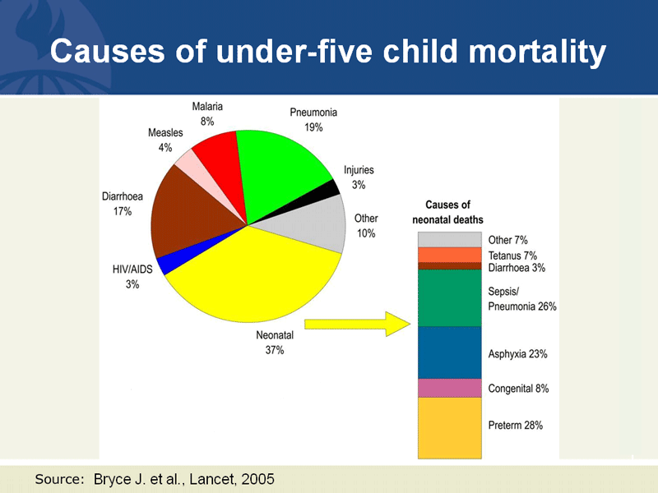

Slide 11
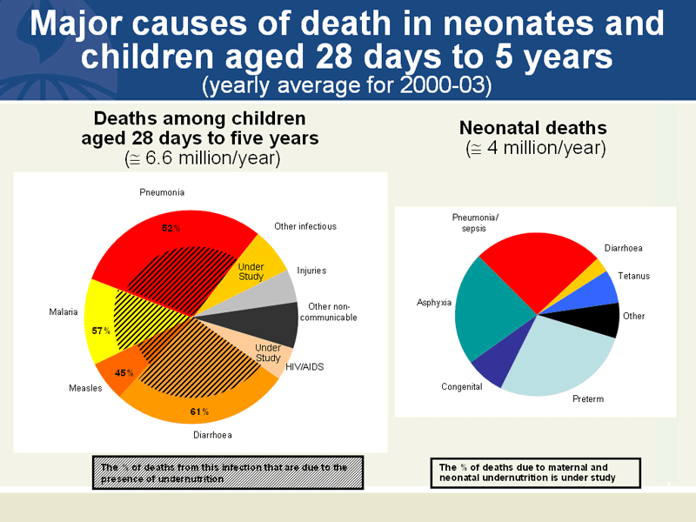
Malnutrition as underpinning cause of mortality

Slide 12
Poverty is “the single most important determinant of childhood death”
Diarrhea
Undernutrition
Notes:
This illustrates the vicious cycle between diarrhea and undernutrition, where children with diarrhea eat less, and are less able to absorb the nutrients from their food; and malnourished children are more susceptible to diarrhea when exposed to fecal material in the generally hygiene-challenged environments where they live.

Slide 13
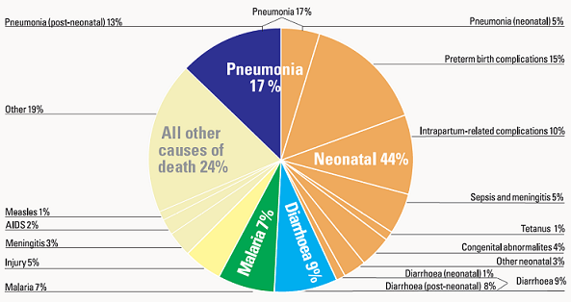
UNICEF: Committing to Child Survival: A Promise Renewed –
Progress Report 2013

Slide 14
2005
2013

Slide 15








Millennium Development Goals
Goal 1: Eradicate extreme hunger and poverty
Goal 2: Achieve universal primary education
Goal 3: Promote gender equality/ empower women
Goal 4: Reduce child mortality
  Target: Reduce by 2/3, between 1990 and 2015, the under-five mortality rate. (~13million/yr → ~4m/yr)
Goal 5: Improve maternal health
Goal 6: Combat HIV/AIDS, malaria, other diseases
Goal 7: Ensure environmental sustainability
Goal 8: Develop a global partnership for devlopmt

Slide 16
MDG 1: extreme poverty
World Bank report:
Number of people living on $1.25 per day halved between 1990-2010
Lancet “This week in medicine,” 379(9819), March 10-16, 2010

Slide 17
MDG 4: good news/sobering news
12.7m deaths in 1990
7.6m in 2010
6.6m in 2012
5.9m in 2014
Factors: better newborn care, vaccines, clean water, better nutrition, prevention and tx of childhood diseases
Improved rates did not meet 2015 goal- 16,000 deaths/day

Slide 18
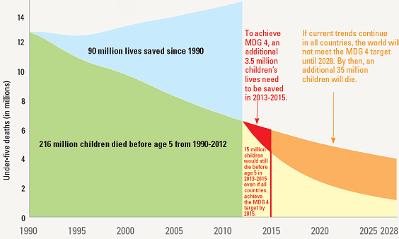
Under-five mortality rate, 1990-2012 and projected 2013-2028
UNICEF: Committing to Child Survival: A Promise Renewed – Progress Report 2013

Slide 19
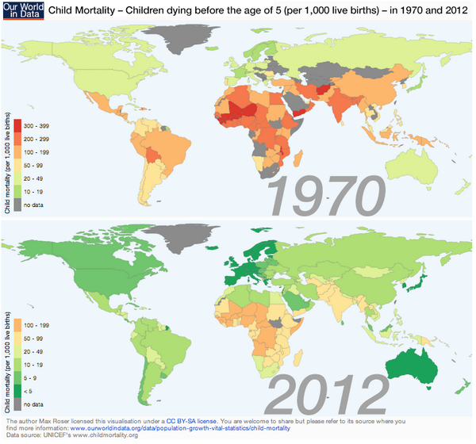
Our World in Data
62/195 countries met goal (Unicef 2015)

Slide 20

SDG 2030
Sustainable Development Goals:
  17 goals with
  169 proposed targets with
  304 proposed indicators
SDG 3: ‘Good health and well-being’
  “By 2030, end preventable deaths of newborns and children under 5 years of age…
  reduce neonatal mortality to 12 /1,000 live births;
  Under-5 mortality to 25 /1,000 live births”
  U5M in 2015: 51/1000 in Oceania and S Asia; 83 in sub-Saharan countries; 32 in Caucuses
  Translates to goal of U5M of 4.9m /year

Slide 21
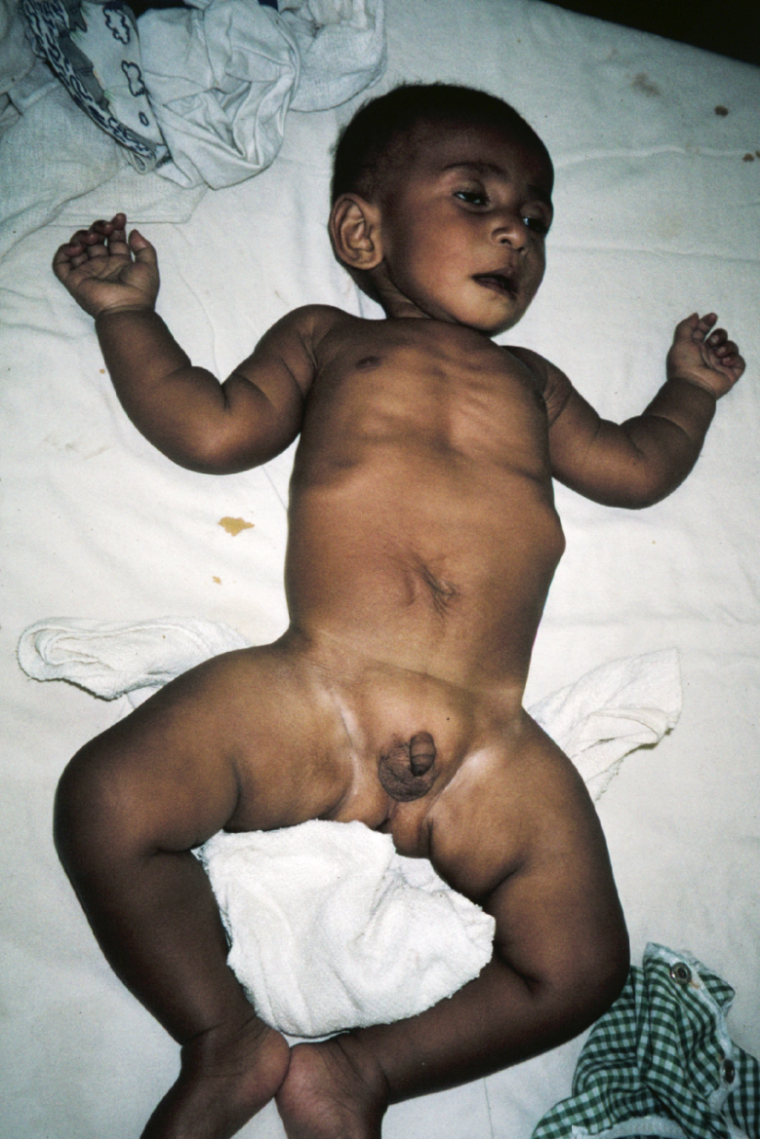

Case study: Anis
Anis is a 2 year old presented from health clinic with 4 day history of profuse diarrhea. Vomiting everything for 2 days.
Lethargic and not able to drink for 1 day.

Slide 22

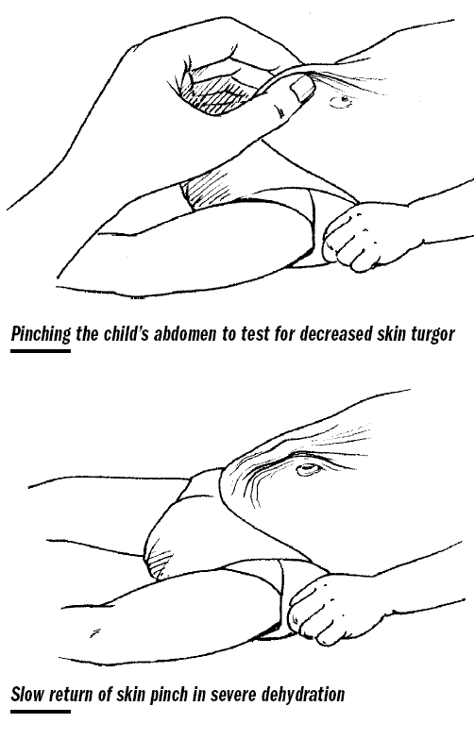
Poor skin turgor

Slide 23
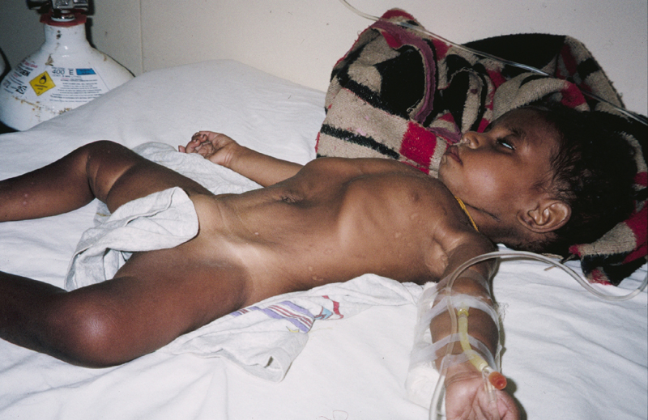
Is Anis in shock?

Slide 25


Slide 27
Emergency treatment
IV fluids should be given when signs of shock
  Best fluids: LR or 0.9% NaCl
  Start ORS by NGT if there is difficulty getting an IV infusion
  Do not use 5% dextrose on its own
  20mls/kg fast
  In severe malnutrition generally give fluids at a slower rate –
  → Reassess pulse and capillary refill

Slide 28
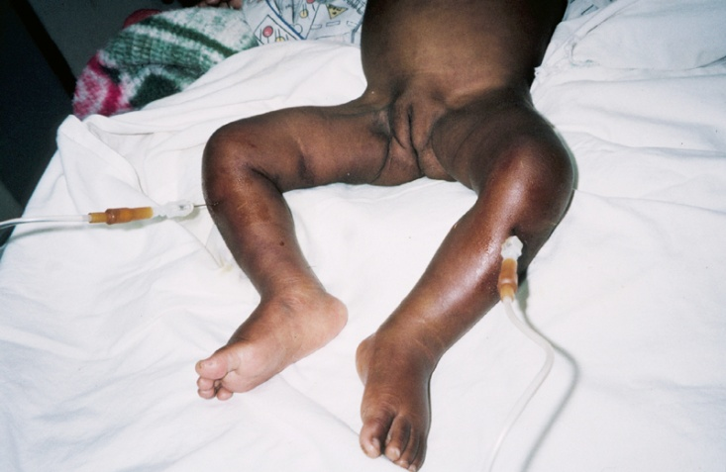
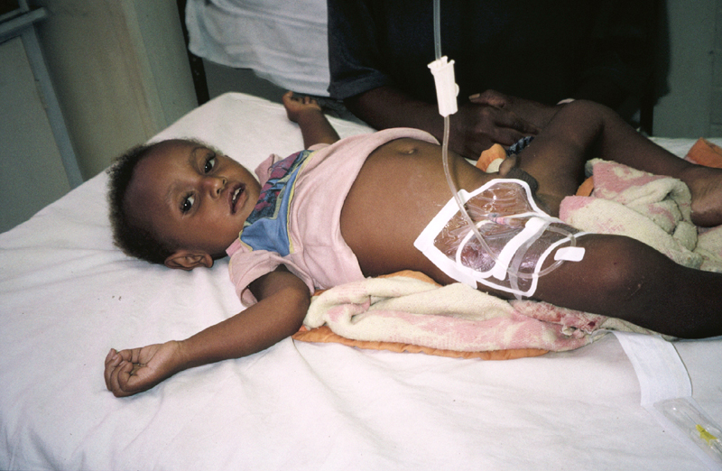
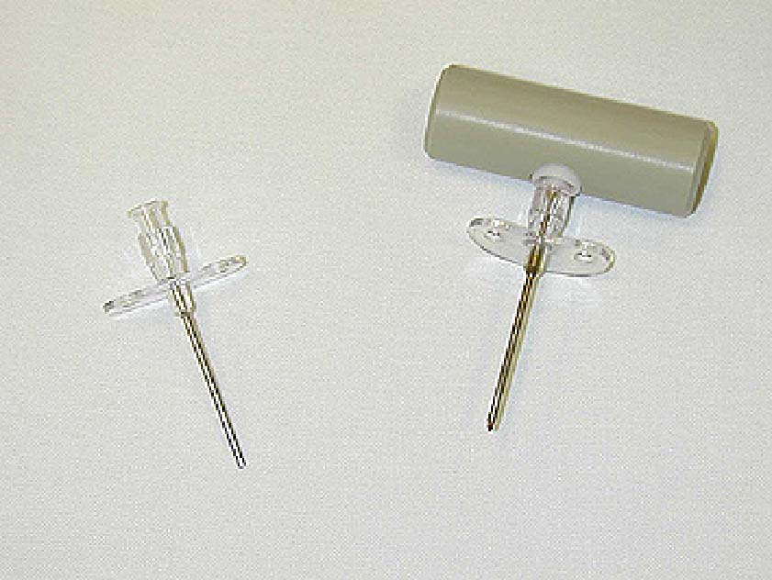
Other options for access
Intraosseus using
spinal needle
Femoral venous access
Intraosseus needle

Slide 29
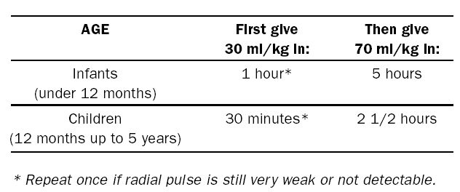
Fluids in severe dehydration
In the first 4-6 hours give 100 mls/kg of IV or NG ORS as shown in table below
Start oral fluids as soon as child can drink
Continue feeding

Slide 30
Reassessment of Anis
NS bolus 20mls/kg given, followed by 2nd bolus
What next?
  Reassess
  Child more alert and looks to his mother; shows improved skin turgor; CR 2 seconds; P140
What next?
  Oral rehydration: how much?
What are discharge criteria?
What are the 4 rules of home treatment:
  Give extra fluids (100-200mls/loose stool), give zinc, give food
  When to return

Slide 31
Further Treatment
Infection control: hand washing
Continue feeding with oral rehydration
Zinc
Antidiarrheal agents: never necessary and often harmful
Antiemetics
Antibiotic treatment – rarely necessary. Only for:
  Dysentery (mostly Shigella)
  Cholera
  Severe abdominal distension (e.g. gut sepsis)
  -- this has been longstanding teaching

Slide 32
Traveller's diarrhoea:
ETEC, rotavirus, Campylobacter jejuni
Bloody diarrhoea = dysentary:
Shigella, amoebiasis, trichuriasis
Cholera
Worms: ascariasis, whipworm, hookworm
Prolonged diarrhoea:
Giardia, E histolytica, Cyclospora/Crypto, bacterial and viral causes
Is differential diagnosis of diarrhea different in low resource setting?

Slide 33
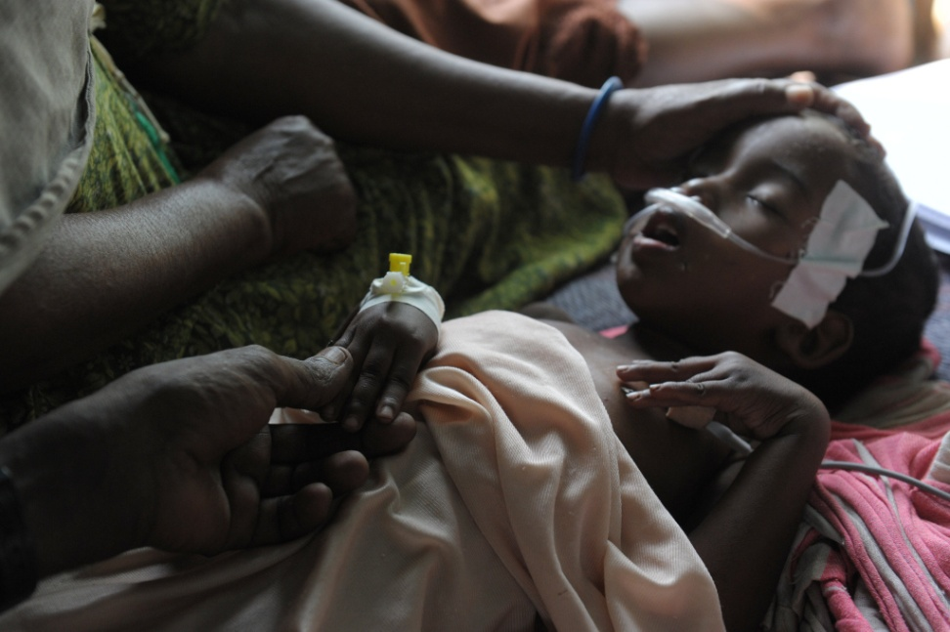
A Quiet Revolution in the Treatment of Childhood Diarrhea- NYT Aug 10, 2015
Global Enteric Multicenter Study (Lancet, 2013):
  Top 5: rotavirus, Cryptosporidium, 2 strains Ecoli, Shigella
  In some places: Aeromonas, Campylobacter, Vibrio cholerae
Botswana study (PIDS, April 2015):
  Lack of blood does not mean not bacterial
Abshira Abdukadir, a four-year-old girl in Somalia

Slide 34
Antibiotic use
Not clear when to use antibiotics:
  Admit if severely malnourished or <2mo
  Admit if toxic: seizures, abd distension, lethargic
  Treat if bloody diarrhea?
  Sequentially treat for amoebiasis
Persistent watery stools: parasitic infection
  Metronidazole, other nitroimidazoles
  Single dose tinidazole effective against Giardia

Slide 35

Continue feeding:
Continue to feed as much nutrient-rich food as will be accepted
“Food should never be withheld and the child's usual foods should not be diluted. Breastfeeding should always be continued.…”
  Why?
  To prevent malnutrition
  To speed the recovery of normal intestinal function, including the ability to digest and absorb various nutrients.
  “Children whose food is restricted or diluted lose weight, have diarrhoea of longer duration, and recover intestinal function more slowly.”

Slide 36
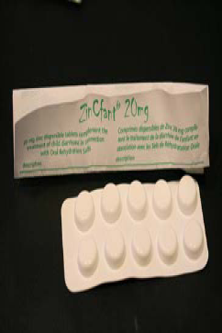
Zinc supplementation
8 systematic reviews with10 RCTs reviewed
Findings:
  duration of diarrhea ↓ by 13-50%
  stool output ↓ and more vomiting
  admission rate to hospital: effect over ensuing 2-3 mos
  protective for pneumonia
WHO recommends Zinc: (level A recommendation)
  dissolve 1 tablet of zinc into water
  10-20mgs per day for 10 days
Barrier: given for 5 days only
    ICHRC: http://www.ichrc.org/

Slide 37
Antiemetics
6 cohort studies or RCT and 1 Cochrane review
Ondansetron reduces vomiting > metaclopramide or dexamethasone > placebo
Increased diarrhea seen in treatment groups
The AAP endorses the CDC’s position by stating that “reliance on pharmacologic agents shifts the therapeutic focus away from appropriate fluid, electrolyte, and nutritional therapy, [and] can result in adverse events.” (2004)
Ondansetron costs $$$

Slide 38

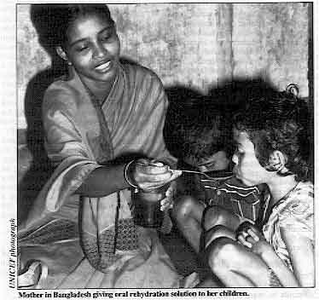
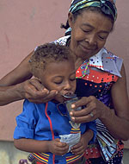
Fluids during diarrheal illnesses:
  ORS- "potentially the most important medical advance of this century." (The Lancet)

Slide 39
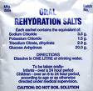
Oral Rehydration Solution:
First large-scale trial during Bangladeshi Liberation War (1971):
  1 camp of 350,000 people trialed on ORS → 3% mortality
  2nd camp without oral solution had 20-30% mortality
1950s: Na and glucose transported together, with water following passively
Relevant parts of rehydration solutions:
  Sodium/Glucose
  Osmolarity
  Carbohydrate
  Citrate
  Flavouring

Slide 40
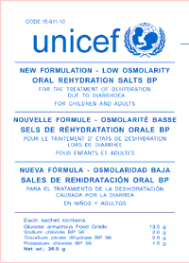
UNICEF recommendations Feb 2004; announced March 2006
Lower Na: 90 to 75mEq/L
Lower glu: 75mmol/L
Lower osmolarity: 311 to 245 mOsm/l
  ↓ stool output by 25%
  ↓ need for IVF by 1/3
  ↓ vomiting by 30%
  transient asymptomatic hypoNa
http://www.who.int/child_adolescent_health/documents/fch_cah_06_1/en/index.html

Slide 41
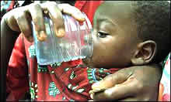
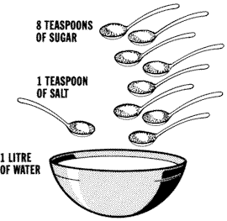
Do-It-Yourself Version

Slide 42
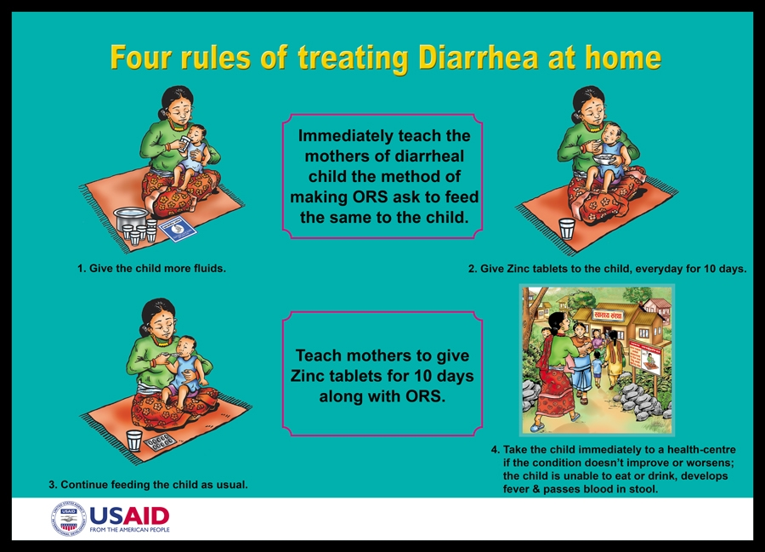

Slide 43
Taste test…

Slide 44
Comparison of oral fluids
Solution | -CHO | glu | Na | mOsm
ORS | dextrose | D2 (20g/L) | 75 | 245
Pedialyte | dextrose | D2.5 (25g/L) | 45 | 250
Gatorade | sucrose, fructose | 255g/L | 20 | +
PepsiCola | fructose | 700g/L | 1 | ++

Slide 45
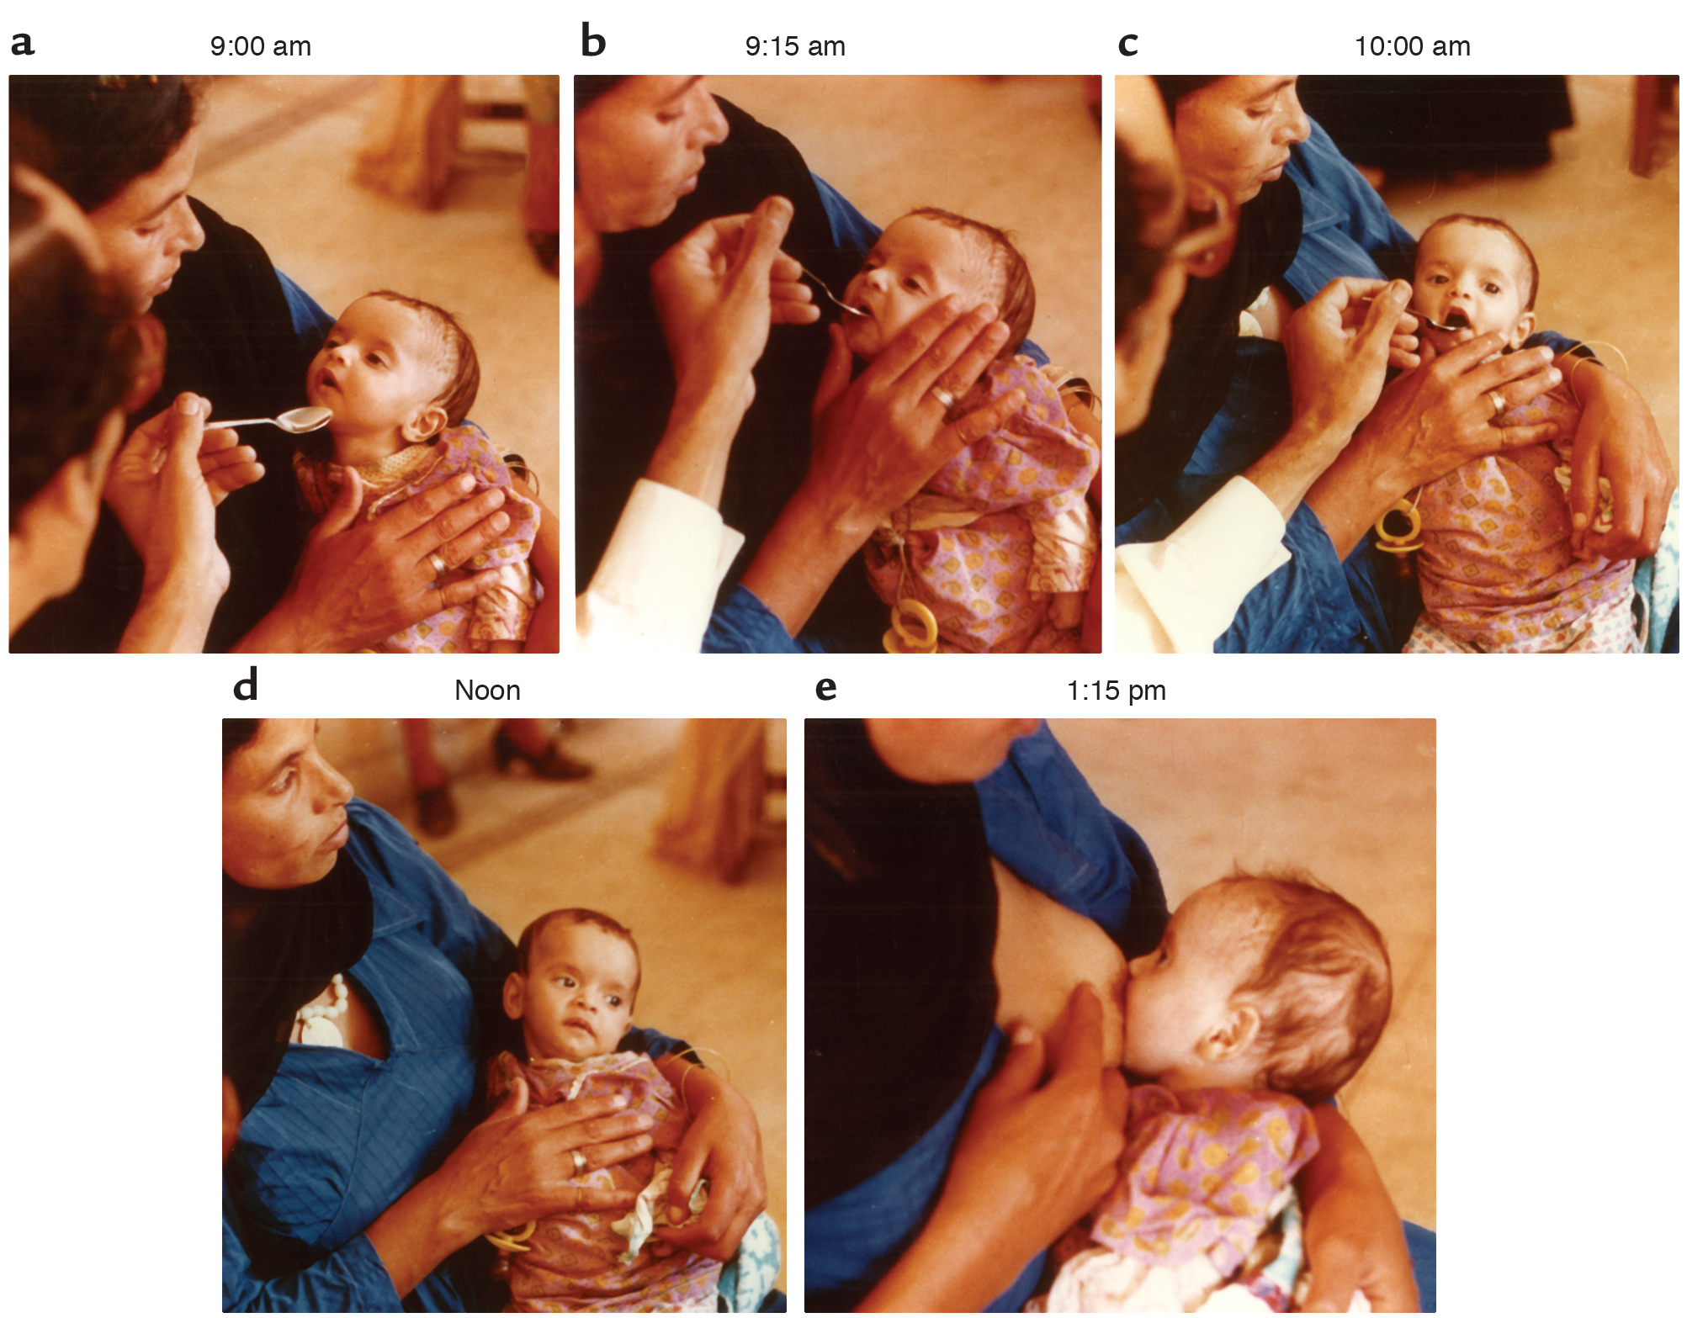

Slide 46
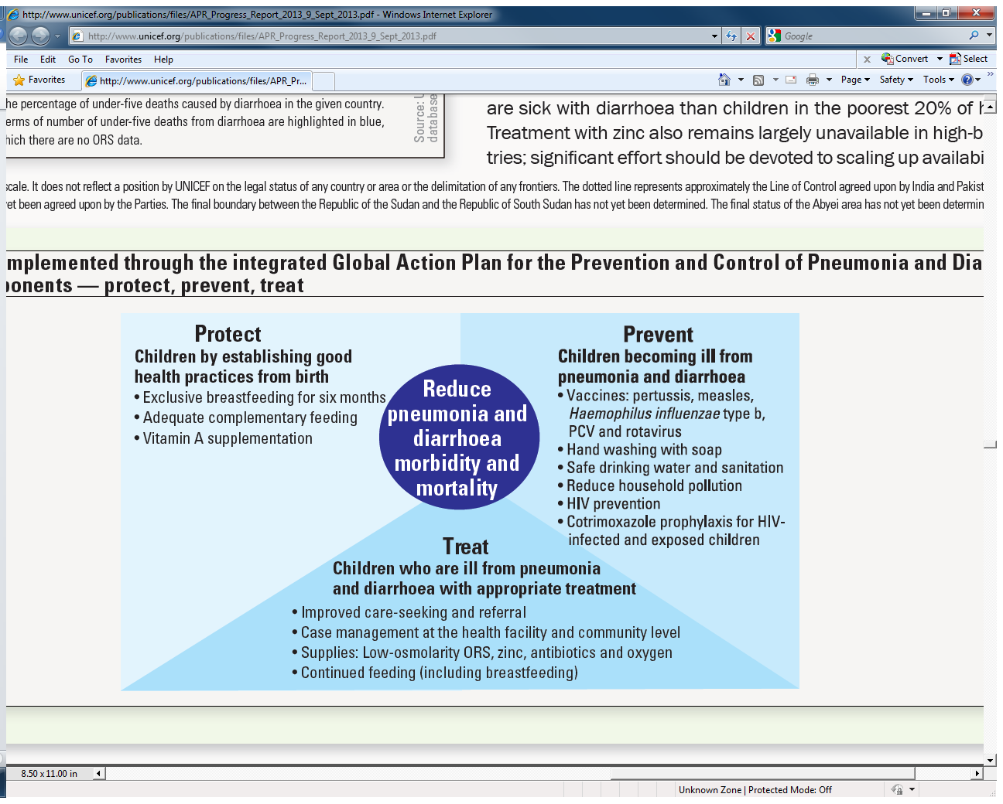
Global Action Plan for the Prevention and Control of Pneumonia and Diarrhoea- WHO, UNICEF April 2013

Slide 47
We have discussed-
Improvement in Under-5 Mortality Rate
Contribution to U5MR from diarrhea
Methods to treat and reduce diarrheal mortality
Integrated plan of management to address this problem

Slide 48
In your clinic…
3yo girl with profuse watery diarrhea (+) rotavirus
Tired, interactive, sips ginger-alert
P125, brisk CR, soft ND abdomen
Fluid treatment plan between now and tomorrow
Other recommendations

Slide 49
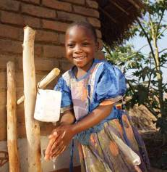
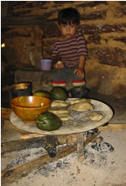
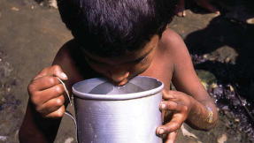
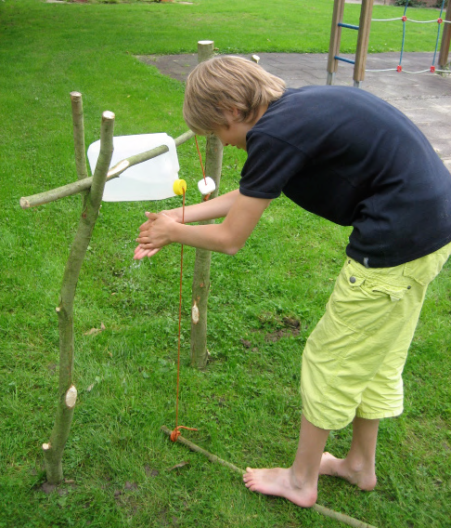
Cycle of wellness

Slide 50
Under-5 Mortality Rate (2012)
Under-5 Deaths (2012)
1. Sierra Leone 182
2. Angola 164
3. Chad 150
4. Somalia 147
5. D R C 146
6. C A R 129
7. Guinea-Bissau 129
8. Mali 128
9. Nigeria 124
10. Niger 114
1. India 1,414,227
2. Nigeria 826,604
3. Pakistan 408,805
4. D R C 391,229
5. China 258,250
6. Ethiopia 204,926
7. Indonesia 151,605
8. Angola 148,006
9. Bangladesh 126,835
10. Kenya 108,097

