Slide 1
Acute Lower Respiratory Infection
Global Child Health Elective
Kristen Breslin, MD MPH
October, 2013

Slide 2
Objectives
For children presenting with cough or difficulty breathing in developing countries:
Discuss differential diagnosis
Assess patient in low-resource setting
  Key aspects of history & physical
Understand WHO algorithms in low-resource settings
Notes:
Discuss the differential diagnosis of breathing difficulty in developing countries
How to using tests sparingly and what information is critical in hx and PE
Understand WHO algorithms as agreed-upon pathways to manage illness but also as teaching tools for other parts of the health care team

Slide 3
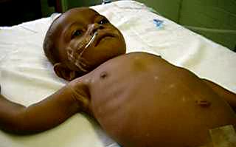

Case Study: Health Center
16mo with 5 days cough and fever, unable to feed x 1 day
16mo with 5 days cough and fever, unable to feed x 1 day
Notes:
What would you like to know about this patient?

Slide 4
Differential Diagnosis
Pneumonia
  Bacterial, viral
Tuberculosis
Asthma
Severe anemia
Malaria
Measles
Congestive heart failure
HIV/PCP
Effusion/empyema
Pertussis, Foreign body, Croup, Diphtheria, PTX, Acute chest
Bronchiolitis

Slide 5
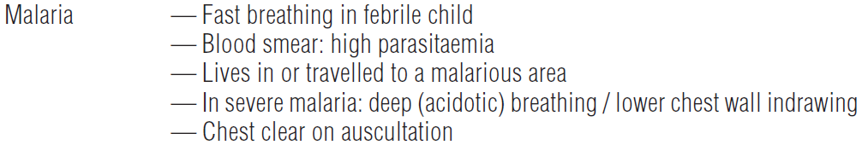
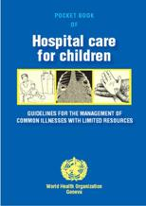

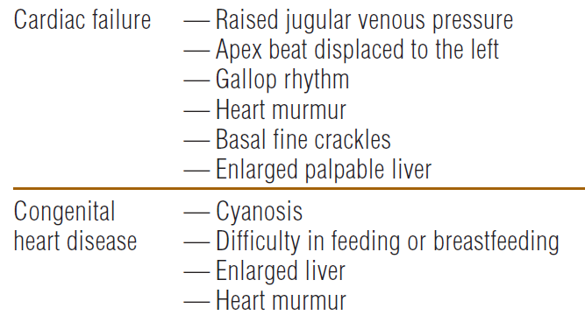
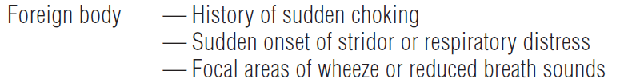
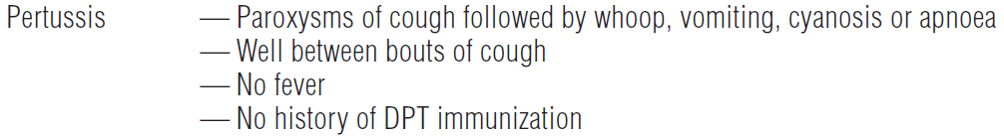
Cough or difficult breathing
Notes:
15% of children unvaccinated against pertussis

Slide 6
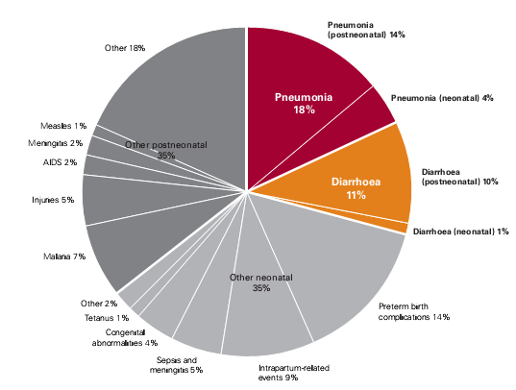
Likely & life-threatening
Leading cause of death for children <5
1.2 million deaths/year
Malnutrition contributing cause to PNA mortality
Pneumonia
Causes of <5 Mortality, 2010
Notes:
http://www.who.int/mediacentre/factsheets/fs178/en/index.html
Major causes of death in neonates and children under five globally – 2008
World Health Statistics 2011, WHO
Global, regional, and national causes of child mortality in 2008: a systematic analysis.
GAPP
2014 fact sheet – 15%

Slide 7
Some Definitions
Pneumonia = presumed pneumonia based on WHO clinical algorithms
Acute respiratory infection includes upper (URI) and lower (LRI) respiratory infection
LRI = below the epiglottis
  Includes pneumonia & bronchiolitis

Slide 8
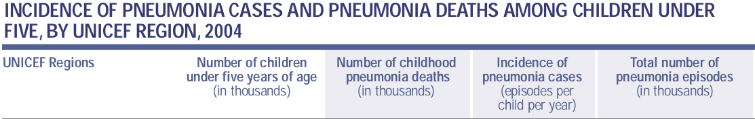
Likely & life-threatening
Incidence & case-fatality rates are higher in the developing world
Notes:
PNA, Forgotten Killer

Slide 9
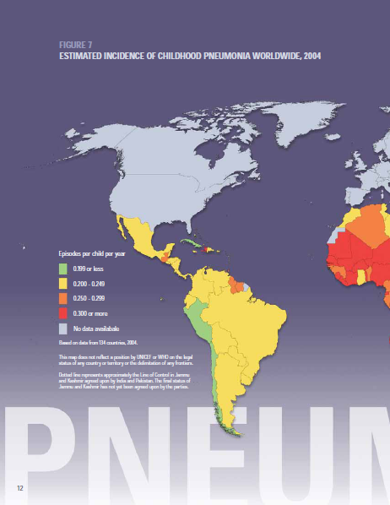
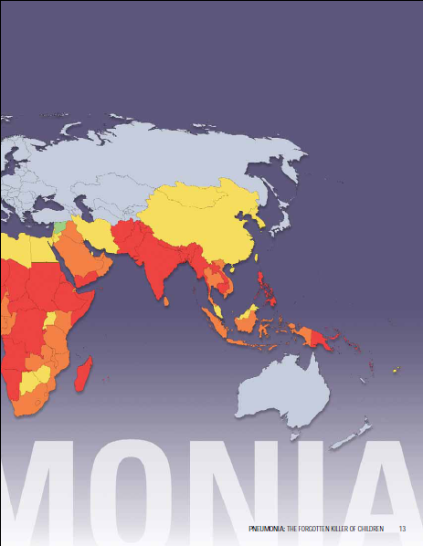
Notes:
Incidence of pneumonia, Forgotten Killer

Slide 10
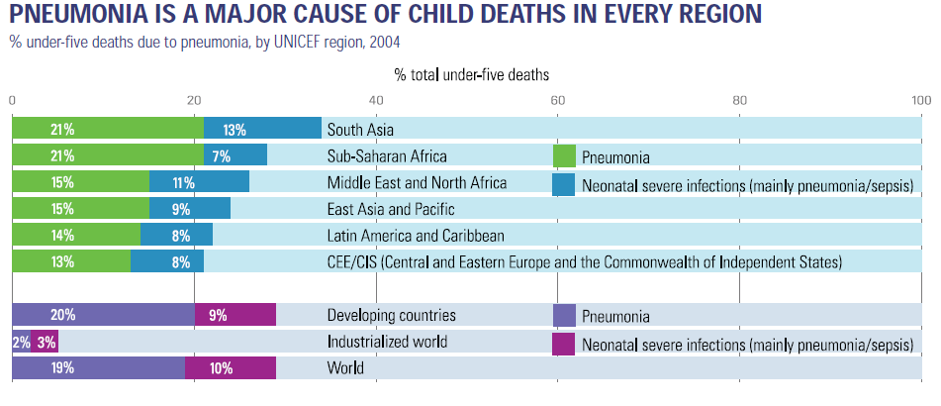

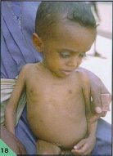

Notes:
UNICEF PNA Forgotten Killer

Slide 11
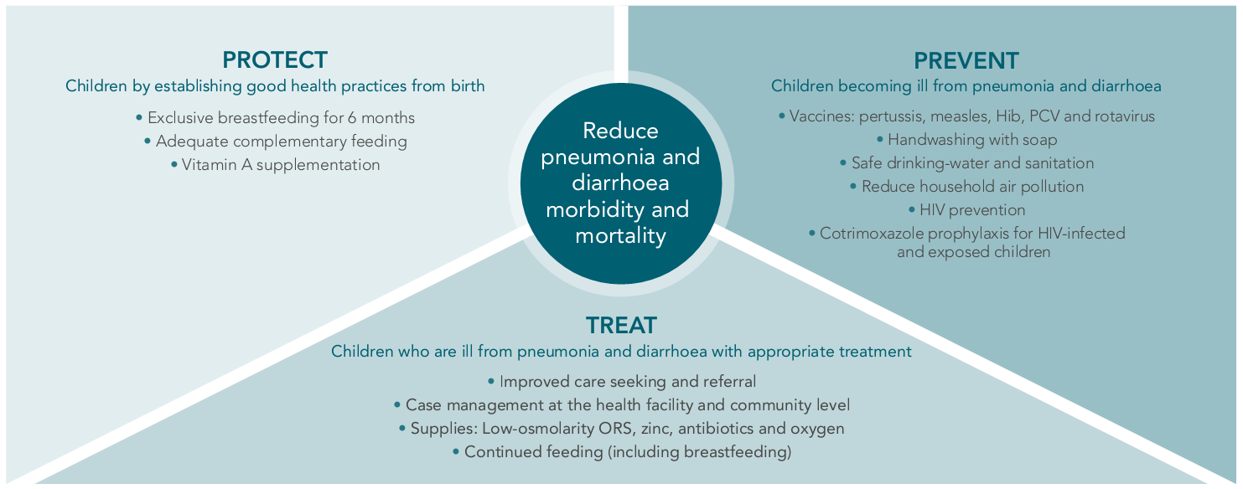
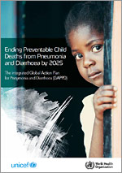

Slide 12

Conceptual Framework
ENVIRONMENTAL
WASH*, reduce overcrowding and Household air Pollution
INCREASED SUSCEPTIBILITY
DELIVERY PLATFORMS
Community based health & behavior change promotion
Financial Incentives to promote care seeking
Integrated Community Case Management
Facility Based IMCI
NUTRITION
Breast feeding promotion,
Preventive vitamin A or zinc supplementation*
EXPOSURE
VACCINES
Measles, haemophilus Influenzae type B, Pneumococcal infection, Rotavirus, cholera
TREATMENT
Oral rehydration solution,
continued feeding after diarrhoea, zinc for diarrhoea treatment, probiotic use,
antibiotics and oxygen therapy for pneumonia, antibiotics for dysentery
PNEUMONIA
DIARRHOEA
SURVIVAL
DEATH

Slide 13
Case Management
Case management (IMCI)
  Recognize the child is sick
  Seek appropriate care
  Treat appropriately with antibiotics
60-80% of children with suspected PNA are taken to a healthcare provider
30% of children with PNA get antibiotics
Notes:
http://www.who.int/mediacentre/factsheets/fs178/en/index.html
Estimates PNA forgotten killer
78%, 30% - WHO 2013 pna page and fact sheet

Slide 14
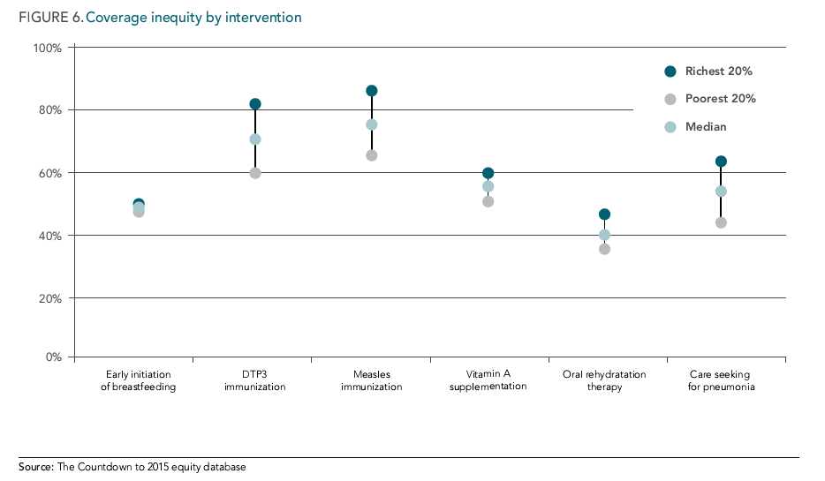
Notes:
Intergrated GAPPD 2013

Slide 15
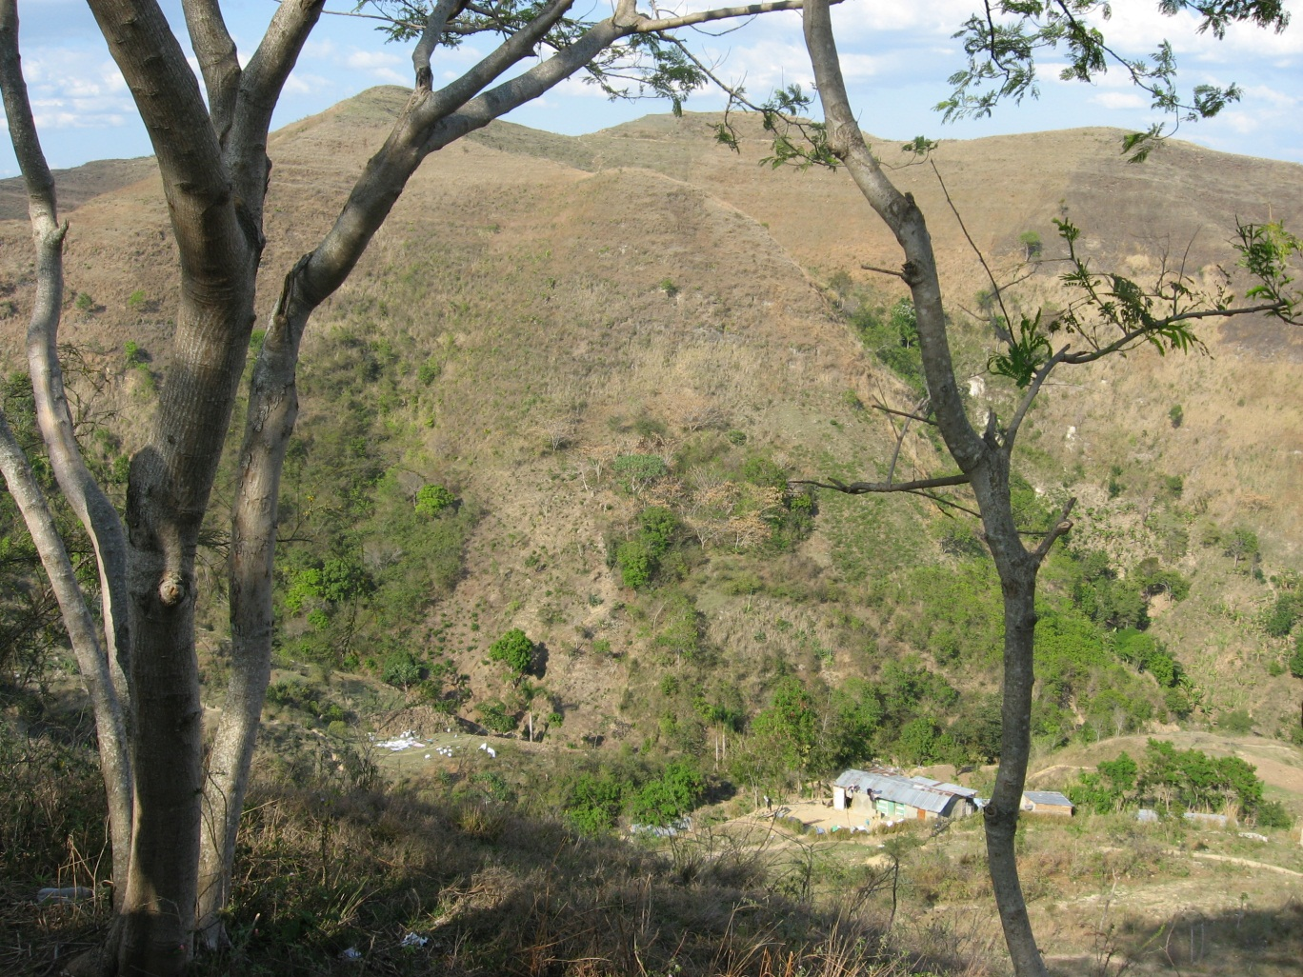
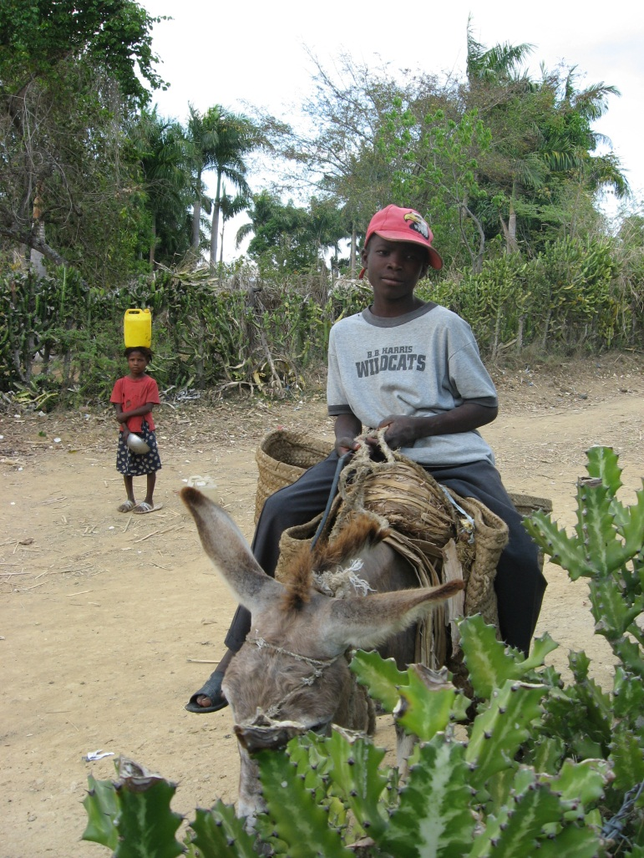
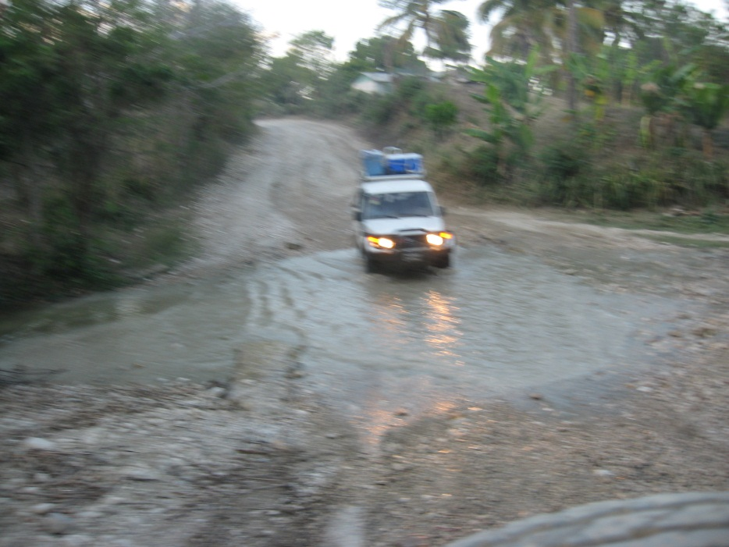
Notes:
Many challenges to seeking care
How to make it clear to both parents & local providers who is sick? Who needs treatment? Who needs IV antibiotics, oxygen and hospitalization?

Slide 16
Case Detection
Children with cough OR difficult breathing
  Fewer than 25% of children with cough have difficult breathing
  Many causes of difficult breathing may not have cough
  Using either/or does create more false positives
Important signs for pneumonia
  Fast breathing
  Lower chest wall indrawing

Slide 17
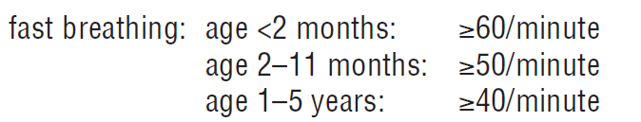
Fast Breathing
Count for one minute, quiet & alert child
Do not wait for fever to subside

Slide 18
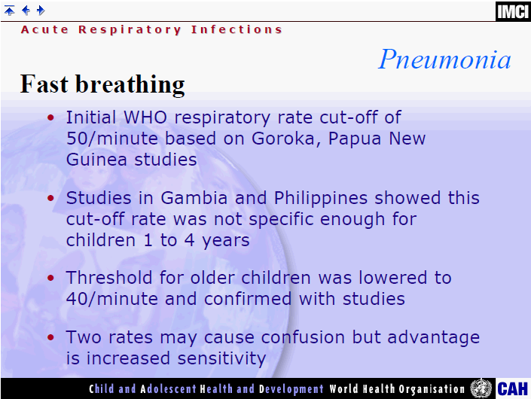
Notes:
Cherian T, John TJ, Simoes E, Steinhoff MC, John M. Evaluation
of simple clinical signs for the diagnosis of acute lower respiratory
tract infection. Lancet 1988; 16:125–8.
Usen S, Weber M, Mulholland K, Jaffar S, Oparaugo A, Omosigho
C, Adegbola R, Greenwood B. Clinical predictors of hypoxaemia
in Gambian children with acute lower respiratory tract infection:
prospective cohort study. Brit Med J 1999; 318:86–91.

Slide 19
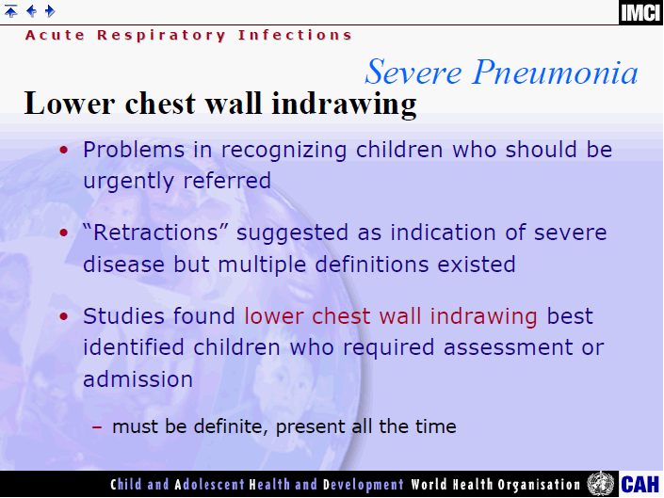

Slide 20
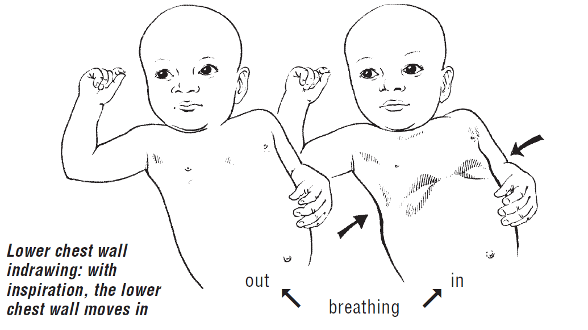
Chest indrawing

Slide 21
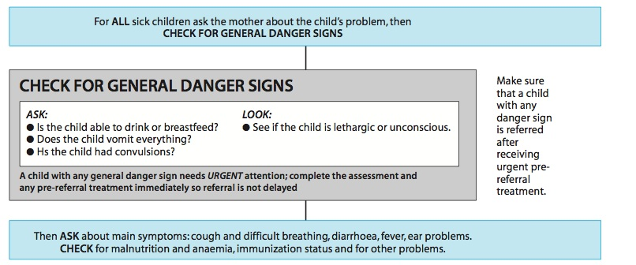
IMCI, Age 2 mo – 5 years

Slide 22
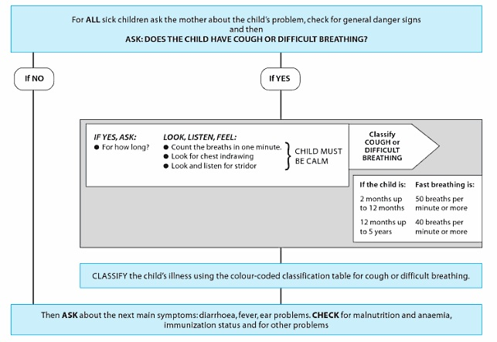

Slide 23
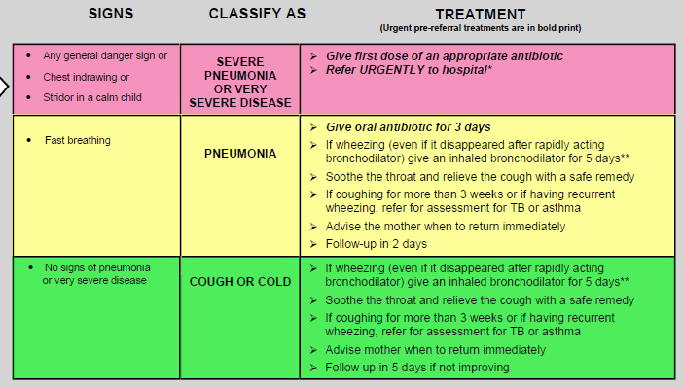
Treatment Recommendations

Slide 24
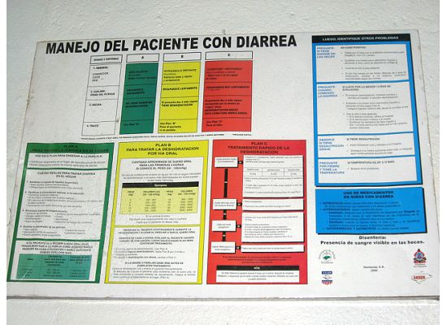
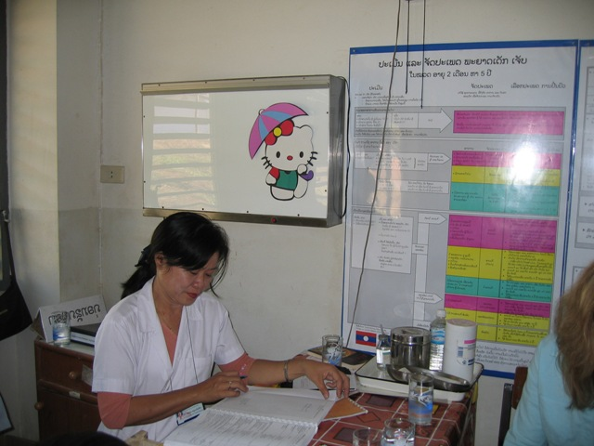
IMCI Urgent Referral Criteria
Urgently refer children with cough OR difficulty breathing AND
  Lower chest wall indrawing OR
  Stridor when calm OR
  Any general danger sign

Slide 25
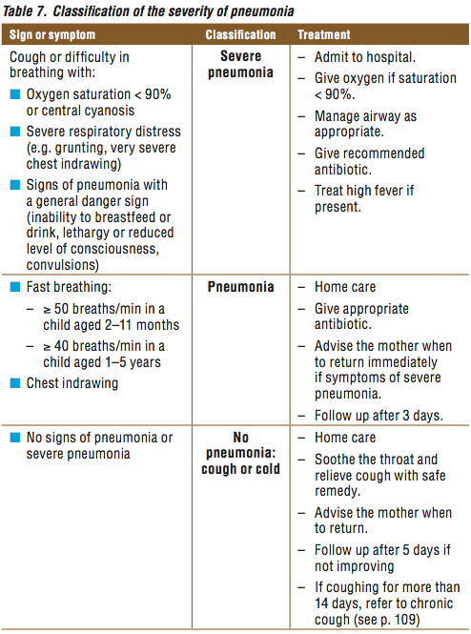
Treatment Recommendations

Slide 26
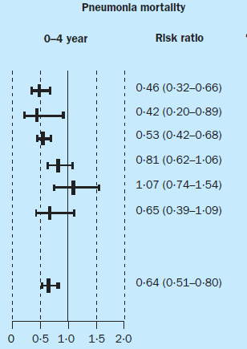
EBM: Case Management
Meta-analysis of 7 case management studies
  Children 0-4
  36% decrease PNA mortality
  24% decrease overall mortality
Sazawal, Lancet Inf Dis, 2003
Notes:
Sazawal, et al, Lancet Infectious Diseases, 2003
Not randomized, not blinded

Slide 27
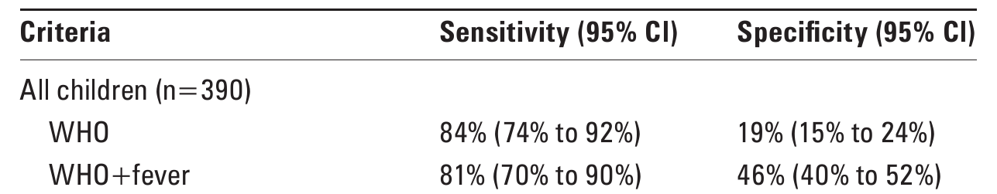
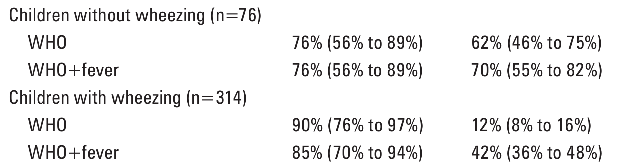
Case Detection
Case Detection among children with LRI
Notes:
390 children in Brazil diagnosed with LRI
Pneumonia, bronchiolitis, bronchitis, or wheezing
Cardoso 2010

Slide 28
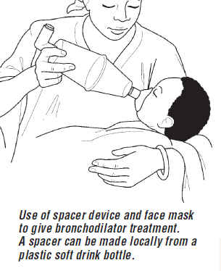
Wheezing
2005: If wheeze is present with rapid breathing or chest indrawing, may give up to 3 cycles of bronchodilator before classifying as pneumonia
2012: If wheeze is present, but no chest indrawing or danger signs, and no fever >38C, no antibiotics
Notes:
IMCI 2005 update and pocketbook 2012 update
873 children in Pakistan with non-severe PNA
Randomized to amox x 3 days or placebo
No difference in rates of “treatment” failure

Slide 29
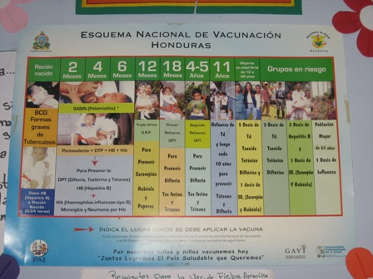
Epidemiology
Causes of severe pneumonia
  Strep pneumoniae
  Hemophilus influenzae
  Staph aureus
  Under 2months, wider range of organisms
  S. aureus, E. Coli, Klebsiella & other gram negative rods
Viral 25%
  RSV most common
Notes:
Evidence for the pocket guide

Slide 30
Empiric Treatment (age 2-59mo)
Severe Pneumonia
First line
  Ampicillin 50 mg/kg or benzyl penicillin 50,000 units/kg IV/IM q 6 hours x 5 days AND
  Gentamicin 7.5 mg/kg IV/IM x 5days
Second line
  Ceftriaxone 50 mg/kg daily
  Cloxacillin and Gentamicin if no improvement and Staph suspected
Other considerations: cloxacillin 50mg/kg q6
        erythromycin 30-60mg/kg q6
        co-trimoxazole 20mg/kg/d
Notes:
Penicillin V not effective against Hib but benzyl pcn IV/IM better
Under 2mo – admit, benzyl pcn & gent
If staph suspected (based on xray or no improvement) – cloxacillin
Increased cotrimaxazole for PCP
Switch to ceftriaxone if possible for HIV+ child not improving

Slide 31
Empiric treatment (age 2-59mo)
Pneumonia
Current recommendations:
  Amoxicillin divided bid x 3 days
  Amoxicillin divided bid x 5 days if high HIV prevalence
  At least 40 mg/kg/day
  Best evidence for 80-90 mg/kg/day
IMCI IV/IM options:
  Benzyl Penicillin 50,000u/kg q6 x3 d, amox x 2d
  Ceftriaxone 50 mg/kg/day
  Chloramphenicol 25 mg/kg/IV q8, po q6 x 10 days

Slide 32
Oral vs. IV Antibiotics
APPIS 8-country trial for severe PNA
  High dose amox (90 mg/kg/day) comparable to IV/IM penicillin
  Treatment failure about 20%
Pakistan trial for severe PNA
  Inpatient ampicillin x 2 days, then amox x 3 days versus home amox 90 mg/kg/day x 5 days
  Treatment failure 8.6% inpatient, 7.5% outpatient
Notes:
Addo-Yobo, et al. Oral amoxicillin versus injectable penicillin for severe pneumonia in children aged 3 to 39 months: A Randomized Multcentre Equivalency Study. 2004.

Slide 33
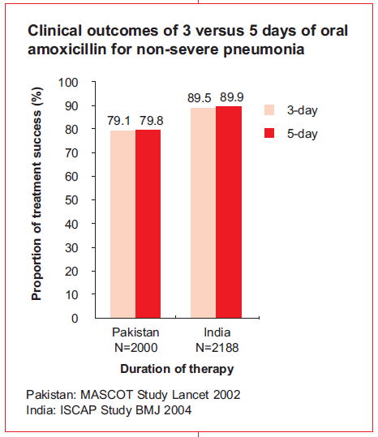
Duration of treatment
Nonsevere PNA age 2-59 mo
RCTs in Pakistan & India showed similar treatment failure/cure rates for amox 3 & 5 day course
RCT in Indonesia/Bangledesh showed similar cure rates for 3 & 5 days of co-trimoxazole with less resistance
Short course not recommended in HIV endemic areas or age <2mo

Slide 34
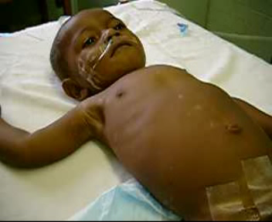
Case Study: Hospital
16mo with 5 days cough and fever, unable to feed x 1 day
T 39, RR 50, HR 160
Alert, interactive
Retractions
Bilateral crackles
No wheeze
Admit?
Oxygen? CXR?
Antibiotics?
Notes:
What would you like to know about this patient?

Slide 35
Case Study: Hospital
16mo with 5 days cough and fever, unable to feed x 1 day
T 39, RR 50, HR 160
Retractions
Crackles, no wheeze
Gallop
Hepatosplenomegaly
Palmar pallor
Now what?
Notes:
What would you like to know about this patient?

Slide 36
Full blood examination
Haemoglobin 5 gm/l (105-135)
Plateletes 858 x 10⁹/l (150-400)
WCC 30.6 x 10⁹/l (6.0-18.0)
  Neutrophils 17.4 x 10⁹/l (1.0-8.5)
  Lymphocytes 3.4 x 10⁹/l (4.0-10.0)
  Monocytes 1.2 x 10⁹/l (0.1-1.0)
Blood glucose 4.5 mmol/l (3.0 - 8.0)

Slide 37
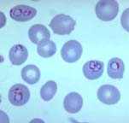

Blood slide: Plasmodium falciparum
(Ref. p.57)

Slide 38
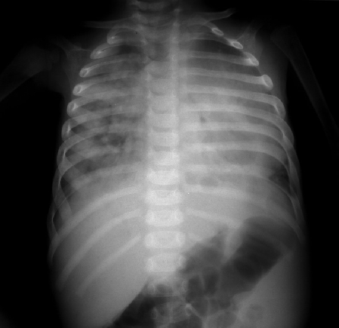
Pneumonia, enlarged heart

Slide 39
Treatment
Severe pneumonia
  Oxygen
  Antibiotics
Heart failure
  Diuretics
Severe anaemia (with heart failure)
  Blood transfusion
Malaria
  Antimalarials
    Quinine or artemether plus Fansidar (sulphadoxine-pyrimethamine)

Slide 40
Other considerations
Viral infections
HIV
  More severe bacterial pneumonia
  Consider ceftriaxone
  PCP pneumonia
Measles
Tuberculosis

Slide 41
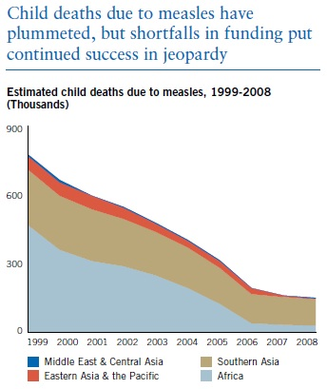
Measles
Child mortality trends
  1980 – 2.6 million
  2000 – 733,000
  2011 – 158,000
78% decrease 2000-08 through immunization
Immune suppression, epithelial damage, vitamin A deficiency
Mortality: Respiratory or neurologic complications
Primary (viral) or secondary (viral/bacterial) pneumonia
Morbidity: chronic lung disease, blindness
UNICEF
Notes:
http://www.unicef.org/immunization/index_measles.html
http://www.cdc.gov/mmwr/preview/mmwrhtml/mm5748a3.htm?s_cid=mm5748a3_e
Virus causes immune compromise, vitamin A deficiency
Epithelial damage especially conjunctivae, lungs, GI tract
Pneumonia from measles virus or secondary infection
http://www.who.int/mediacentre/factsheets/fs286/en/index.html
Pocket Guide Evidence Book

Slide 42
Measles Complications
Significant complication rate 15-30%
Case fatality rate 5-25% in hospitalized children
Pneumonia, diarrhea, malnutrition, otitis media, severe mouth ulcers, severe conjunctivitis, xerophthalmia, croup
Less common encephalitis, myocarditis, nephritis, pneumothorax
Late complications of recurrent infection, FTT, postinfectious neurologic complications
Notes:
Pocket Guide Evidence
Late complications: postinfectious demylenating disease, Subacute sclerosing panencephalitis (SSPE)

Slide 43
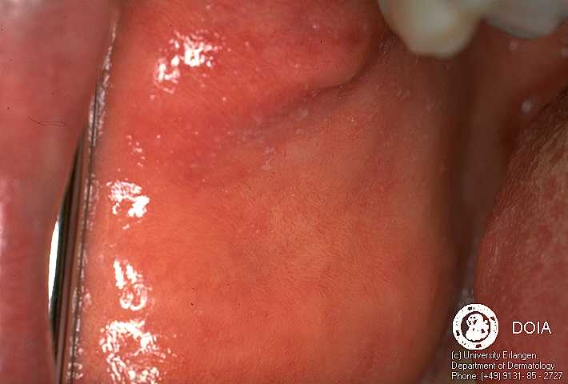
Measles
Prodrome 2-4 days
  High grade fever
  Cough, coryza, conjunctivitis
Koplick’s spots
  1-3mm white or grey-blue elevations on an erythematous base opposite the molars
  “grains of salt on a red background”
Notes:
Image: www.dermis.net
http://www.cdc.gov/vaccines/pubs/pinkbook/meas.html

Slide 44
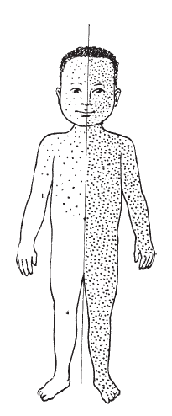
Measles Rash
Starts on face, spreads head to toe
Maculopapular, blanching, dark red
Becomes confluent
Peaks in 3 days, persists 5-6 days
Fades head to toe
Often desquamates after fading
Notes:
Image: www.who.int
http://www.cdc.gov/vaccines/pubs/pinkbook/meas.html

Slide 45
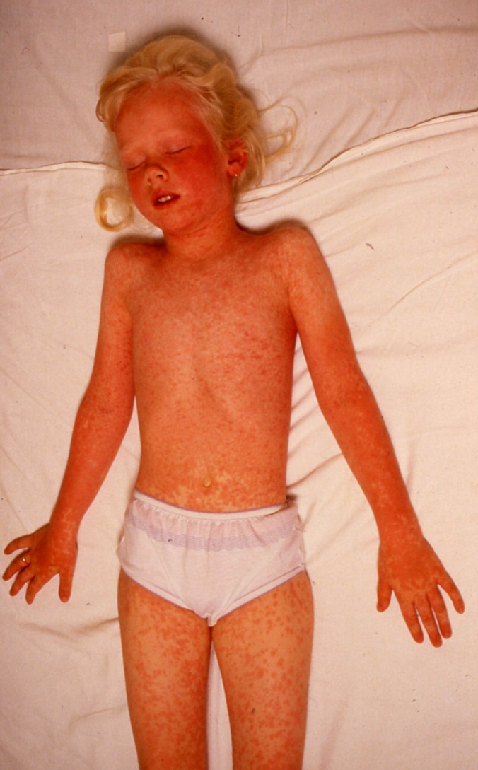
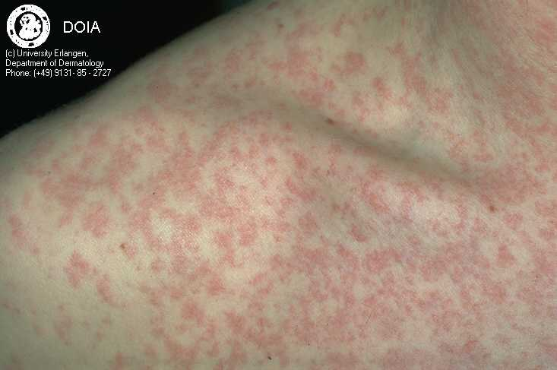
Measles Rash
© Dermatlas
Notes:
Shoulder: www.dermis.net
Girl: www.dermatlas.org

Slide 46
WHO Measles Diagnosis
Typical measles rash OR
Fever, generalized maculopapular rash and one of:
  Cough
  Runny nose
  Red eyes
Signs may not be present in HIV+ children
Notes:
Pocket Guide

Slide 47
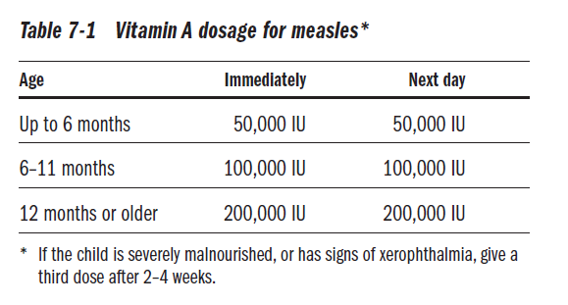
Measles Treatment
Nutritional support, treatment of complications
Among hospitalized children, vitamin A reduces risk of death or major complication by 50% (RR 0.51, 95% CI 0.35 – 0.74)
Notes:
Hussey GD, Klein M. A randomized, controlled trial of vitamin A
in children with severe measles. N Engl J Med 1990; 323:160–4.

Slide 48
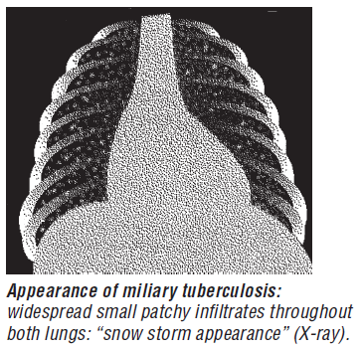
Tuberculosis
Not responding to antibiotics
Fever > 14 days
Cough > 30 days
Unexplained weight loss, FTT
Known contact
Malnutrition
HIV prevalence
Effusion, enlarged cervical node, abdominal swelling, bony deformity, meningitis

Slide 49
Summary
Pneumonia kills more children than any other illness in the world
One strategy for pneumonia control includes case detection and management
Case detection is based on recognizing tachypnea
Start supportive and empiric treatment for pneumonia based on severity of classification

