Slide 1
Using the Media to Advocate for Children & Adolescents: Making Your Message Matter
Jamie Poslosky
Federal Advocacy Communications Manager
American Academy of Pediatrics
Department of Federal Affairs

Slide 2
What We’ll Discuss Today
Overview of media platforms and how they can be used to advocate
Understanding how to craft your message for the media
Examples of how media advocacy works and a real-time demonstration

Slide 3
Understanding the Media:
Earned vs. Paid
Earned media:
Interviews
Letters to the Editor, Op-Eds
Editorials
Blogs
PSA Placement
Social Media
Paid media:
Press events
Websites
PSA Production
Advertising (traditional and online)

Slide 4
Understanding Social Media
Internet-based tools for sharing and discussing information
Increasingly popular and effective way to rapidly inform large audiences about a cause or issue

Slide 5
Why Use the Media to Advocate?
Persuades decision-makers to act because they believe the public is paying attention.
Increases the likelihood that more people will get involved because they are aware of the issue and how they can help change circumstances affecting the children they know and care about.
Establishes credibility for your issue by demonstrating how that issue affects you and why it deserves the public’s attention.

Slide 6
Why Use Social Media to Advocate?
Complements and strengthens existing advocacy strategies
It’s free!
Increases organizational accessibility, visibility and awareness
The online conversation is already happening—join in!
Provides another platform to reach decision-makers
Expands organizational reach to new and diverse audiences
Allows for an online conversation: direct response is possible
It’s easy to use
Can be seamlessly integrated into communications plans
Can exponentially increase access to organizational resources
Notes:
Why AAP uses soc med

Slide 7
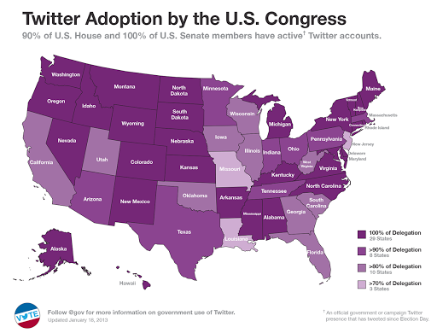
Congress is Tweeting
Congress is on social media:
Collectively, 3 million followers track lawmakers’ tweets
As of Jan. 2013, 90% of Representatives & 100% of Senators are on Twitter
According to Congressional
Chiefs of Staff, Twitter is:
An indicator of knowledge deficit
A new voice in decision-making
A signal to step-up or stand-down on issues
National Journal, New Tools of Advocacy, December 2012

Slide 8
Earned Media Tactics: How To Get Your Message Out

Slide 9
Federal Advocacy in Action: How Media Fits In
Grasstops: Lobbying | Grassroots: Member Mobilization | External Communications: Media Advocacy
Legislative Relationship-building Hill visits & staff meetings Federal testimony | Member communications Frequent policy updates Up-to-date resources Action alerts/requests | Interviews & pitching stories Get to know reporters Undergo media training Fill a gap in coverage
Appropriations Sustained communication Understanding of process Key committee staff | Advocacy trainings Washington, DC visits Skills-building workshops CME opportunities | Op-eds, letters to the editor Local & national coverage Template op-eds/LTEs Co-sign w/gov’t, partners
Regulatory Interim, draft & final rules Targeted communication Federal agency contacts | Member advocacy Webinars & conf. calls Advocacy incentives One-click e-advocacy | Social media campaigns Twitter town halls, chats Facebook promotion Leadership/member blogs

Slide 10
Media Advocacy: Op-Eds & LTEs
Opinion Editorials (op-eds) | Letters-to-the-Editor (LTEs)
Guest editorial, typically by a community leader, expert or prominent individual Should be timely but does not have to be in response to a specific story Your opinion: personal voice, express a position you are uniquely suited to write about 400-600 words No guarantee it will be published | Sent “To the Editor” of publication in response to editorial and/or news article Must be timely Used to clarify a point, refute a charge, praise an initiative Typically less than 250 words No guarantee it will be published

Slide 11
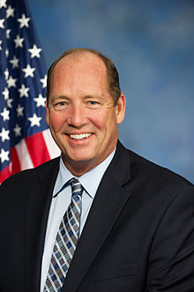
From Idea to Action: Op-ed Example
Influential public figures often pen op-eds to communicate a policy position or call to action to the general public
AAP leadership and members use op-eds in local and national papers to further advance children’s health issues in their communities and at the national level

Slide 12
Media Advocacy: Blogs
First person, informal version of an op-ed that is often more personal in content and tone
Can be pitched for placement but often self-published
Ability to attract loyal followers if blogs are regularly posted on specific topics
Frequently updated

Slide 13
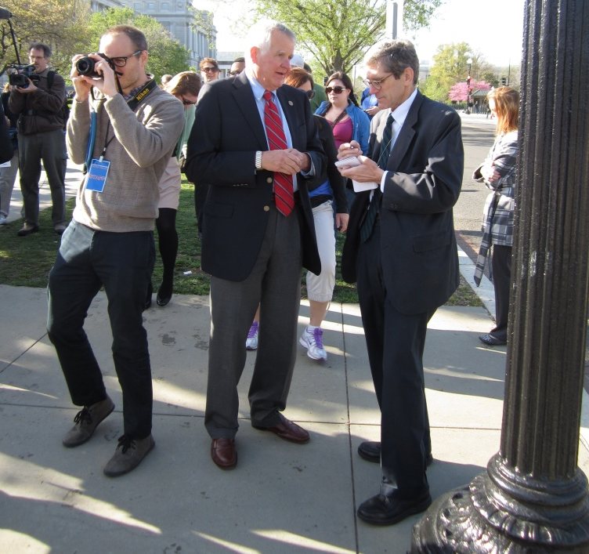
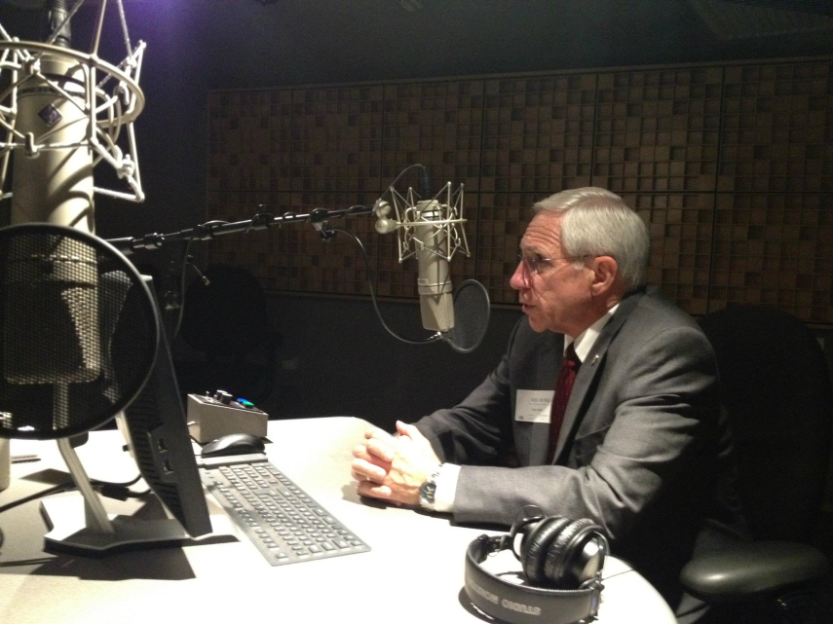
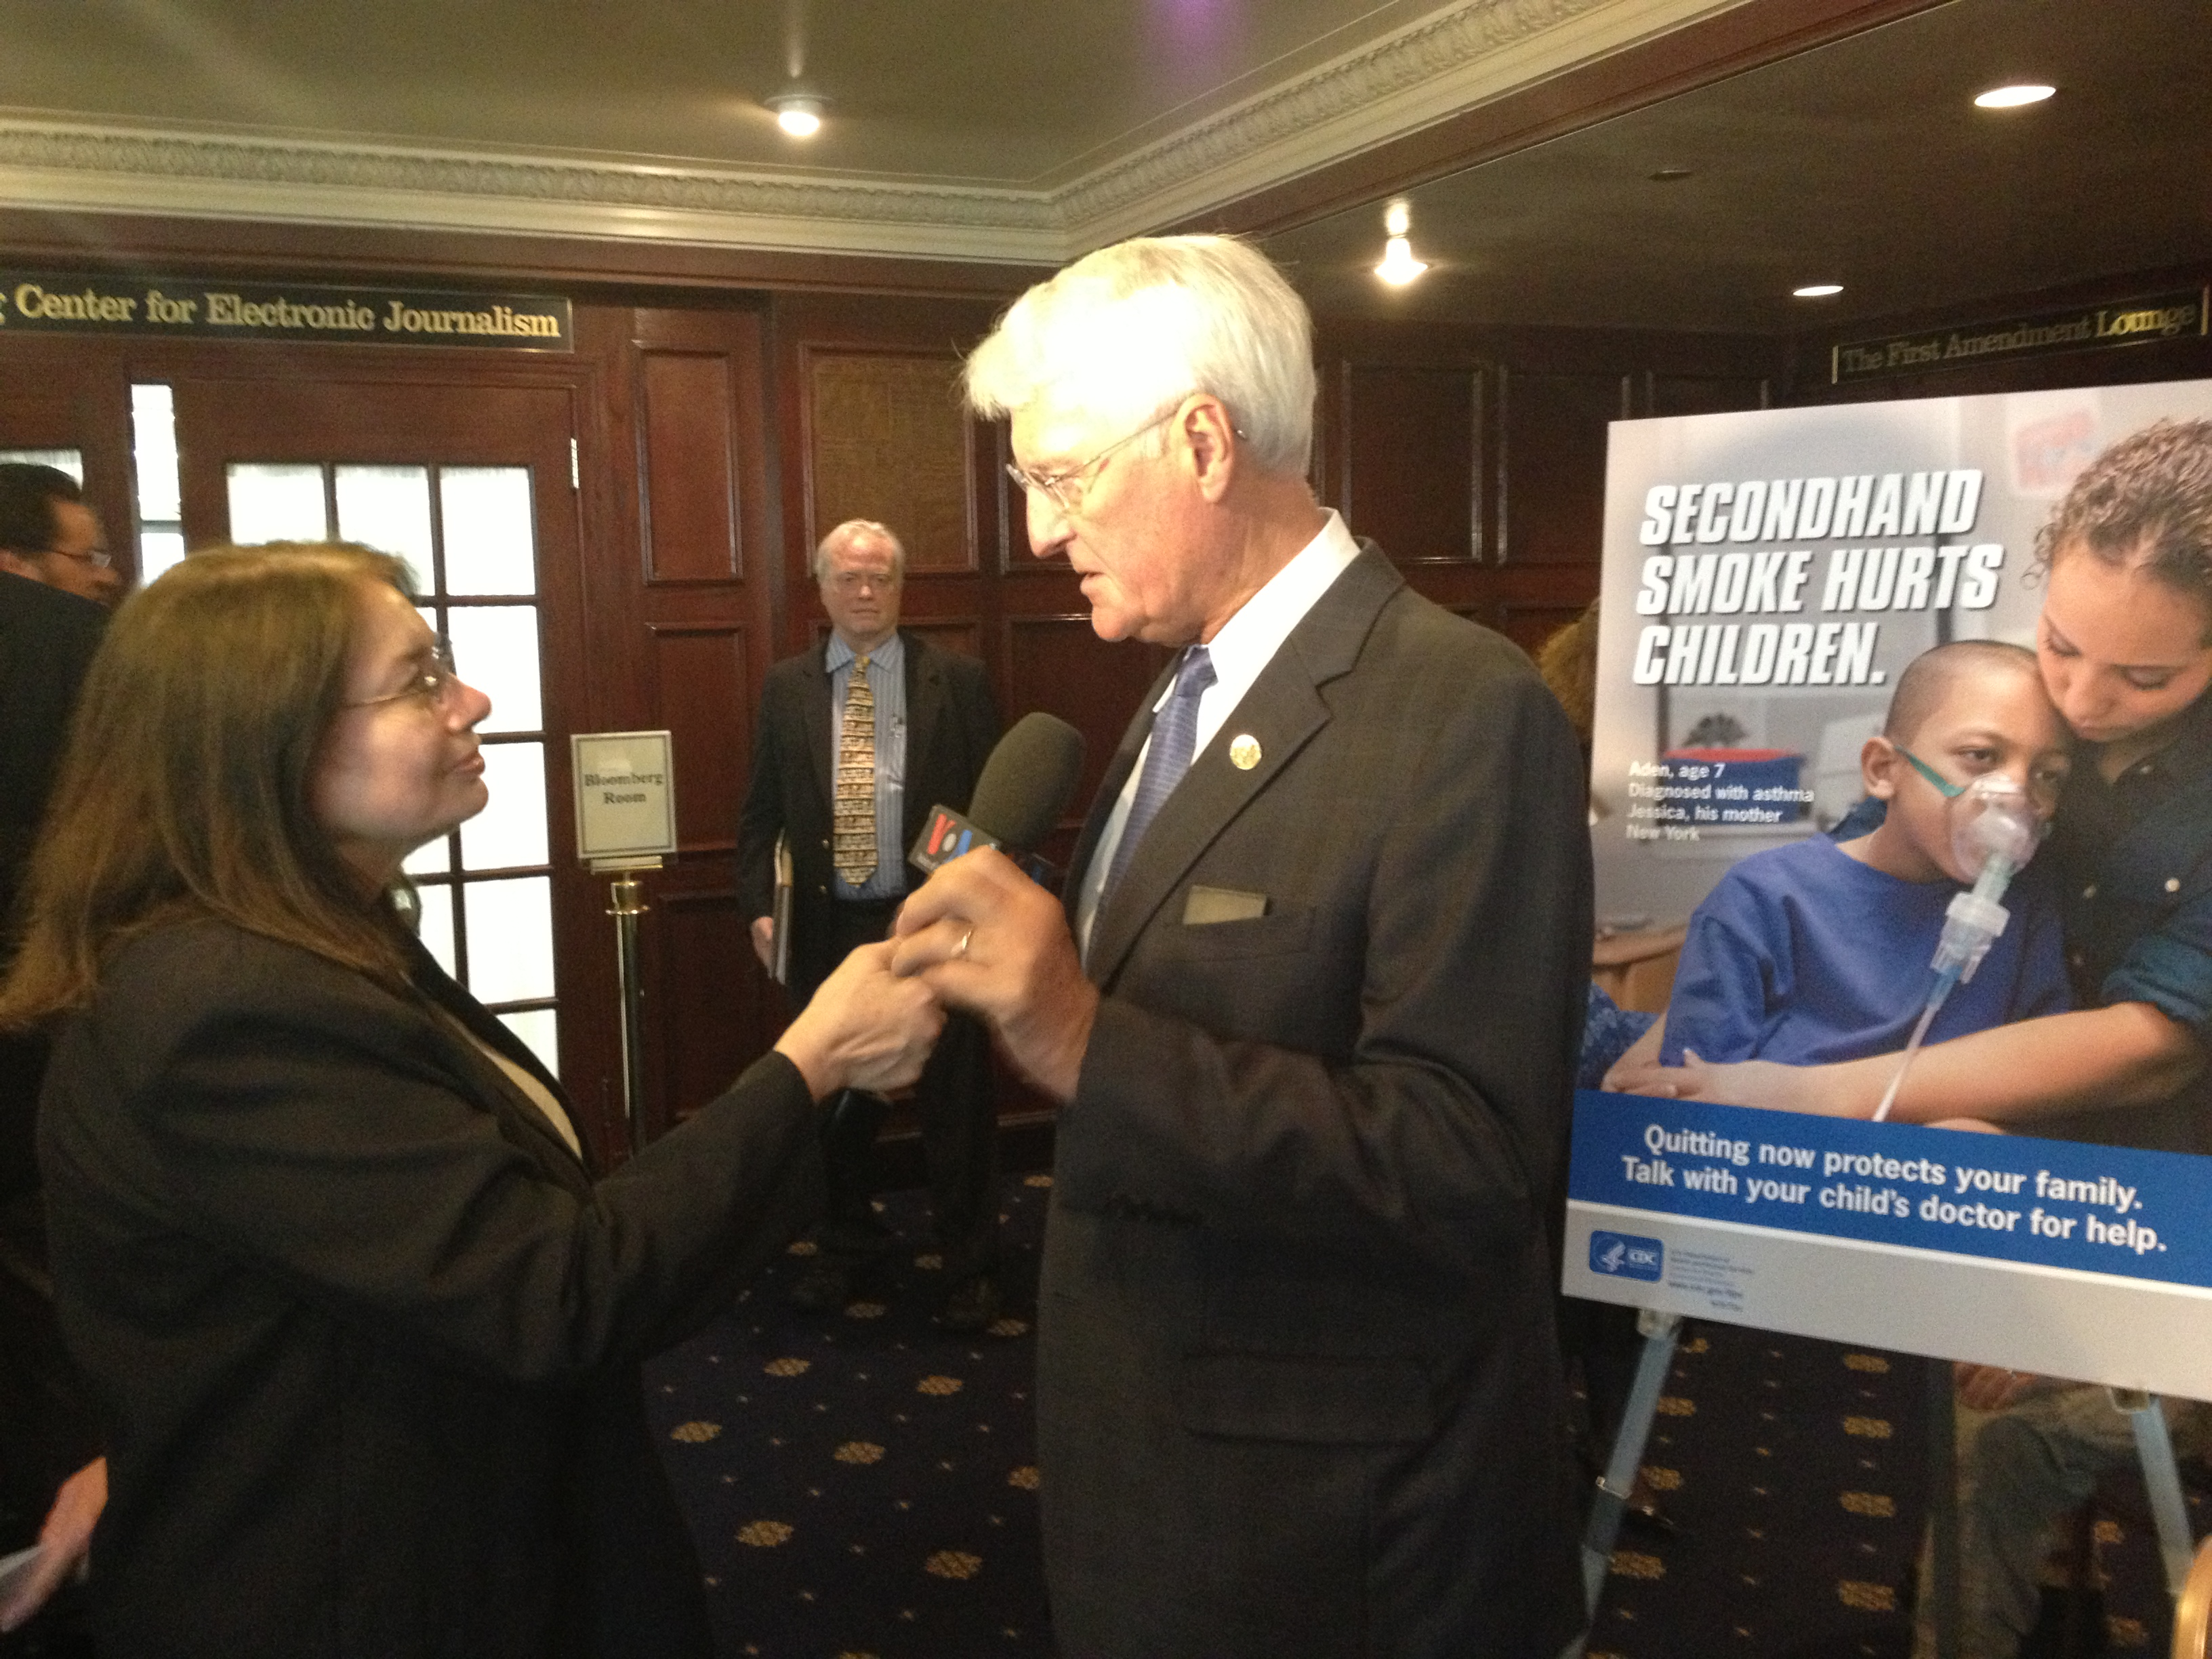
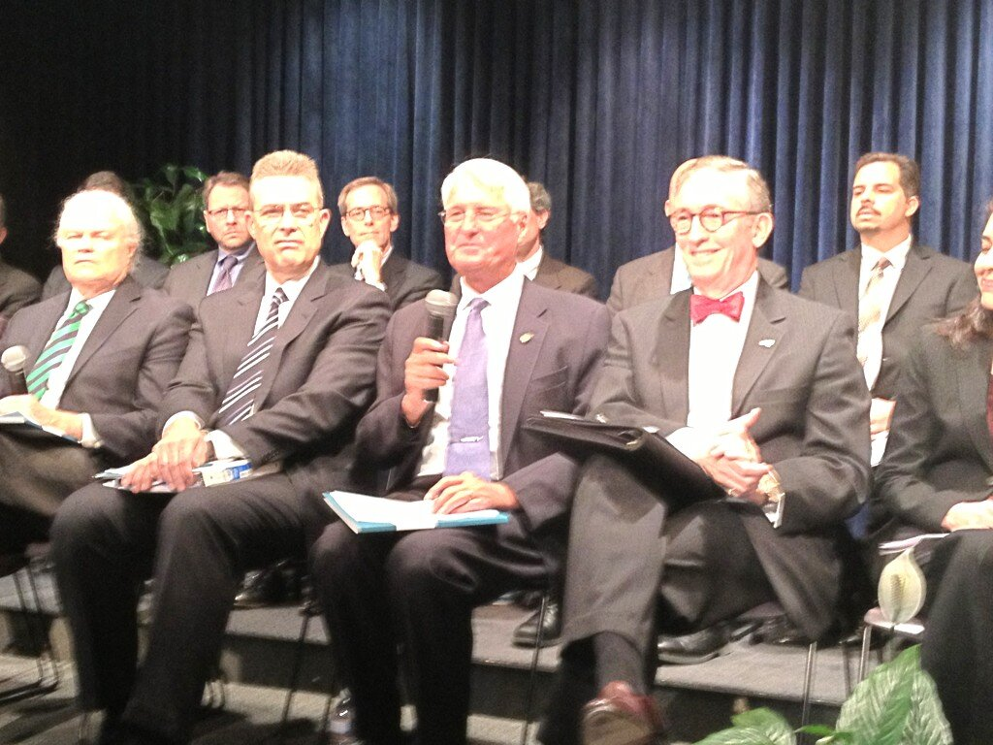
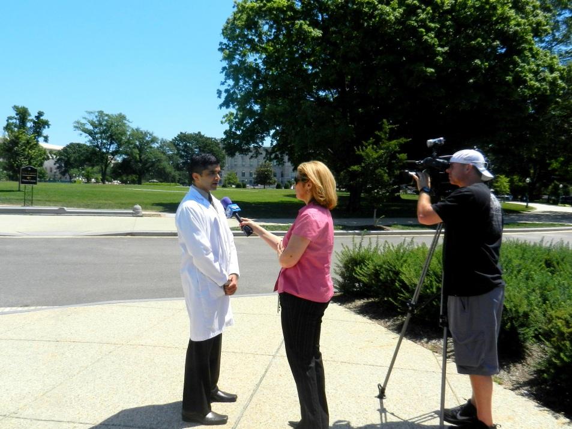
Media Advocacy: Interviews

Slide 14
From Advocacy to Action: Landing an Interview
Be assertive when approaching reporters at crowded events
Prepare a sound byte/overarching message in advance
One successful interview begets more interview requests

Slide 15
Media Advocacy: Editorial Board Meetings
Editorials are the official opinion of the newspaper
Typically authored by editorial page editor
Considered third-party validation and/or endorsement
Editorial Board meetings are an opportunity to influence the publication’s position on an issue
Approach meeting like a lobby visit or pitch—you are selling your side of the story
Read by legislators, community leaders

Slide 16
Editorial Examples

Slide 17
Social Media Platforms: Ways To Amplify Your Message

Slide 18
Federal Advocacy: How Social Media Fits In
Grasstops: Lobbying | Grassroots: Member Mobilization | External Communications: Media
Legislative Relationship-building Hill visits & staff meetings Federal testimony | Member communications Frequent policy updates Up-to-date resources Action alerts | Media relations Press events & briefings Media trainings Pitching stories to reporters
Regulatory Public comments to regs. Targeted communications Federal agency contacts | Advocacy trainings Washington, DC trainings Skills-building workshops Days of action | Op-eds, letters to the editor Local & national coverage Template op-eds/LTEs Co-sign w/gov’t, partners
Social media advocacy Linking to policy docs Connecting w/Congress Live tweeting Hill events | Social media advocacy #Putkids1st campaign AAP leader Twitter chats Unified coalition msgs | Social media advocacy Media-hosted Twitter chats Linking to press coverage Proactive media monitoring

Slide 19
How Social Media Fits In Cont’d
Overall Advocacy Message: Protect children from gun violence
Hill ask
Pitch DC media
Use social media
Engage partner orgs.
Grass-roots action
“What AAP has to say on the Senate's failure to pass gun safety legislation: ow.ly/kax6a #putkids1st”

Slide 20
How AAP Uses Social Media to Advocate at the Federal Level
Live tweeting public events: briefings, testimony, Hill visits, AAP events & trainings
Coordinating and cross-promoting research, stories, resources from partner organizations
Making AAP leaders more accessible through live chats, posted photos, blogs
Engaging AAP members directly through re-tweets, Facebook posts, live chats

Slide 21
Social Media Advocacy: Facebook
AAP Washington Office on Facebook: www.Facebook.com/AAPFederalAffairs
Nearly 1,500 fans
Photos of AAP members participating in federal advocacy activities
Links to federal policy letters, press statements, media coverage, federal testimony & more

Slide 22
Facebook Advocacy Snapshot:
Getting the Word Out

Slide 23
Social Media Advocacy: Twitter

Slide 24
Twitter Advocacy: #Putkids1st
The goal:
To frame the conversation on gun violence around children.
To urge Congress to give children a vote by passing gun safety legislation.
To unite like-minded and diverse child advocates in raising awareness that gun violence is a public health threat to children.
To share AAP gun violence prevention facts, data, advocacy requests and AAP resources quickly and broadly.
The result:
More than 50 tweets and 350 retweets over two weeks using #putkids1st
Engagement of leading third party stakeholders with hundreds of thousands of followers
Liz Szabo, USA Today (26k followers)
APHA
(243k followers)
First Focus
(5k followers)
American Journal of Nursing
(19k followers)

Slide 25
AAP on Twitter: Coordinating Federal Advocacy
Robert Block ‏@DrBobBlock Apr 12 We tweet to raise awareness, to advocate, to focus the conversation on what children need: to be safe #putkids1st
Thomas McInerny @AAPPres Apr 09 Looking fwd to having you! MT @Peds_doc: @AAPPres looking fwd to AAP Legislative Conf. in DC to #putkids1st keep kids safe from gun violence
American Academy of Pediatrics @AmerAcadPeds Apr 12 "Protecting children from gun violence is not a political decision, it's a public health imperative" @CNN #putkids1st ow.ly/k0yjX
HealthyChildren @healthychildren Apr 14 RT @AmerAcadPeds Gun violence is a public health issue that profoundly affects children. Congress: act next week to #putkids1st & keep them safe.
> 900 followers
> 450 followers
> 18,100 followers
> 14,400 followers

Slide 26
Social Media Advocacy: Pinterest
Pinterest is an interactive online pinboard
AAP’s Florida Chapter uses pinterest as an advocacy platform and way to engage their community
Infographic contest for Autism Awareness Month
Child health/public health pins

Slide 27
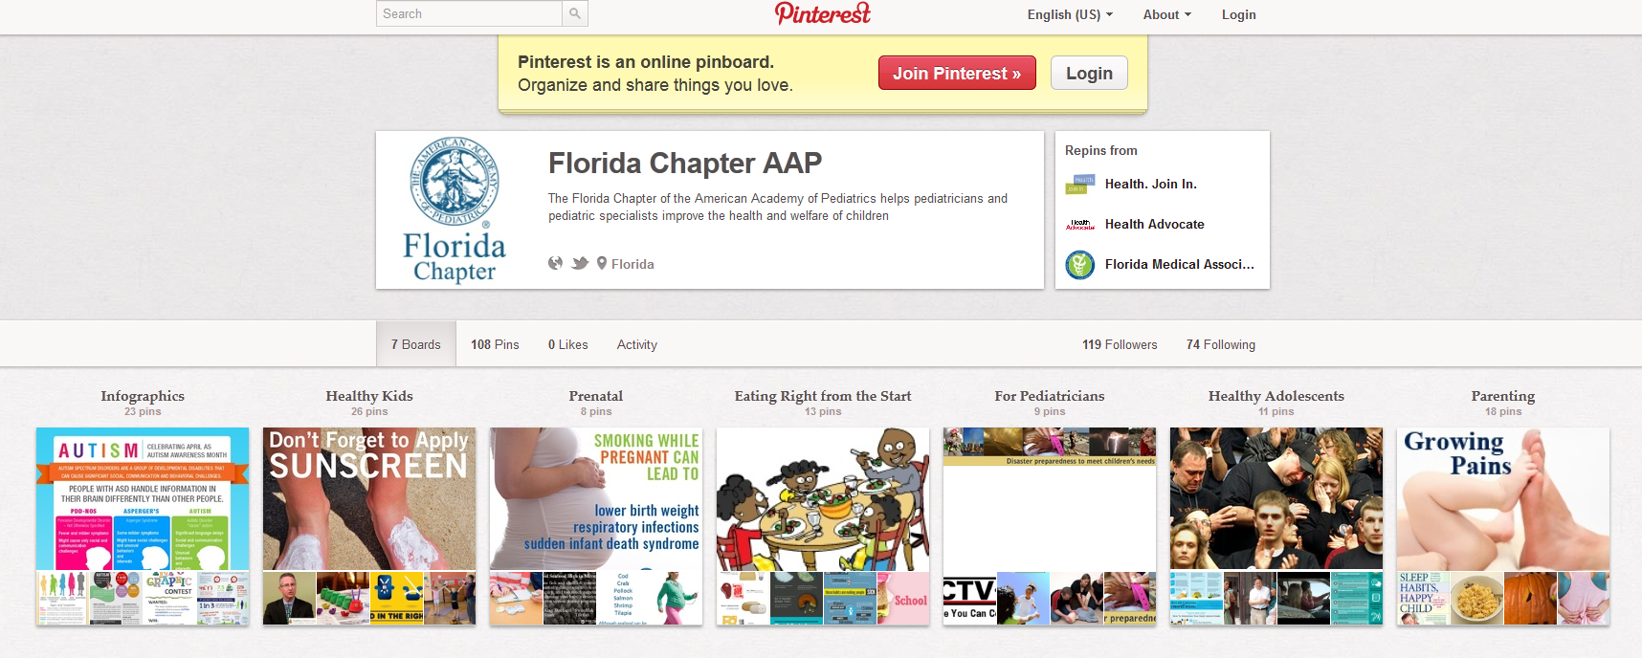
Pinterest Advocacy Example

Slide 28
Social Media Advocacy: YouTube
YouTube receives more than 100 million views per day
Can be used as an outreach or education tool to make data, resources come to life
Capacity for emotional engagement

Slide 29
Crafting Your Message for the Media

Slide 30
Crafting Your Message for the Media
Essentially, your message is what follows “because”:
“Gun violence is a public health threat to children because in 2010, firearms caused twice as many deaths as cancer, five times as many as heart disease and 15 times as many as infections.”
“Protecting children from gun violence is not a political decision, it's a public health imperative.”

Slide 31
Crafting Your Message for the Media
Your message is the core statement of why your issue is important and should be the underpinning of all your media and communications work, and should be:
Clear.
Concise.
Memorable and relatable.
Persuasive.
Repeat, Repeat, Repeat.

Slide 32
Crafting Your Message for Different Media Outlets
Radio:
Sound bytes
Short, repeated phrases
Enunciation and speaking slowly are key
Vocal variety/fluctuation in delivery
You can have materials/talking points in front of you
“What children need in health reform is as simple as A, B, C: Access, Benefits, & Coverage.”

Slide 33
Crafting Your Message for Different Media Outlets
Print:
You have longer to talk and can be more detailed
Risk of rambling and burying quotable phrases
Try to answer the question by repeating the question (easier to pull quotes)
Be sure to highlight your three primary priorities
Everything you say could be published!
“"We get derailed over and over again in people's ethical and moral concerns about whether teens should be sexually active, and not that this is a safe drug that can be and should be available to all women of reproductive age," said Dr. Cora Breuner. She's a professor of pediatrics at the University of Washington and co-author of the American Academy of Pediatrics position paper on Emergency Contraception.

Slide 34
Crafting Your Message for Different Media Outlets
Online:
Media landscape evolving to focus more online
24/7 news cycle
Pithier, more pointed blogs and online media outlets affect message framing
Photos, unexpected “man on the street” interviews that go viral
Instant access to constantly changing information
“Gun violence is a public health threat to our children. My husband, Sean Palfrey, and I are pediatricians. We are not specialists or experts in the field of injuries, but we are, sadly, all too familiar with the devastating impact of guns in children's lives. Firearms have claimed the lives of patients, friends and family members.”
AmerAcadPeds Apr 12, 4:30pm "Protecting children from gun violence is not a political decision, it's a public health imperative" @CNN #putkids1st ow.ly/k0yjX

Slide 35
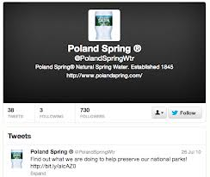
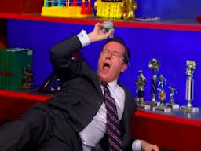
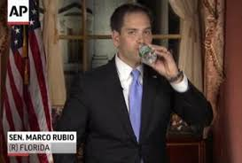
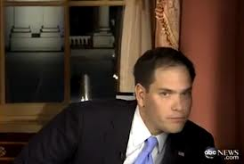
Crafting Your Message for Different Media Outlets
TV:
Body language is critical
Wear solids: no loud prints or flashy jewelry
To wear or not wear the white coat?
Remember to smile
Speak slowly, look at the reporter and not the camera
Be conversational with the reporter, as if talking to a friend
Don’t get defensive or nervous
Repeat key messages
Practice ways to avoid
tough questions

Slide 36
Crafting Your Message for Different Media Outlets
The interview:
Use simple, direct language
Repeat messages for emphasis
If speaking, be sure to pause
Avoid jargon
Understand the opposing view
Stay in your zone of expertise
Use research to back up your argument
Don’t say it if you don’t know it or if you don’t want it repeated
Strengthen your message with partnerships
Personalize and localize
10 Tips

Slide 37
Crafting Your Message for Social Media

Slide 38
Getting Started
Do Your Homework
Prioritize high-risk/high-reward policy areas
Use an authentic voice & a positive tone
Content Loops
Promote your content on multiple channels
Third-Party Sharing
Share stories from external parties, always give credit
Encourage external allies to share your platform
Identify timely story lines
Etiquette
Reward your peers for sharing and engaging: retweet, mention, favorite
Transition from content sharing to community building over time
Identify “shareable” content
Coordinate content sharing with partners, colleagues
Interact regularly and in real-time
Limit barriers to follower interaction

Slide 39
Identify Your Platform
Ask yourself the right questions to determine the right social media platform
What is your end goal?
What kind of content are you sharing?
Who do you want to communicate with?
How much time can you allocate?
What is right for me?
Twitter: short bursts, links to content
YouTube: video
Blogs: longform information sharing
Facebook: interactive multimedia
Pinterest: photos and infographics
LinkedIn: professional nertworking
Flickr and Instragram: photo-sharing

Slide 40
The Basics: Twitter Cheat Sheet
While you have 140 characters to use on Twitter, using < 120 allows for easier RTs
Retweet: Good Twitter etiquette calls for RTs before forwarding on someone else’s post. Use “MT” when modifying a tweet before sharing.
@usernames allow for quick shout-outs & public conversations between users; a “.” before an @ mention allows your followers to easily follow
Direct messages are private conversations between two users on Twitter
“Trending” topics are those popular across Twitter, and can be filtered by country or regional and found on the lefthand side of your home page
#Hashtags are used to organize posts and to easily create and surf trends
FollowFriday: On Fridays, use #ff to recommend others your followers may be interested in following (a great way to promote partners’ & colleagues’ work)
120
RT
@
DM
Trends
#
#ff

Slide 41
The Interview: How To Prepare and Effectively Deliver Your Message

Slide 42
Before the Interview
Learn about the reporter and the outlet
Know the length, topic and format of the interview
Provide background information in advance
Ask who else they have spoken to, what the angle of the story is

Slide 43
Headlining: Think Like a Journalist
Make the most important point first, in one sentence
Limit your answers to three sentences
Back it up with facts or “proof points”
Short. Simple. Bold.

Slide 44
Blocking and Bridging
Blocking halts direction of interview
Bridging helps you move from questioner’s agenda to your agenda/messages
Both help you seize control and play offense, not defense

Slide 45
Blocking and Bridging
Don’t ignore or evade the question
Address the topic of question
Asked about the problems, talk solutions

Slide 46
Blocking and Bridging
“Yes…and in addition to that…”
“No…let me explain…”
“I don’t know that…what I do know…”
“The real issue here is…”
“What you’re really asking is…”
“Let me put that in perspective….”

Slide 47
Flagging
3
examples
“The most important thing to remember is…”
“I’ve talked today about many issues. It boils down to these three things…”
“Let me make one thing perfectly clear…”

Slide 48
Do Your Homework
Find an issue or two that you are passionate about and that impacts your patients
Read up and research that issue: join organizational listservs and talk to colleagues at your institution
See how local media outlets in Baltimore are covering the issue

Slide 49
Do Your Homework
Figure out when stories are written/prepared at various media outlets:
TV stations vs. blogs vs. print outlets
Get to know the reporters/producers in your area who cover your issue
Pitch yourself as a resource on child health in your community

Slide 50
Partner with Media Experts
Work with the media relations team at your hospital or health institution
Follow AAP media coverage and see which pediatricians are quoted on issues you care about: e-mail them and ask if they can mentor you
Work with the communications teams within the AAP Elk Grove office and DC office

Slide 51
Take the Media Advocacy Challenge
Determine your advocacy issue
Engage with your federal legislators
Write about your issue in earned media
Amplify your message on social media
Share your earned media coverage with your federal legislator

Slide 52
Let’s Dive In!

Slide 53
Question and Answer Session
Jamie Poslosky
Manager, Federal Advocacy Communications
AAP Department of Federal Affairs
jposlosky@aap.org
202-347-8600

