Slide 1
The Cardiac Cycle
Bradley Clark, MD
Kristen Burns, MD
Anne Greene, MD Editor
Notes:
Welcome to our lecture on the cardiac cycle!

Slide 2
We will go through the phases of the cardiac cycle.
This next diagram contains all of the aspects of the cardiac cycle and gives an idea how everything interacts
We will examine each individual part of the cardiac cycle diagram throughout the presentation
It relates to the cardiac cycle on the ECG.

Slide 3
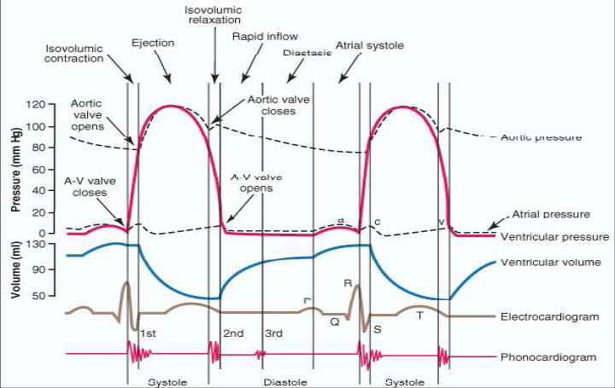
Cardiac Cycle Overview

Slide 4
Overview of Tracings
Heart sounds
Electrocardiogram
Aortic pressure
Cardiac Cycle

Slide 5
There are 5 individual components to the cardiac cycle diagram
Heart sounds (Phonocardiogram)
Electrocardiogram
Left ventricular volume and pressure
Aortic pressure
Left atrial pressure
We will examine each individual tracing separately

Slide 6
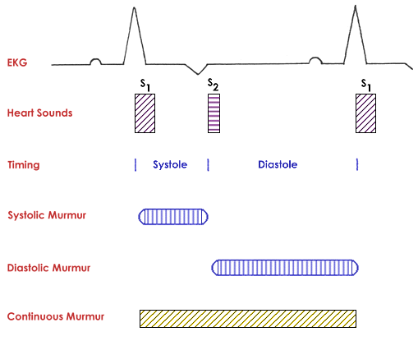
Heart Sounds
S1: closure of mitral/tricuspid valves
S2: closure of aortic/pulmonary valves

Slide 7
This diagram displays the relationship of heart sounds and murmurs to the electrocardiogram (which will be examined in a future slide)
S1 correlates with the closure of the mitral and tricuspid valves and signals the beginning of systole
S2 correlates with the closure of the aortic and pulmonary valves and signals the end of systole
In normal individuals, there is a physiologic splitting of S2, that occurs due to respiration
This will be explained further in a future slide

Slide 8
On this diagram, notice that diastole is longer than systole
This correlates well with clinical exam
The ability to distinguish S1 from S2 on auscultation is based on the ability to recognize systole (short) from diastole (long)
Additionally, this helps to distinguish systolic from diastolic murmurs
Systole also produces a pulse, which you can feel while auscultating the heart.

Slide 9
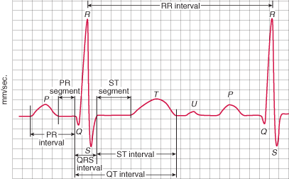
Electrocardiogram: review the parts of the ECG

Slide 10
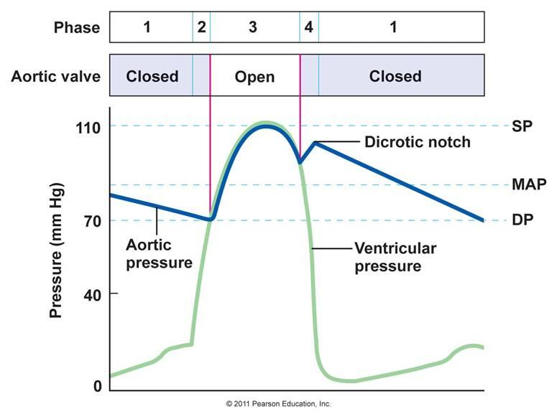
Aortic Pressure Tracing
Dicrotic notch: closure of the aortic valve

Slide 11
This figure contains both the aortic pressure tracing (dark blue) as well as the ventricular pressure tracing (light blue)
SP = systolic pressure, MAP = mean arterial pressure, DP = diastolic pressure
There is a steady decrease in diastolic aortic pressure and a rapid increase in ventricular pressure that occurs during isovolumic contraction

Slide 12
Isovolumic Contraction
This is a very important concept.
Just before the Aortic and Pulmonic Valves open there is contraction of the ventricles and a rise in pressure in those chambers.
There should not be any flow sounds at that time because no valves are open.
If there is a murmur at this time, it will obscure S1.
Two of the lesions that might cause this : VSD or mitral regurgitation.

Slide 13
Once the ventricular pressure becomes greater than the aortic pressure, the aortic valve opens and systole begins
During systole, the ventricular pressure and aortic pressure are similar
There is a rapid increase in aortic pressure early in systole that correlates with rapid ventricular ejection that then slowly decreases
When ventricular pressure becomes less than aortic pressure, the aortic valve closes
The closure of the aortic valve causes a brief spike in aortic pressure seen on the diagram as the dicrotic notch
After closure of the aortic valve, ventricular pressure rapidly decreases during isovolumetric relaxation

Slide 14
Phases of the Cardiac Cycle
Atrial systole
Isovolumetric ventricular contraction
Rapid ventricular ejection
Reduced ventricular ejection
Isovolumetric ventricular relaxation
Rapid ventricular filling
Reduced ventricular filling (diastasis)

Slide 15
Cardiac Cycle Diagram Overview
Aortic pressure
Ventricular pressure
Atrial pressure
Ventricular volume
Electrocardiogram
Heart sounds
Notes:
Here is a reminder of the various tracings on the cardiac cycle diagram (from top to bottom):
Aortic pressure tracing
Ventricular pressure tracing
Atrial pressure/jugular venous pressure tracing
Ventricular volume tracing
Electrocardiogram
Heart sounds

Slide 16
Now we will examine the phases of the cardiac cycle separately
Atrial systole
Isovolumetric ventricular contraction
Rapid ventricular ejection
Reduced ventricular ejection
Isovolumetric ventricular relaxation
Rapid ventricular filling
Reduced ventricular filling (diastasis)

Slide 17
Atrial systole
P wave (atrial depolarization) on electrocardiogram
Beginning of QRS complex (ventricular depolarization) occurs prior to end of atrial systole
Only active portion of ventricular filling due to atrial contraction
Leads to final increase in ventricular volume
On left atrial pressure tracing, represented by “A” wave
4th heart sound (S4) can be audible during this phase
Caused by ventricular filling by atrial contraction against a stiff ventricle

Slide 18
The first phase of the cardiac cycle is atrial systole
Atrial pressure:
Initial slow increase in atrial pressure from passive atrial filling during diastole
A wave occurs which represents rapid increase in pressure from atrial contraction
Ventricular pressure:
Since AV valve is open, the ventricular pressure is similar to the atrial pressure

Slide 19
Ventricular volume:
Steady increase in ventricular volume due to diastolic filling
Passive initially and then active filling from atrial contraction
Electrocardiogram:
This phase contains the P wave as well as the very beginning of the QRS complex on ECG
The P wave correlates with atrial depolarization which precedes atrial contraction
Electrical activity in the ventricles has begun but they have not fully depolarized
Heart sounds:
4th heart sound (S4) can be audible during this phase
S4 is not physiologic
It is caused by active ventricular filling during atrial contraction against a stiff, non-compliant, ventricle

Slide 20
Isovolumetric Ventricular Contraction
Occurs after the onset of the QRS wave
AV valves (mitral, tricuspid) close when ventricular pressure becomes greater than atrial pressure
AV valve closure corresponds to first heart sound (S1)
Splitting of S1 can occur as normal variant due to earlier tricuspid valve closure
Ventricular contraction against a closed aortic valve
Isovolumetric because no ejection occurs
There fore not a time for ejection murmurs
No significant change in aortic pressure or ventricular volume

Slide 21
The next phase is isovolumetric ventricular contraction
Aortic pressure:
Minimal decrease in pressure during the end of diastole
Ventricular pressure:
There is a rapid increase in ventricular pressure
Ventricular contraction occurs against a closed aortic valve
Isovolumetric since there is no ejection of blood

Slide 22
Rapid Ventricular Ejection
Time of maximum ventricular pressure
Aortic valve opening occurs when ventricular pressure becomes greater than aortic pressure
Due to large pressure gradient, rapid ejection of blood into aorta
Increase in aortic pressure mimics that of ventricular pressure
Majority of stroke volume is ejected during this phase
Atrial filling begins
Onset of T wave (repolarization) occurs at the end of this phase
Marks end of ventricular contraction and rapid ejection

Slide 23
The next phase is rapid ventricular ejection
Aortic pressure:
After aortic valve opening and rapid ejection, there is a rapid rise in aortic pressure which mimics the rise in ventricular pressure
Ventricular pressure:
As with the aortic pressure tracing, there is a rapid rise in ventricular pressure which correlates with rapid ejection of blood from the left ventricle
Rapid ejection occurs due to pressure gradient between the left ventricle and the aorta
Atrial pressure:
A slow and steady increase in pressure occurs due to early atrial filling with closed AV valve

Slide 24
Ventricular volume:
The majority of stroke volume is ejected during this phase
Results in rapid drop in volume
Electrocardiogram:
Majority of the ST segment and beginning of T wave occur during this phase
The onset of the T wave signals the beginning of ventricular repolarization
Heart sounds:
There are no heart sounds associated with this phase of the cardiac cycle

Slide 25
Reduced Ventricular Ejection
Slower ejection of blood from ventricles
Ventricular and aortic pressure begin to decrease
Aortic pressure decreases due to runoff from larger to smaller arteries
Majority of T wave (repolarization) occurs
Left atrial pressure continues to rise from atrial filling

Slide 26
The next phase is reduced ventricular ejection
Aortic pressure:
There is steady decrease in aortic pressure
Occurs due to the runoff from larger to smaller arteries
Change in aortic pressure continues to mimic that of ventricular pressure
Ventricular pressure:
There is a steady decrease in ventricular pressure that mimics that of the aortic pressure
Since ventricular pressure is still greater than aortic pressure, blood is still being ejected and the aortic valve remains open
Atrial pressure:
There continues to be a steady rise in pressure from left atrial filling

Slide 27
Ventricular volume:
Continued decrease in ventricular volume due to ventricular ejection, but reduced compared to rapid phase
Electrocardiogram:
Majority of repolarization (represented by T wave) occurs during this phase
Heart sounds:
There are again no heart sounds associated with this phase

Slide 28
Isovolumetric Ventricular Relaxation
Ventricular repolarization (T wave) complete
Aortic and pulmonic valves close
Corresponds with 2nd heart sound (S2)
S2 splits normally with inspiration: ↑ closing time of pulmonary valve from ↑ flow (increased venous return due to ↑ negative intrathoracic pressure)
Closure of aortic valve corresponds with dicrotic notch on aortic pressure tracing
Ventricular pressure decreases rapidly
Relaxation is isovolumetric since all valves are closed
Mitral valve opens when ventricular pressure becomes less than atrial pressure

Slide 29
The next phase is isovolumetric ventricular relaxation
Aortic pressure:
Aortic pressure decreases less than ventricular pressure
Once aortic pressure becomes greater than ventricular pressure, aortic valve closes
Dicrotic notch (brief increase in aortic pressure on tracing) corresponds with aortic valve closure
Ventricular pressure:
Ventricular pressure decreases steadily until it becomes less than the aortic pressure (aortic valve closure)
Once the aortic valve is closed, there is a rapid ventricular relaxation with resultant decrease in pressure
Relaxation is termed isovolumetric because both aortic and mitral valves are closed and there is no change in ventricular volume
Atrial pressure:
Continued atrial filling against closed mitral valve causes steady increase in atrial pressure

Slide 30
Ventricular volume:
After aortic valve closure, there is no change in the ventricular volume
Electrocardiogram:
Ventricular repolarization (T wave) is complete and there is no electrocardiographic activity during this phase
Heart sounds:
Closure of aortic and pulmonary valves results in 2nd heart sound (S2)
Physiologic splitting of the S2 heart sound is a normal and expected variant
Inspiration leads to an increase in the negative intrathoracic pressure
Leads to increased systemic venous return coming to the right side of the heart
Leads to increased flow across the pulmonary valve and delayed closure compared to the aortic valve

Slide 31
Rapid Ventricular Filling
Mitral valve is open
Passive ventricular filling from atria begins
Aortic pressure continues to decrease
Occurs due to run off into smaller arteries
3rd heart sound (S3) can be audible during this phase
Caused by rapid flow of blood from atria into a volume-overloaded ventricle
Can be normal in children but is abnormal in adults
Decrease in left atrial pressure due to ventricular filling

Slide 32
The next phase is rapid ventricular filling
Aortic pressure:
Steady decrease in pressure occurs from runoff into smaller (distal) arteries
Ventricular pressure:
Continued decrease in ventricular pressure during diastole
Once the atrial pressure exceeds ventricular pressure, mitral valve opens
Ventricular pressure remains low to allow for continued passive filling
Atrial pressure:
After opening of the mitral valve there is a rapid decrease in atrial pressure due to passive ventricular filling
Since mitral valve is open, atrial and ventricular pressure are similar

Slide 33
Ventricular volume:
After mitral valve opening, there is a rapid increase in ventricular volume from passive filling
Ventricular filling continues during this phase
Electrocardiogram:
Lack of electrical activity correlates with refractory period
Heart sounds:
3rd heart sound (S3) may be audible during this phase
S3 can be a normal variant in children, but is always abnormal in adults
Rapid atrial filling into a ventricle that is already volume overloaded can lead to S3 heart sound
Volume overload can occur for many reasons including aortic regurgitation, poor LV function

Slide 34
Reduced Ventricular Filling
Termed “Diastasis” or Diastole
Longest phase of the cardiac cycle
Slower ventricular filling
Dependent on heart rate
Elevated heart rate gives less time for diastasis
Continued decrease in aortic pressure
P wave (atrial depolarization) begins at the end of this phase

Slide 35
The last phase is reduced ventricular filling (“diastasis”)
This is the longest phase of the cardiac cycle
Aortic pressure:
There is continued decrease in aortic pressure from runoff
This represents the diastolic blood pressure
Ventricular pressure:
No significant change in ventricular pressure
Atrial pressure:
Atrial pressure mimics ventricular pressure but there is no significant change
Since atrial and ventricular pressure are close to equal, the mitral valve remains open

Slide 36
Thank you!

